Slide 1
Trend Quality Ozone from the OMPS Nadir Mapper and Nadir Profiler
Rich McPeters¹ and Colin Seftor²
¹NASA Goddard Space Flight Center
²Science Systems Applications Inc.
Fall AGU, New Orleans December 11, 2017

Slide 2
The version 2 processing
Improved scattered light and dark current correction
Corrected wavelength registration and bandpass
Calibration adjusted for consistency with SBUV v8.6 time series
Brion/Daumont/Malicet ozone cross sections used
Other instrument artifacts corrected
Goal: data that can be used to continue the MOD long term
Ozone time series
Notes:
Especially the dichroic beam splitter

Slide 3
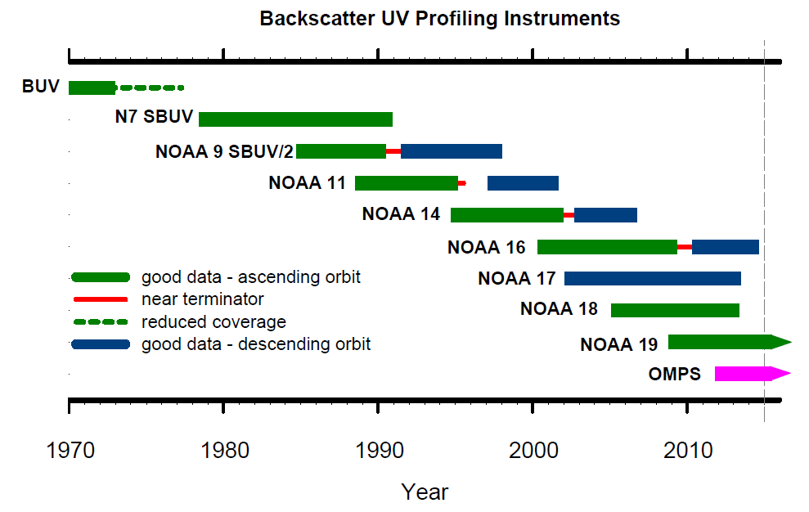
MOD – Merged Ozone Data: a long term time series created by merging data from a series of UV profiling instruments.
OMPS data will continue the time series

Slide 4
OMPS data will continue the time series
Notes:
N19 orbit near terminator

Slide 5
OMPS nadir mapper (NM) total column ozone agrees with ground observations to within half a percent, with near zero time dependence.
Notes:
Stable to within half a percent

Slide 6
Nadir Mapper (NM) vs MOD

Slide 7
Nadir Profiler (NP) vs MOD

Slide 8
NP profile comparison for one sonde station

Slide 9
NP profile comparison with NOAA 19 SBUV/2 and MLS

Slide 11
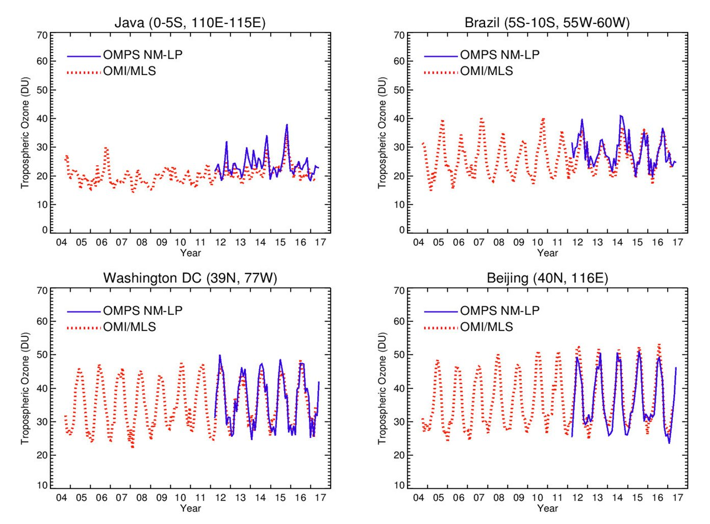
Tropospheric Ozone
red: OMI total – MLS strat
blue: OMPS NM total – LP strat

Slide 12
Conclusions
OMPS v2 ozone datasets are trend quality
NM total column ozone agrees with N19 (-0.2% bias)
NM ozone agrees with Dobson/Brewer network to within half a percent
Tropospheric ozone from OMPS agrees well with OMI/MLS ozone
NP total column ozone has a bias of -1.1%
NP profile agrees with N19 SBUV and MLS to about ±5%

