Slide 1

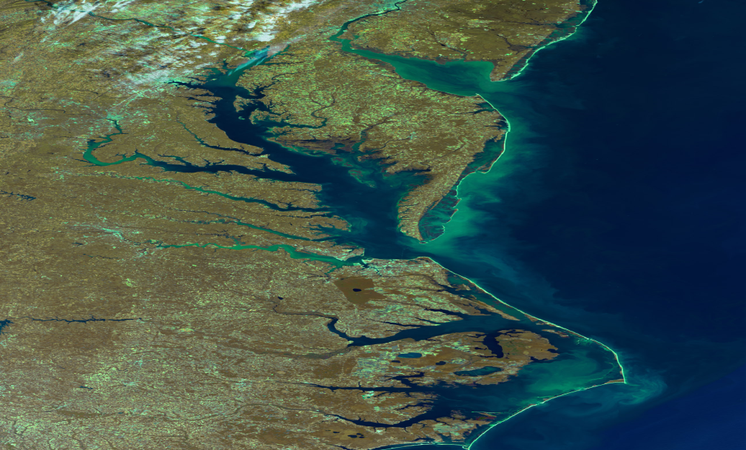
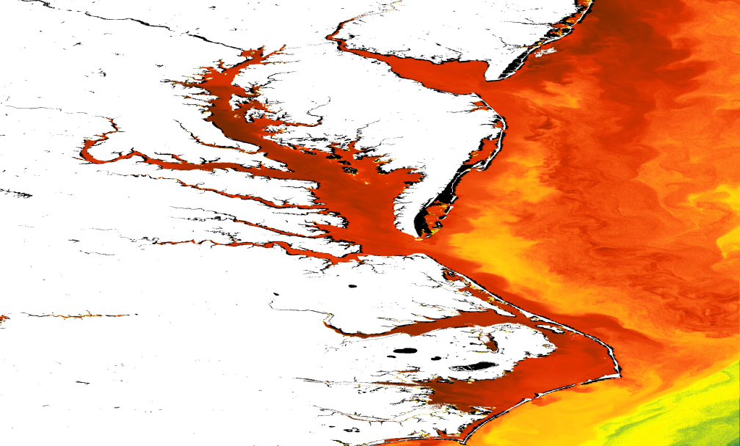
The GEO-CAPE – DISCOVER AQ Connection: Shipboard Observations on Chesapeake Bay
CBODAQ Campaign: GEO-CAPE Chesapeake Bay Oceanographic campaign with Discover AQ
Maria Tzortziou
Research Assistant Professor
ESSIC/University of Maryland College Park
NASA/Goddard Space Flight Center
maria.a.tzortziou@nasa.gov
On behalf of the GeoCAPE
Ocean Science Working Group
MERIS chlorophyll (http://www.coastcolour.org/site_6.html)

Slide 2
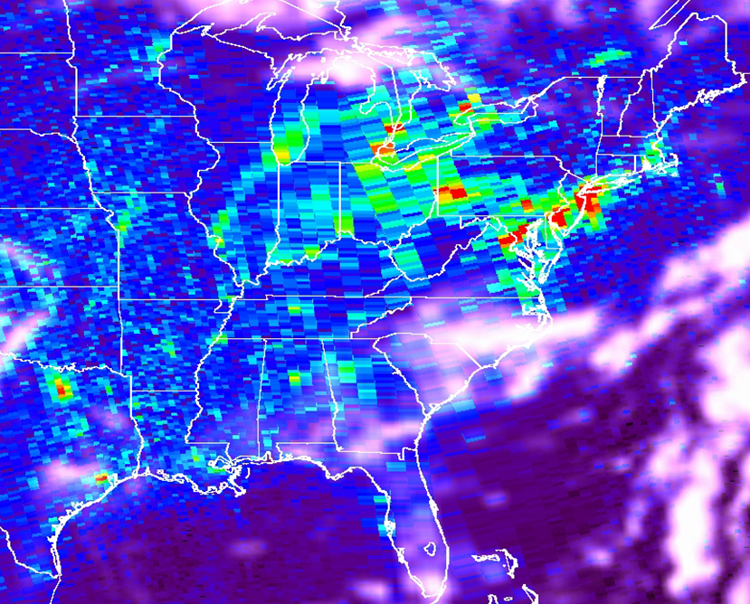

Evaluation of satellite products & derived spatial and temporal variability
NASA SED Director’s Seminar
2 March 2012, NASA/GSFC, Greenbelt, MD
OMI NO2 over the Eastern US
Wed Th Fr Sat Sun Mon Tues
“Weekly cycle of NO2 by GOME “ Beirle et al., 2003

Slide 3
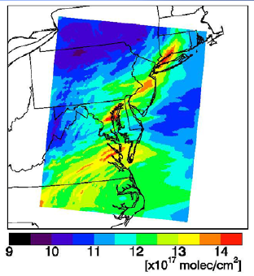
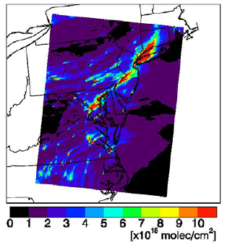
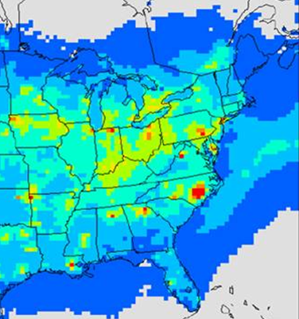
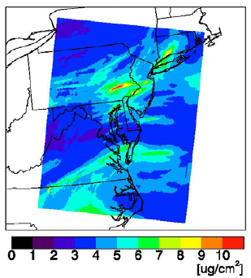
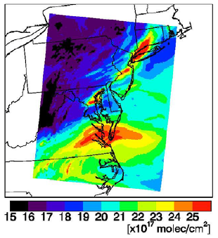
Modeling and prediction of air quality and impacts on coastal ecosystems
NASA SED Director’s Seminar
2 March 2012, NASA/GSFC, Greenbelt, MD
For improving modeling and prediction of sources, transport, chemical transformations, distribution, and deposition of atmospheric pollutants at the land-ocean interface …
Community Multiscale Air Quality (CMAQ) Model simulations
July 9, 2007 – 18 UTC
Trop Column (sfc-200 hPa
In the Chesapeake Bay, at least one third, and probably significantly more, of total nitrogen inputs comes from air deposition [STAC Publ. 09-001, 2009].
O₃
NO₂
PM₂
CO
Total Nitrogen Deposition (Kg-N/HA)– CMAQ Output (2001)

Slide 4
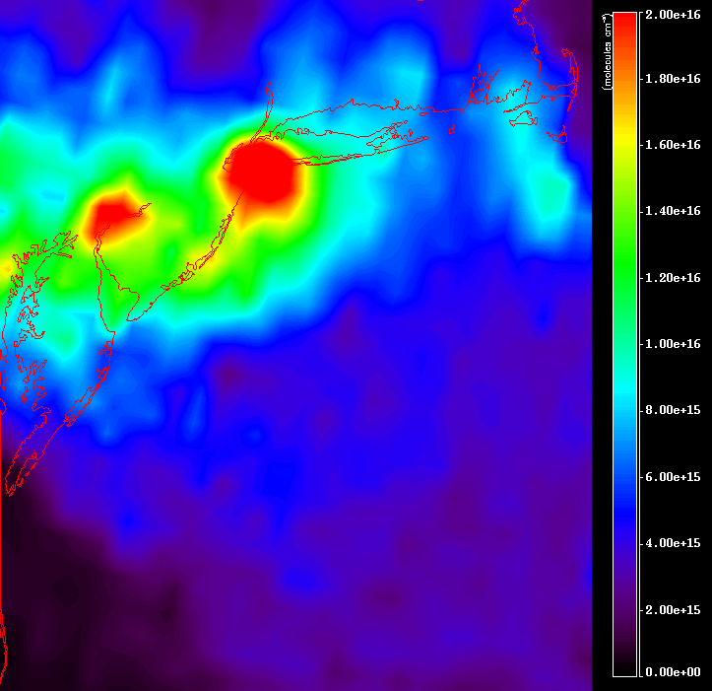
Improved Atmospheric Correction of Satellite Ocean Color
NASA SED Director’s Seminar
2 March 2012, NASA/GSFC, Greenbelt, MD
OMI NO2 (April 11, 2005)
The atmosphere contributes ~ 90% of satellite measured TOA signal in the blue-green, and it must be accurately modeled/removed for accurate ocean color measurements.
The large spatio-temporal variability in aerosols and other absorbing atmospheric constituents such as NO2 remains one of the largest sources of uncertainty for satellite ocean color retrievals, especially in coastal waters that are close to heavily polluted areas.

Slide 5
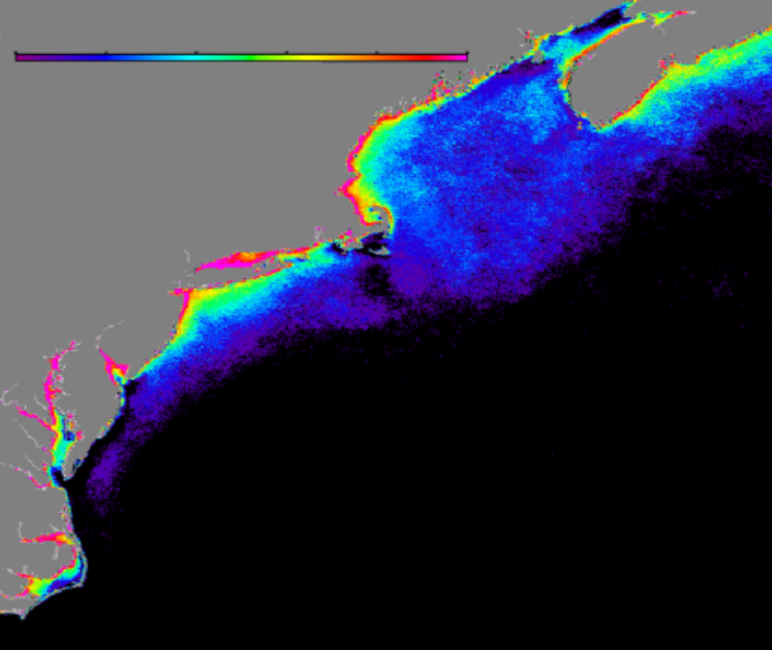
Improved Atmospheric Correction of Satellite Ocean Color
NASA SED Director’s Seminar
2 March 2012, NASA/GSFC, Greenbelt, MD
0.0 0.2 0.4 0.6 0.8 1.0
nLw - P_{neg} (probability)
by Jay O'Reilly; NOAA/NMFS, Narragansett, RI).
Probability of retrieving negative water-leaving radiances for the SeaWiFS 412nm band along the eastern seaboard of North America.

Slide 6
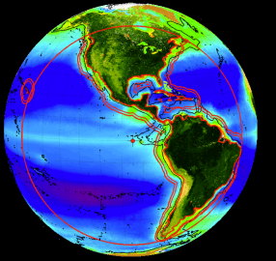
Coastal Ocean Biogeochemical Processes
NASA SED Director’s Seminar
2 March 2012, NASA/GSFC, Greenbelt, MD
NASA’s future Decadal Survey GEO-CAPE (GEOstationary for Coastal and Air Pollution Events) ocean color sensor aims at observing coastal regions at sufficient spatial and temporal scales to resolve near-shore processes, tidal exchanges, coastal fronts, eddies, and track carbon pools and pollutants (Oceans White Paper).
Major objectives:
⬥ Study exchanges of materials (carbon, nutrients, sediments and pollutants) across land-ocean interface
Resolve short-term, near-shore processes and how they interact with and influence larger scale ecosystem dynamics
Understand how the productivity and biodiversity of coastal ecosystems are changing, and how these changes relate to natural and anthropogenic forcing
Understand time and space scales of ocean biological, biogeochemical and optical variability
We need to understand atmospheric variability and accurately account for it in ocean color retrievals.
Otherwise it will lead to a false variability in underwater processes.
Particularly strong gradients in air quality can develop at the land-water interface, where processes such as bay breezes influence the dispersion of pollutants and ozone formation.
Fishman et al., In Press, BAMS

Slide 7
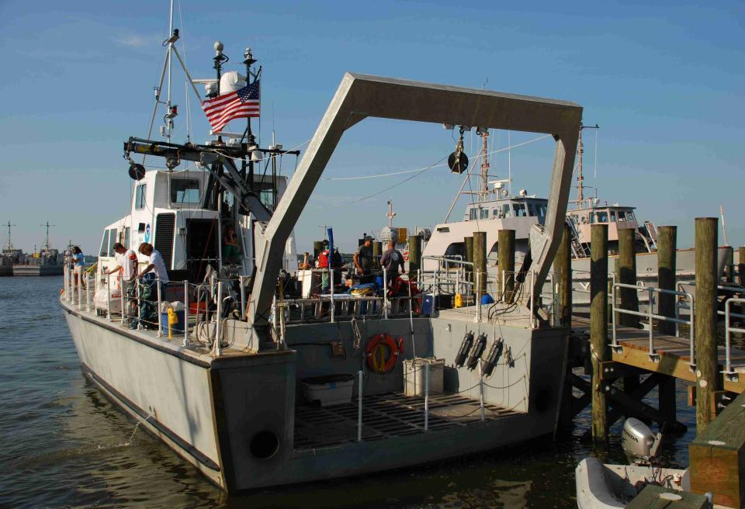
GEO-CAPE CBODAQ Campaign in the Chesapeake Bay ( 11-20 July 2011)
NASA SED Director’s Seminar
2 March 2012, NASA/GSFC, Greenbelt, MD
NOAA Marine Sanctuaries Vessel SRVx - National Marine Sanctuary Test and Evaluation Vessel R8501
• Co-Leads/Chief Scientists: Antonio Mannino & Maria Tzortziou
• Participants: More than 25 scientists and additional students from NASA/GSFC, NOAA, University of Maryland, University of New Hampshire, University of South Florida, Old Dominion University, East Carolina University, Smithsonian Environmental Research Center, Johns Hopkins University, Sigma Space Corporation.
• Cardinal Point Captains, LLC operated the NOAA vessel.

Slide 8
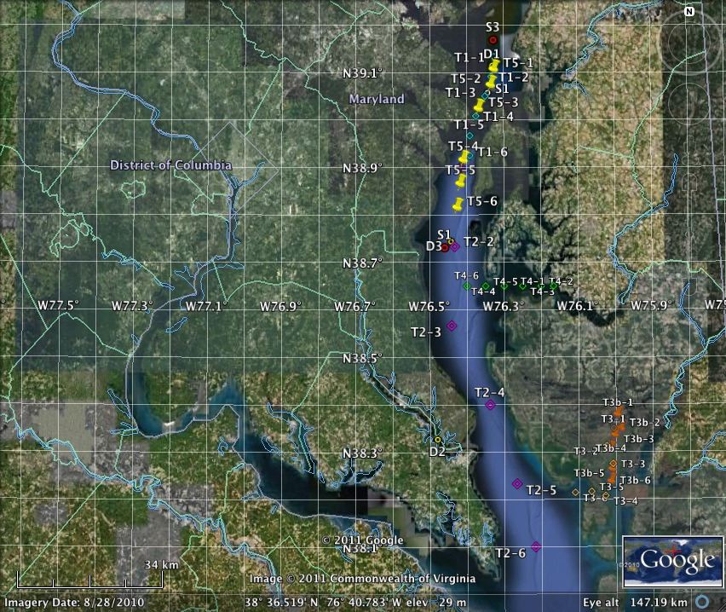
GEO-CAPE CBODAQ Campaign in the Chesapeake Bay ( 11-20 July 2011)
NASA SED Director’s Seminar
2 March 2012, NASA/GSFC, Greenbelt, MD
Station labels:
D# = initial drifter station
T# = transect station
S# = stationary day

Slide 9
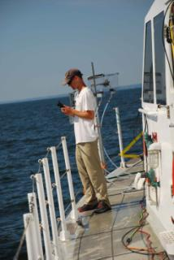
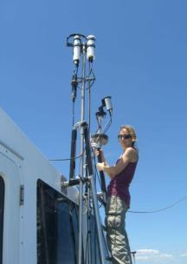
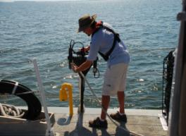
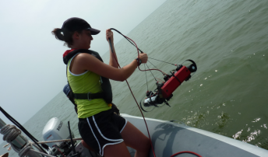
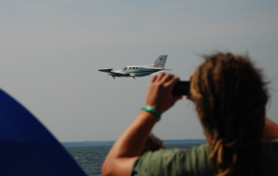
GEO-CAPE CBODAQ Campaign in the Chesapeake Bay ( 11-20 July 2011)
NASA SED Director’s Seminar
2 March 2012, NASA/GSFC, Greenbelt, MD
Objectives of oceanographic campaign:
❖ Study small scale and short-term dynamics in biogeochemical variables, and de-convolve spatial
gradients with diurnal variability
❖ Focus on carbon sources and fluxes
❖ Look at diurnal phytoplankton physiological dynamics & implications for NPP models
❖ Address issues related to potential impacts of water quality on human health
❖ Algorithm development for coastal ocean products
❖ Evaluate the spatial and temporal patterns in atmospheric variability and what this variability
represents in terms of uncertainties in GEO-CAPE ocean color data products
❖ Apply ACAM and HSRL (High Spectral Resolution Lidar) observations to ocean color studies
❖ Apply results from ocean and air-quality measurements to examine optical closure in the
ocean-atmosphere system
❖ Assess the role of the upper Chesapeake as a net source/sink for certain aerosols and trace gases.

Slide 10
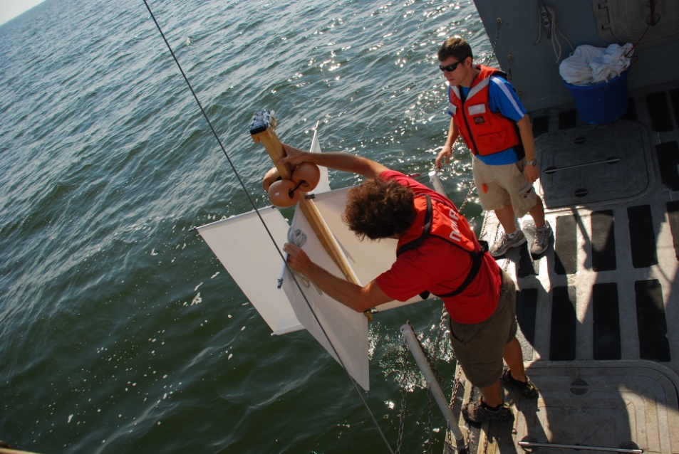
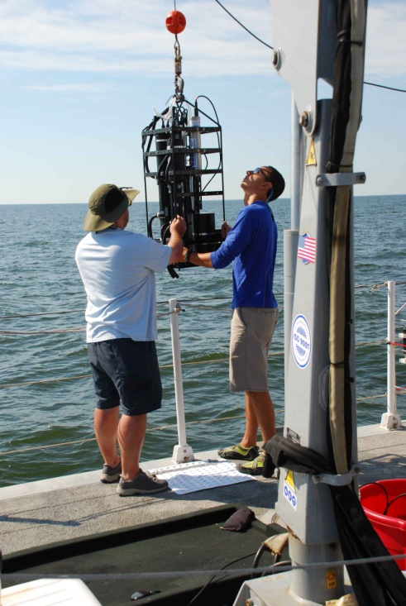
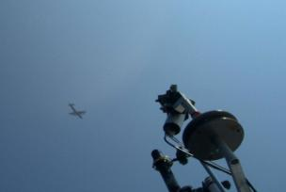
GEO-CAPE CBODAQ Campaign in the Chesapeake Bay ( 11-20 July 2011)
NASA SED Director’s Seminar
2 March 2012, NASA/GSFC, Greenbelt, MD
Measured Parameters
Water Inherent Optical Properties (IOPs): Total in-water absorption, a, scattering, b, attenuation, c, backscattering, bb, (ac-9, ac-s, VSF3, ECO triplet, CTD) – surface measurements and in-water profiles More Optical Parameters: Fluorometric Chlorophyll-a Chl-a, phytoplankton absorption spectra, aph, non-algal particulate absorption spectra, ad, colored dissolved organic matter absorption spectra, aCDOM, CDOM fluorescence Excitation Emission Matrices, EEMs
Radiometry: Surface Down-welling Irradiance, Es, Upwelling Radiance, Lu, Down-welling Irradiance, Ed, Water-leaving radiance, Lw, Remote Sensing Reflectance, Rrs, Normalized water leaving radiance, nLw, exact nLw, Q, Fo, %LL, Photosynthetically active radiation, PAR, Diffuse attenuation coefficient, Kd, KdPAR, KLu, Zeu, Kbio, OCnVn, etc. (C-Ops; 19-band UV-NIR sensor; 10nm FWHM) – profiles Ed, Lu, Es - HyperPro (UV-NIR; 3nm FWHM). NIR hand-held above-water radiometer/ 350 to 880 nm 512 channels (15 days).
Biogeochemical variables: Particulate Organic carbon and nitrogen, POC/PN, Dissolved Organic Carbon DOC, Total Dissolved Nitrogen, TDN, Suspended Particulate Matter, SPM; HPLC pigments (no cost); Phytoplankton cell count sample collection;
Primary Productivity incubations
Phytoplankton cell counts
O2 and partial pressure CO2 pCO2, Dissolved Inorganic Carbon DIC, Total Alkalinity TA, pH
Analysis for Vibrio species in collected water samples, including cholera
Measurements of aerosols/trace gases: AOD – Microtops instruments Total Column NO₂, O₃, SO₂, H₂O, HCHO, BrO - Pandora measurements Surface O₃, NO, NOy – In-situ sensors on the ship Boundary Layer Height and NRB – Micropulse Lidar (MPL) measurements Aerosols and Trace Gases - Samples of CH4, Analysis for water-soluble inorganic ions; Organic analysis; Detailed information on submicron size distributions.

Slide 11
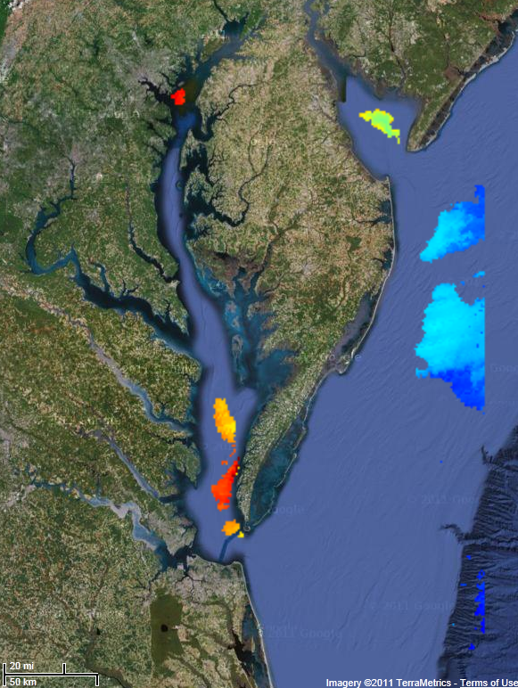
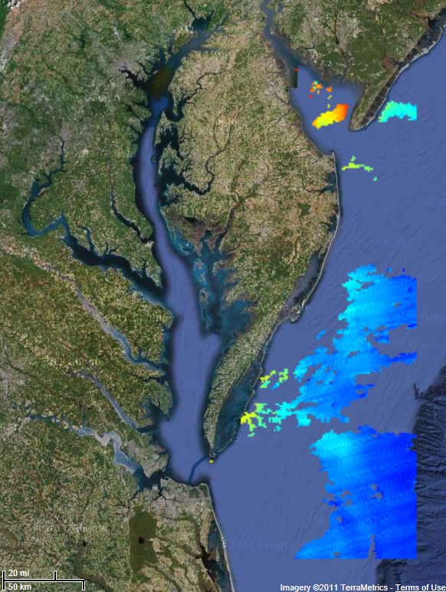
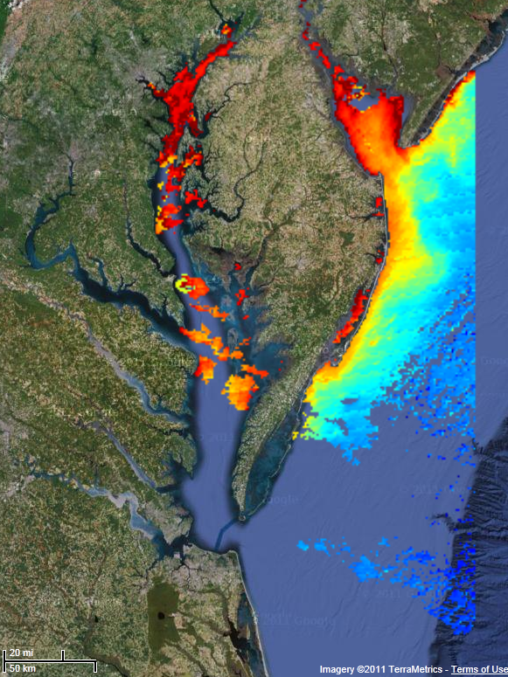
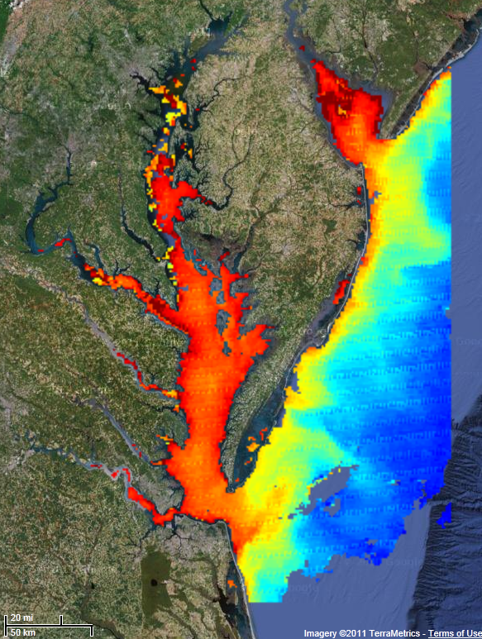
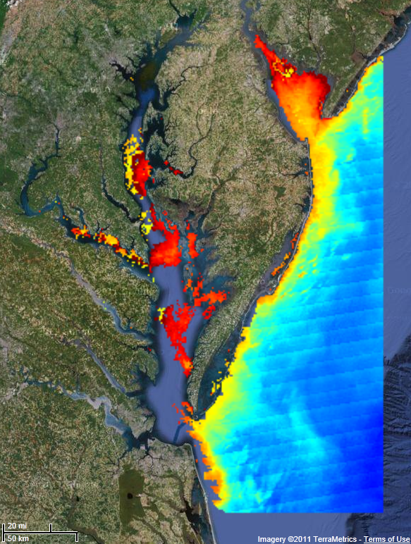
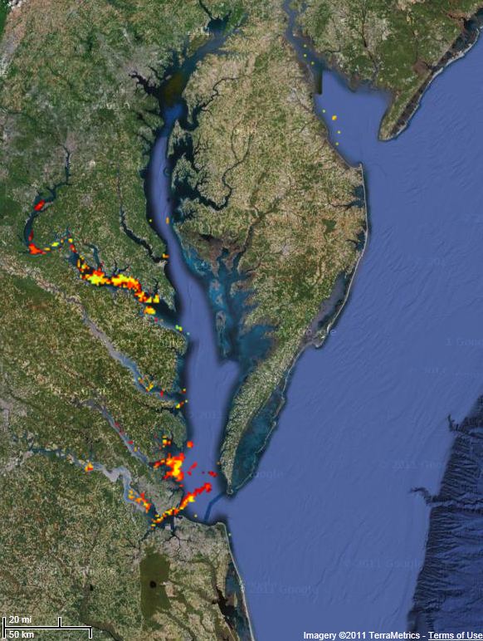
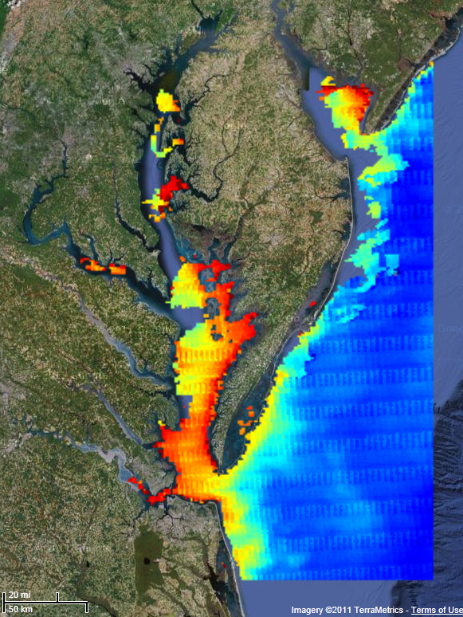
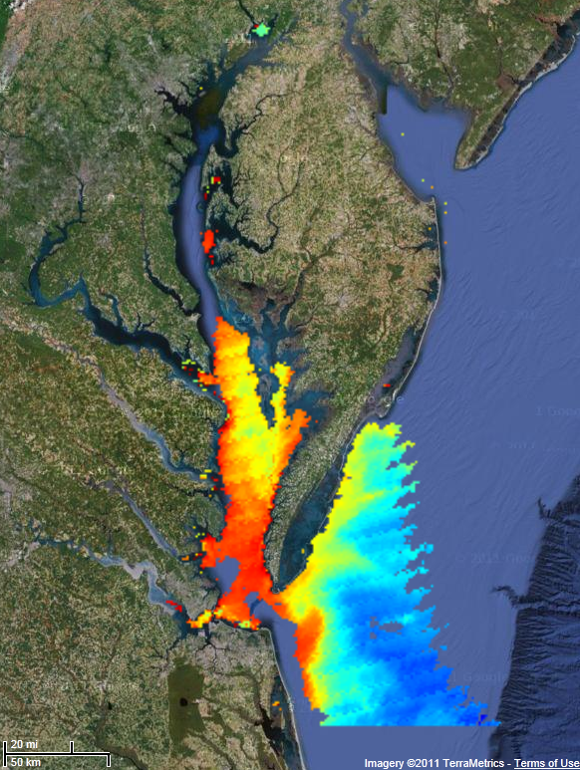
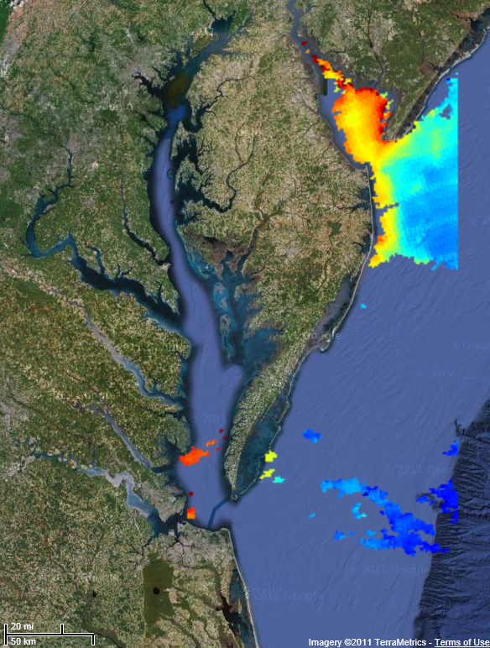
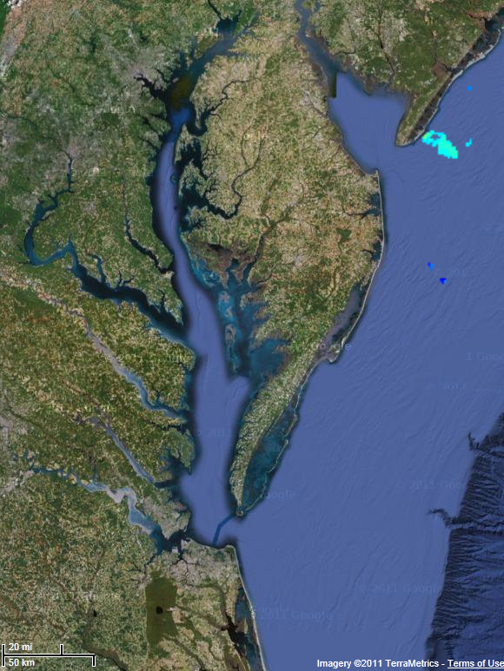

Ocean Color Satellite Observations
NASA SED Director’s Seminar
2 March 2012, NASA/GSFC, Greenbelt, MD
07/11/11
07/12/11
07/13/11
07/14/11
07/15/11
07/16/11
07/17/11
07/18/11
07/19/11
07/20/11
MODIS-Aqua chlorophyll-a images:
Strong spatial gradients close to the shore
Large variability in chl-a from CB-north (optically complex, turbid waters) to the mouth of the Bay (less turbid waters).
Many days with no satellite OC imagery

Slide 12
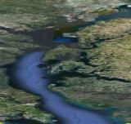
Aerosols (Microtops Sunphotometer)
NASA SED Director’s Seminar
2 March 2012, NASA/GSFC, Greenbelt, MD
Bad air quality days at the beginning, improving later in the week, gets worse during the last few days
Large variability in AOT, by more than a factor of 2, in most days
Good agreement with measurements along the western shore (CIMEL at SERC) when we were close to SERC, but larger differences as we move further away (AOT gets lower over the water)
The Angstrom exponent was highly variable, but always > 1.0, showing the large influence of urban aerosols over the Bay
MicroTops
AOT(440)
> 0.7
< 0.1

Slide 13
Aerosols (Microtops Sunphotometer)
NASA SED Director’s Seminar
2 March 2012, NASA/GSFC, Greenbelt, MD
Bad air quality days at the beginning, improving later in the week, gets worse during the last few days
Large variability in AOT, by more than a factor of 2, in most days
Good agreement with measurements along the western shore (CIMEL at SERC) when we were close to SERC, but larger differences as we move further away (AOT gets lower over the water)
The Angstrom exponent was highly variable, but always > 1.0, showing the large influence of urban aerosols over the Bay
MicroTops
AOT(440)
> 0.7
< 0.1

Slide 14
Column NO2 from Pandora, OMI and CMAQ
NASA SED Director’s Seminar
2 March 2012, NASA/GSFC, Greenbelt, MD
July 18, 2011
Overall good agreement between Pandora and OMI Total Column NO₂
Consistency in the diurnal patterns predicted by the model (CMAQ) and those measured by the Pandoras
Large diurnal variability in Total Column and Tropospheric NO₂

Slide 15
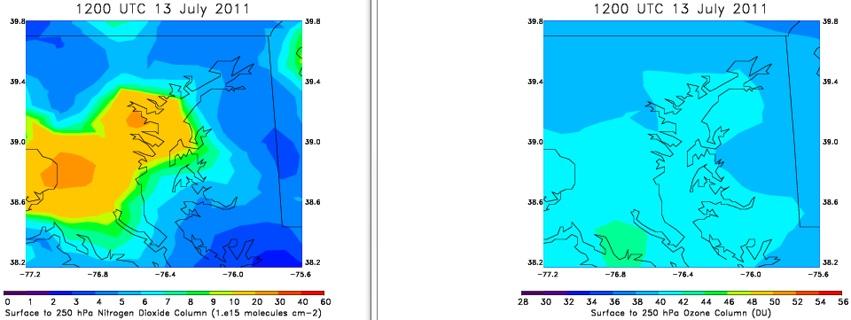
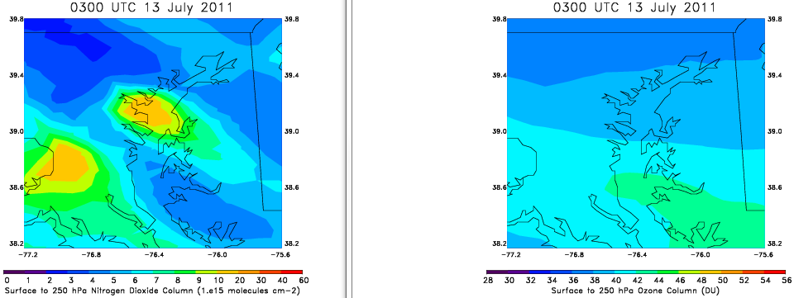
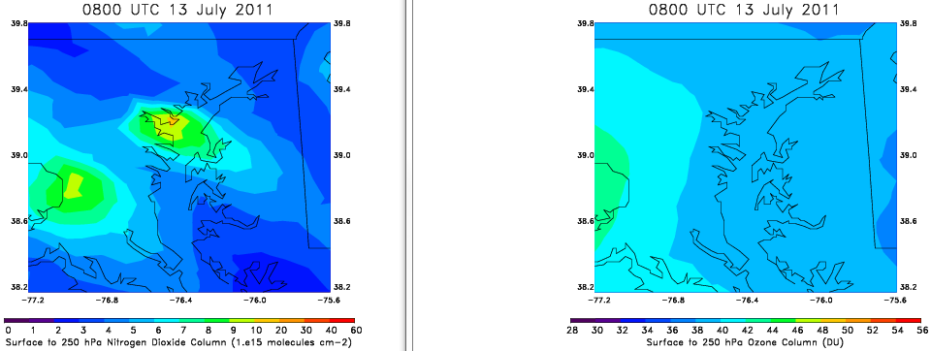
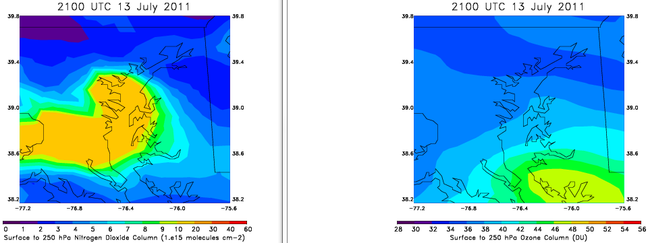
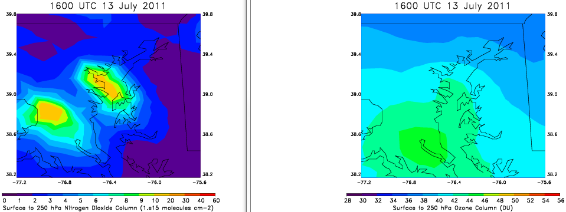
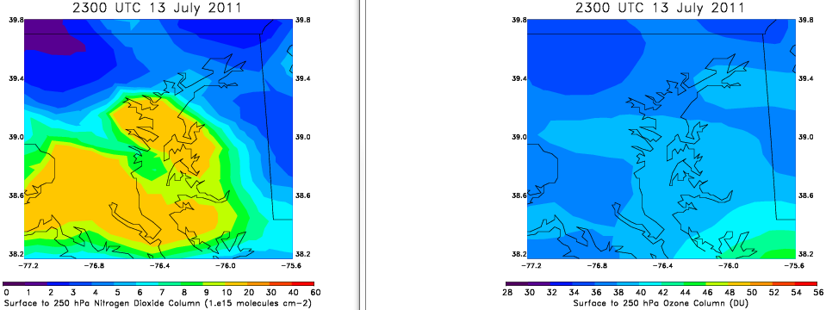
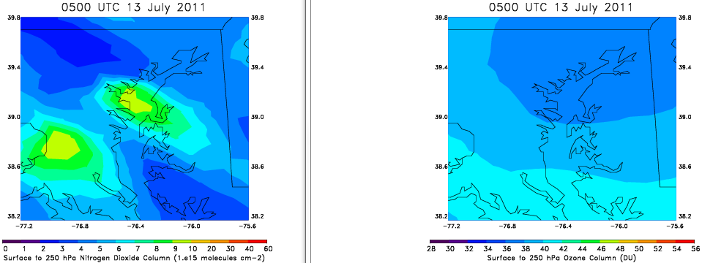
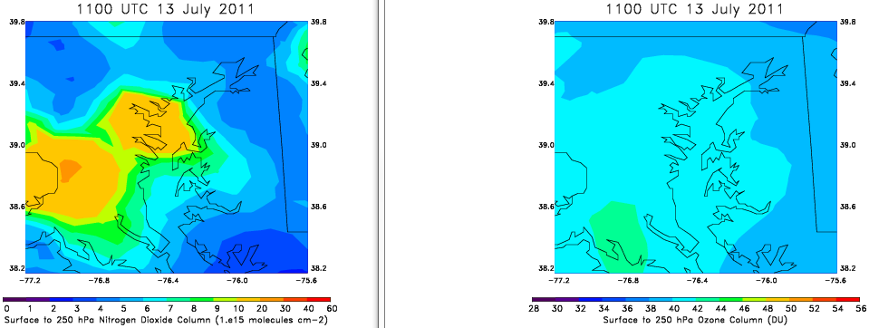
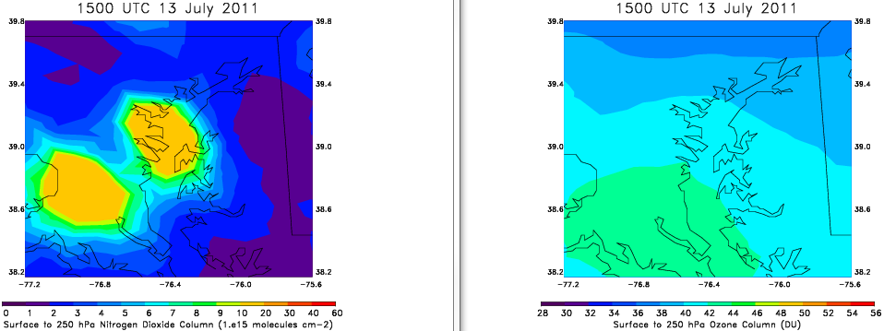
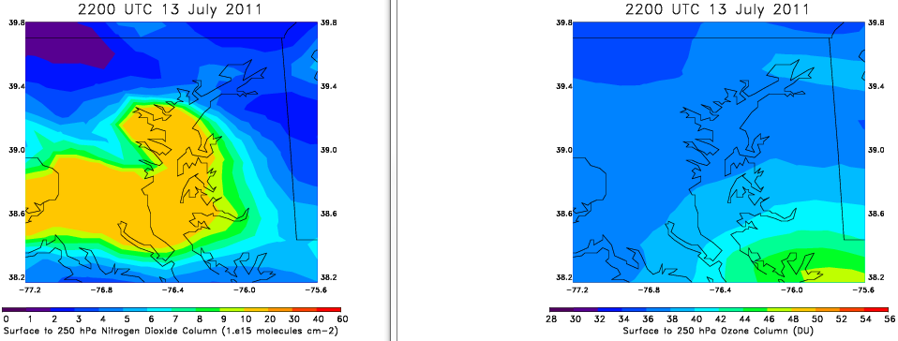
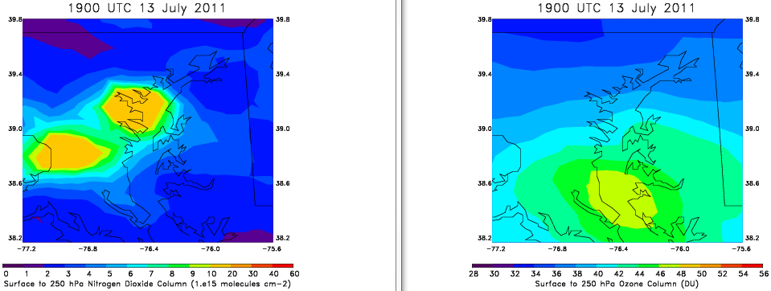
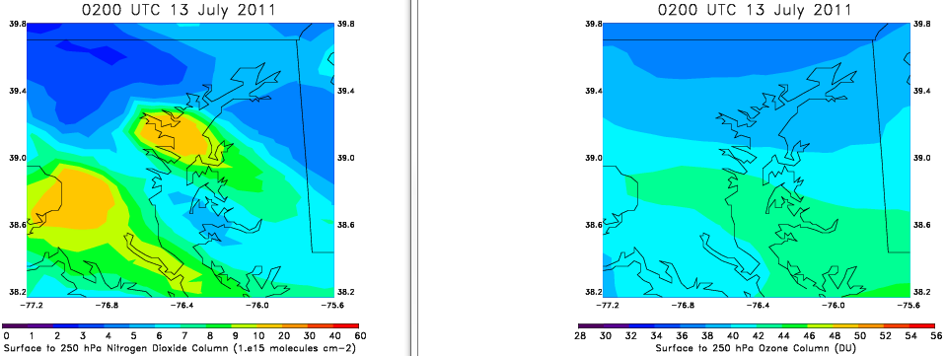
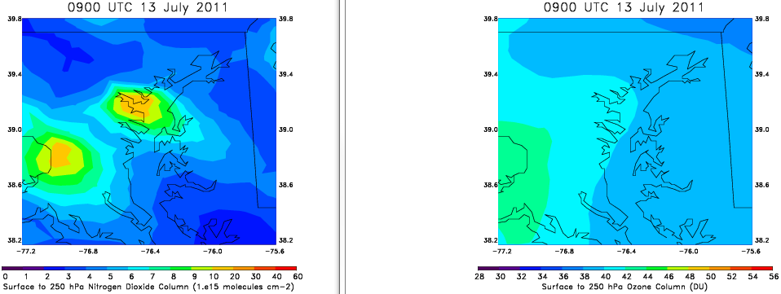
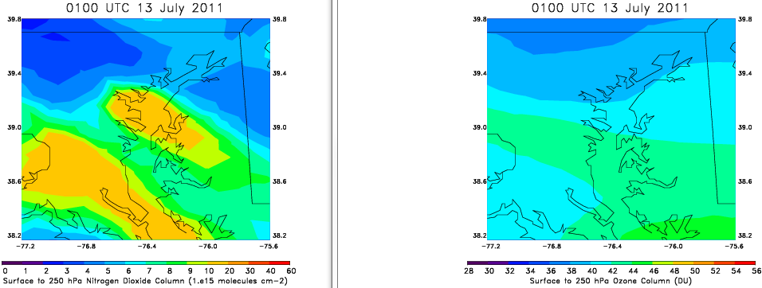
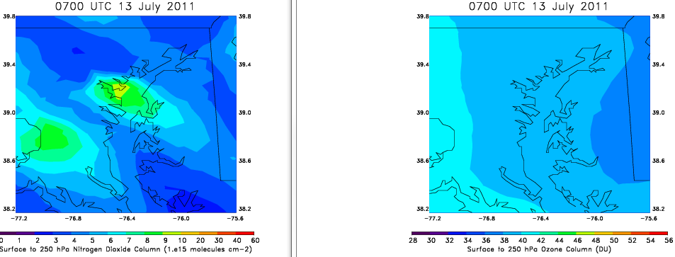
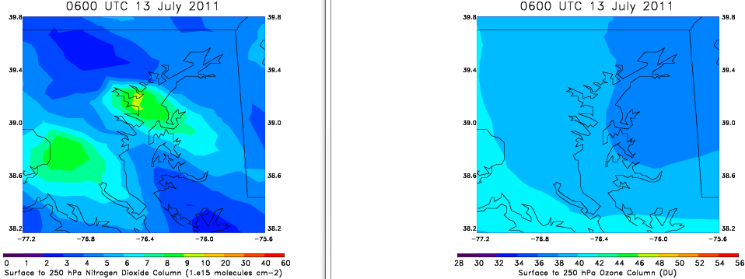
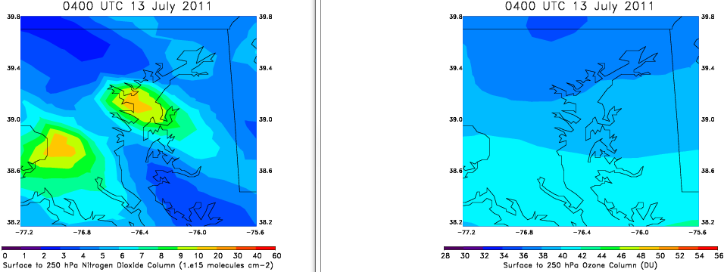
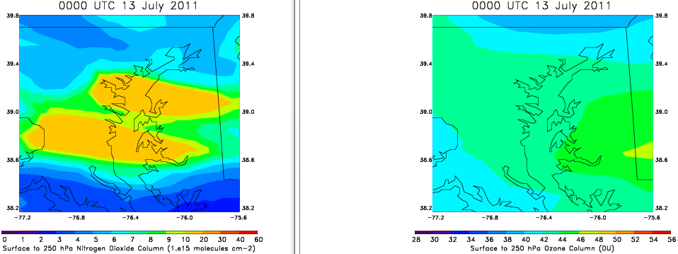







Tropospheric NO and O3 from CMAQ
NASA SED Director’s Seminar
2 March 2012, NASA/GSFC, Greenbelt, MD
Diurnal Variability in Tropospheric NO2 and O3 over the Chesapeake Bay
CMAQ NO2 (Surface to 250 hPa)
CMAQ O3 (surface to 250 hPa)
Significant spatial and temporal variability, of the order of 0.5 to 1.0 DU, in tropospheric NO2 over the Chesapeake Bay estuarine waters
High NO2 in the north Chesapeake Bay , lower in the mid-Bay with larger variability
Significant Variability in column O3 as well
Variability was also found on surface NO, NOy and O3 (up to 60-80 ppbv), both spatially (transect measurements) and temporally (day-to-day and diurnal), both in measurements and model simulations

Slide 16





GEO-CAPE CBODAQ Campaign in the Chesapeake Bay ( 11-20 July 2011)
NASA SED Director’s Seminar
2 March 2012, NASA/GSFC, Greenbelt, MD
❖ Our preliminary RT model calculations showed that, if not sufficiently corrected, this observed variability in NO₂ could result in a false temporal variability in chlorophyll-a, with retrievals errors of 30-50% or more, depending on SZA and chlorophyll algorithm used.
❖ Currently at the stage of working on data analysis and interpretation of measurements from the ship. Results will lead to recommendations on:
measurement requirements,
instrument requirements,
atmospheric correction,
interdisciplinary science,
algorithm development for coastal products
❖ The combined atmospheric and oceanographic data collected are relevant to both atmospheric and ocean components of the GEO-CAPE mission, as well as the PACE and ACE ocean ecosystem mission components.
❖ Collected data uploaded on the NASA SeaBASS ocean color database and the DISCOVER-AQ archive. Aerosols data already on the NASA AERONET Maritime Aerosol Network
❖ Feature article highlighting the CBODAQ activities appeared on:
→ NASA Earth News & Features
http://www.nasa.gov/topics/earth/features/chesapeake-quality.html
→ the Smithsonian Institution News and Highlights
http://sercblog.si.edu/?p=1376
❖ GEO-CAPE CBODAQ website:
https://geo-cape.gsfc.nasa.gov/osb/index.php?section=250

