Slide 1
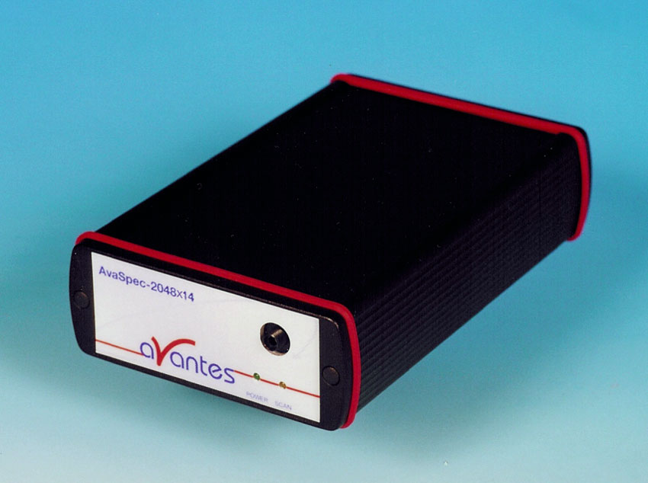
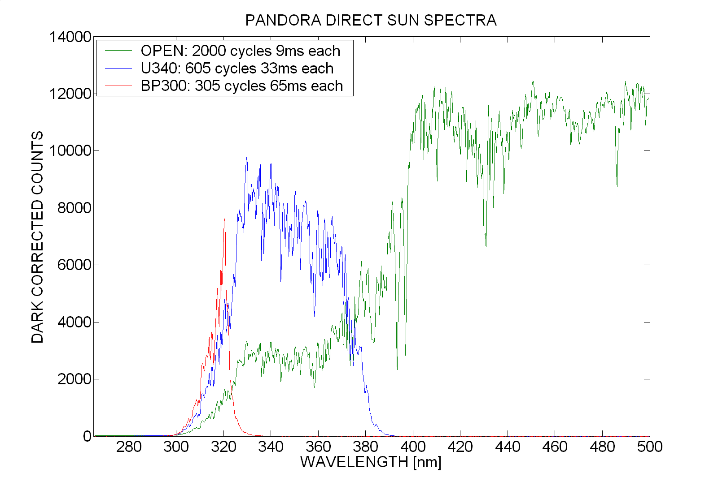
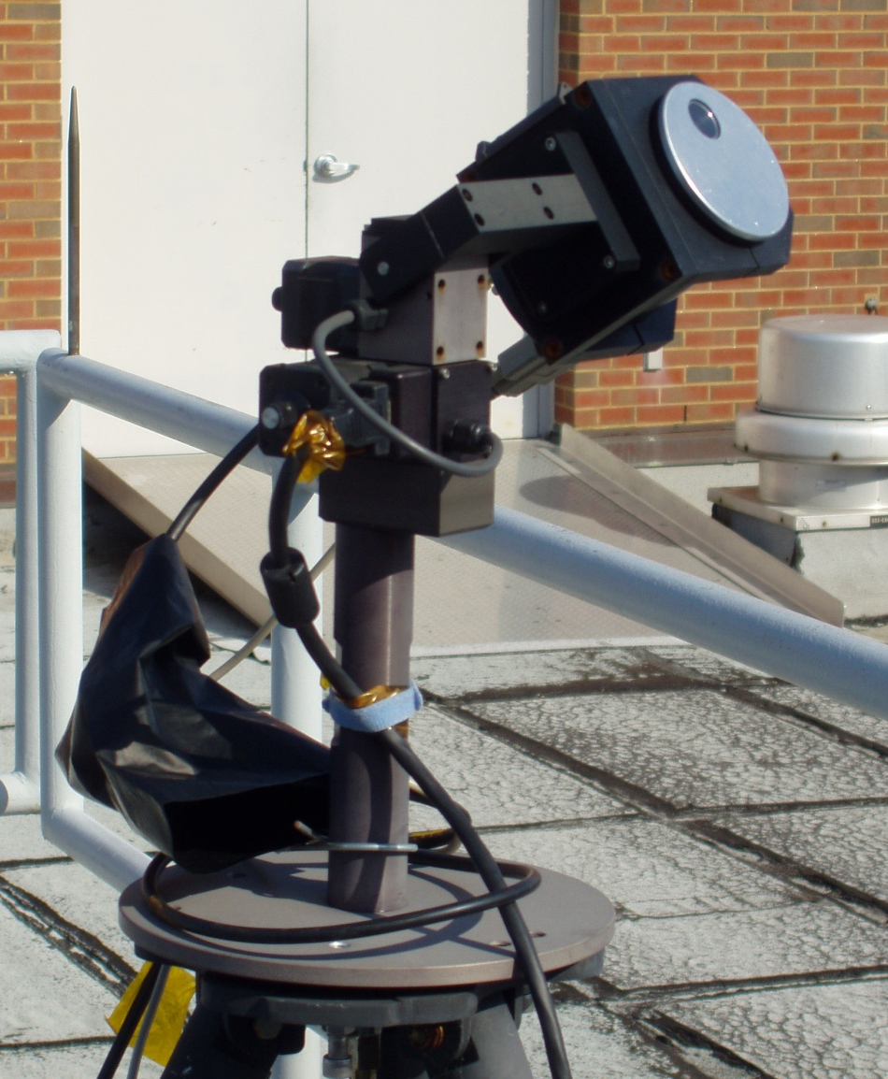
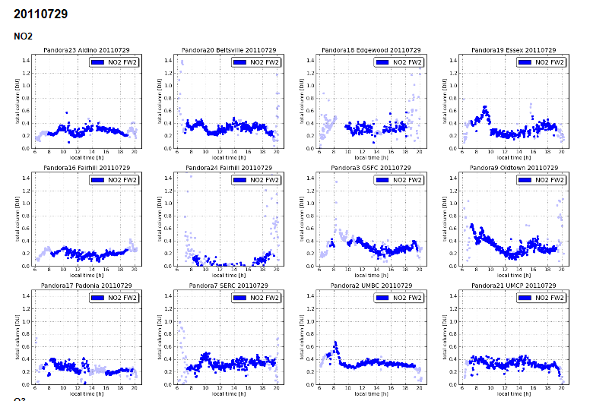
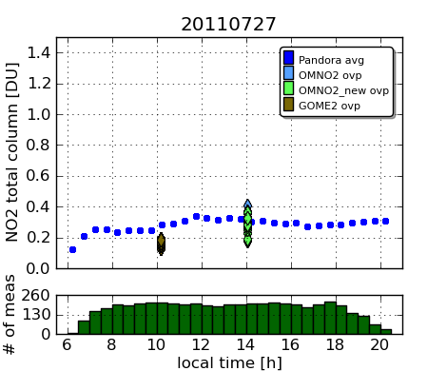
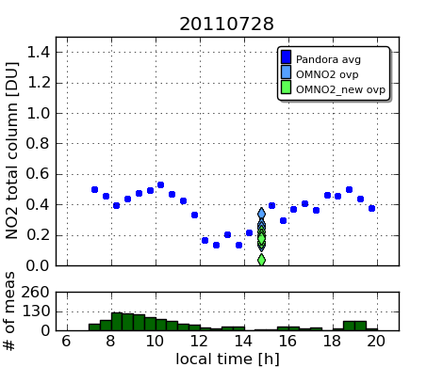
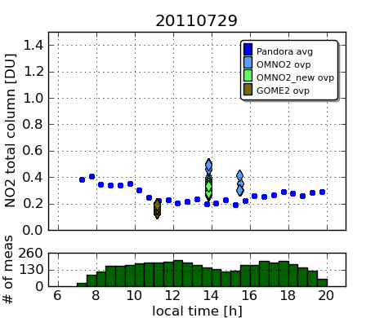
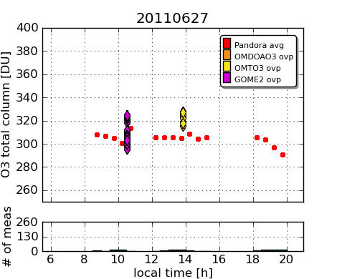
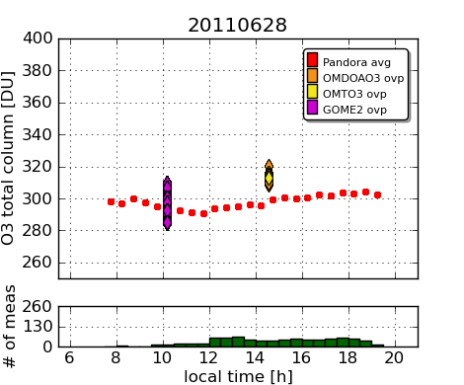
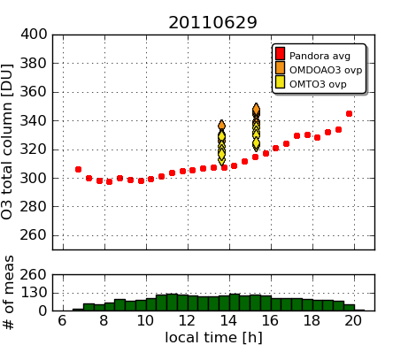
COMPARE OMI with Pandora NO₂ and O₃
Jay Herman Alexander Cede Maria Tzortziou
Nader Abuhassan Christian Rechter
What is PANDORA?
Pandora is a small spectrometer system, It consists of …
What Does Pandora Measure
a “miniature”
spectrometer
and a head sensor on
a sun tracker
Measures sun and sky radiance from 270 to 530 nm in 0.5 nm steps with a 1.6º field of view. Products: NO₂, H₂O, O₃, SO₂, HCHO, and aerosol properties.
Area of Measurements
Area average NO₂ and O₃ compared with OMI values
Pandora vaalues of NO2 and O3 are based on preliminary calibration

