Slide 1
DSCOVR EPIC FILTER CHOICES
λ (nm) | Δλ (nm) | Purpose | Spatial Resolution (km)
317.5 | 1 | Ozone, SO₂ , UV | 8
325 | 1 | Ozone | 8
340 | 3 | Aerosols, UV, and Volcanic Ash | 8
388 | 3 | Aerosols, Clouds, UV and Volcanic Ash | 8
443 | 10 | Blue, Aerosols, Veg | 8
555 | 10 | Green, Aerosols, Veg | 8
680 | 2 | Red, Aerosol, Veg., O₂ B-Band | 8
687.6 | 1.7 | O₂ B-Band Cloud Height | 8
870 760.7 763.3 | 15 3 | Clouds, Vegetation A-Band Absorbing | 8
905 779.5 | 30 3 | Precipitable water A-Band Reference | 8

Slide 2
O2 A- and B-bands are Complimentary
O2 A-Band:
PROS
Greater sensitivity to cloud height
Detect Aerosols CONS
Sensitivity to Temperature
Sensitive to surface reflectivity
Measures over Oceans only
O2 B-Band:
PROS
Cloud height over Land
Can be combined with A-Band
Low sensitivity to Temperature
Low Surface Reflectivity CONS
Less altitude sensitivity
Not useful for thin aerosols

Slide 3
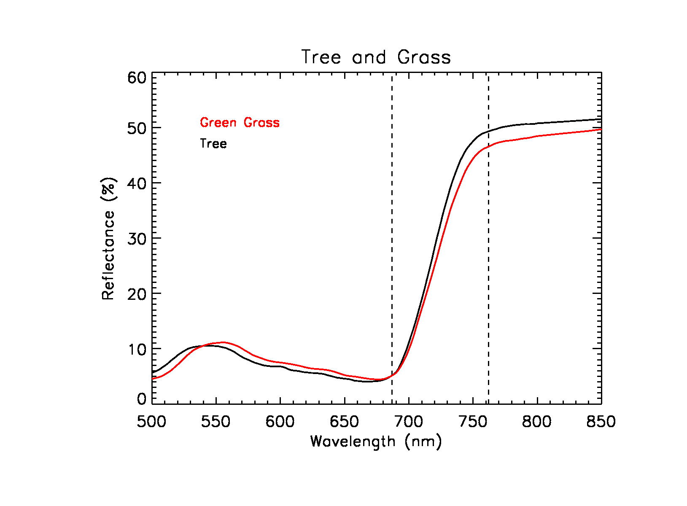
The Effect of Surface Reflectivity
O₂ B-Band Has Less Sensitivity to Vegetation than O2 A-Band
680 nm would be a better reference wavelength than 645 nm
Current EPIC Filter
645±5 nm
RGB and Veg. Index
Reference for Cloud Height
O₂ B-Band Filter
688±1 nm
Cloud Height
680±2 nm
Replacement for 645
RGB and Veg. Index
New Reference for Cloud Height
688 nm O₂ B
O₂ A 763.3 nm
680
779.5

Slide 4
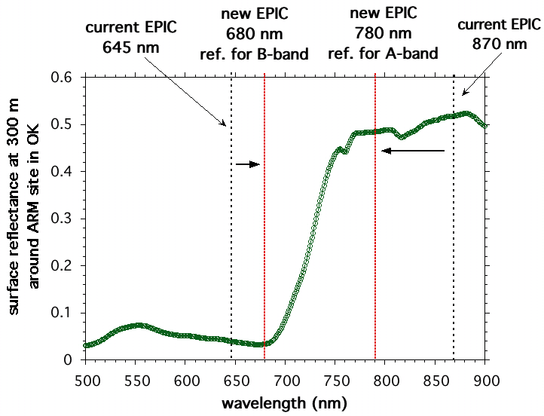
New EPIC channels for Vegetation
- Current EPIC filter 645 nm (similar to MODIS) will be replaced by 680 nm, the reference channel for O2 B-band.
- Current EPIC filter 870 nm (MODIS has 860) will be replaced by 780 nm, the reference channel for O2 A-band.
New EPIC NDVI will be defined as (R₇₈₀-R₆₈₀)/(R₇₈₀+R₆₈₀).
At 680 nm vegetation reflects less than at 645 nm.
At 780 nm reflectance from vegetation is not yet fully saturated and reflects less than at 870 nm.

Slide 5
Comparison for O2 A and B Bands for the
Same pair of scenes – Clear and Cloudy
Normalized albedo from GOME data at spectral resolution of 0.2 nm
For a clear desert scene at 0 km and a cloudy scene at 6 km
Maximum Difference:
D(B-band) = 0.19 D (A-band) = 0.27

Slide 6
Comparison for O2 A and B Bands for the
Same pair of scenes – Clear and Cloudy
EPIC Filter Resolution
B-Band at 2 nm width A-Band at 3 nm width
Cloud height = 6 km based on radiative transfer simulation
A-Band sensitivity is better than B-Band by a factor of 4
Assume EPIC SNR = 250 (max) or 0.25% precision for Cloud scene
SNR = 100 or 1% precision for Clear scene

Slide 7
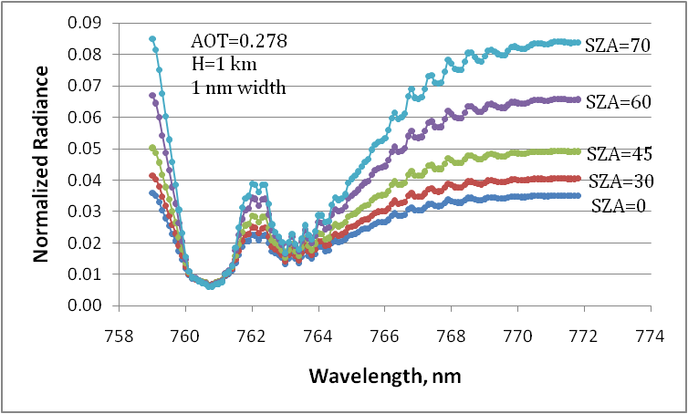
AEROSOLS O2 A-Band using 1 nm Filter width
763.5±1.5 Overlay
763.5±1.5
Saturated

Slide 8
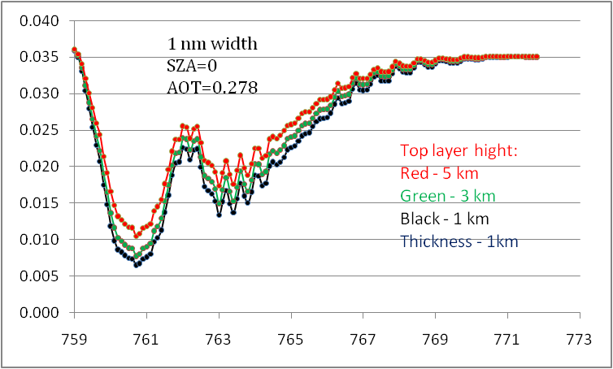
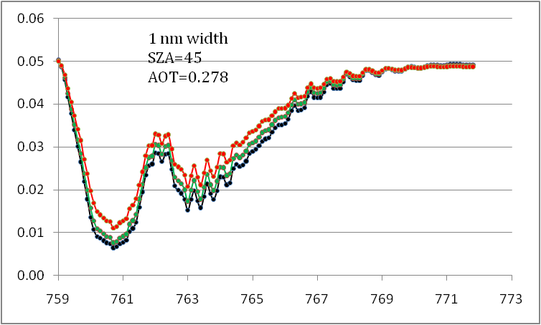
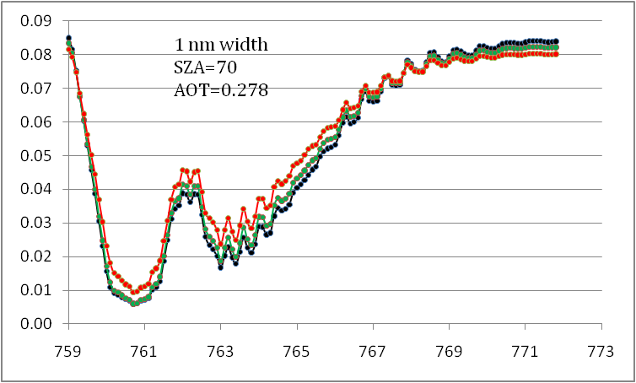
Aerosols A-band
Dependence of results on SZA and Plume Height
Dependence for different aerosol
layer heights.
At maximum absorption (in Q-branch),
sensitivity to aerosol layer height is low for
H≤3 km.

Slide 9
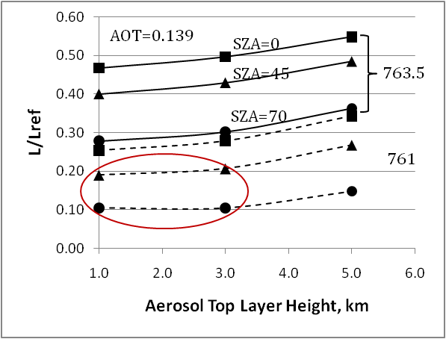
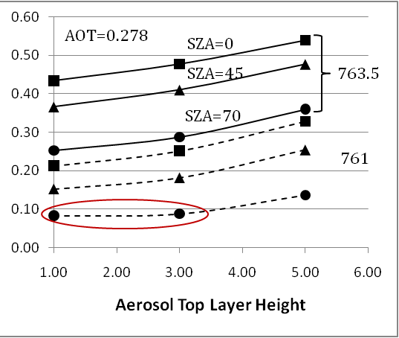
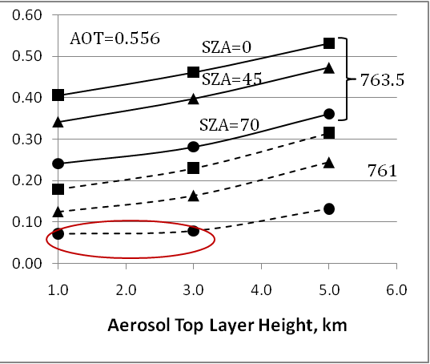
Aerosol Comparison: 761 nm and 763.5 nm
Figures below show a ratio of L to a reference channel
Less absorbing channel 763.5 has a better sensitivity to an effective aerosol layer height.
In 761 nm channel, sensitivity to low tropospheric aerosols is strongly reduced at high SZA (and at low AOT).
Overall, sensitivity over the ocean is good enough for the aerosol height assessment.

Slide 10
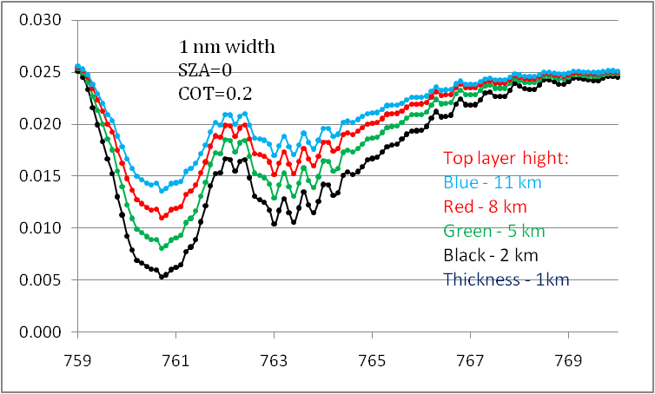
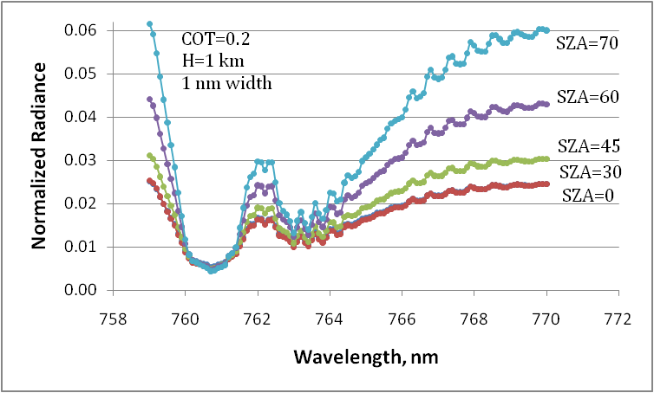
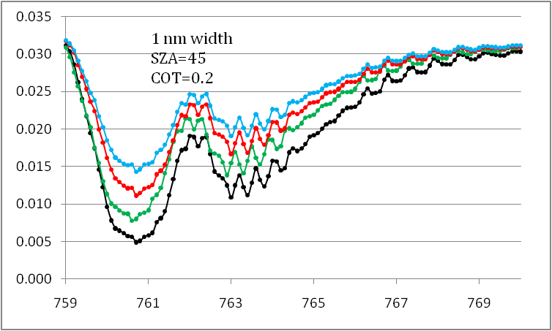
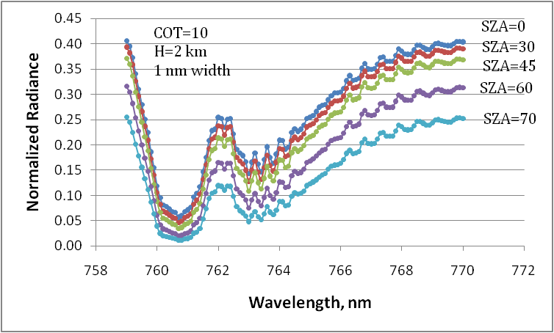
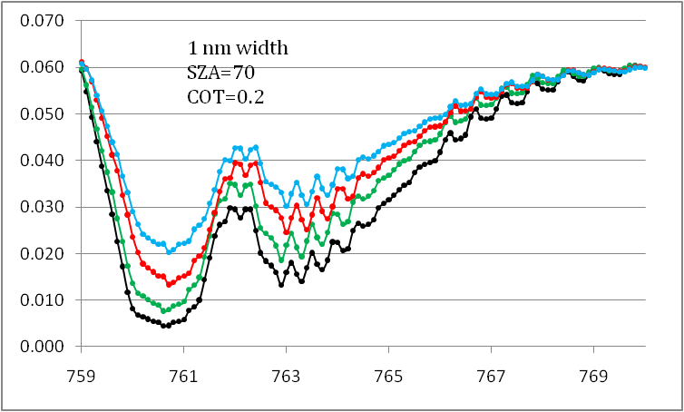
Results at 1 nm SRS (50 µm water cloud)
Dependence of integrated results on SZA
(normalized radiance L=Rcos(SZA) )
Dependence L(SZA) for different
cloud top heights.
Sensitivity to cloud layer height is similar
between 761 and 763.5nm.

Slide 11
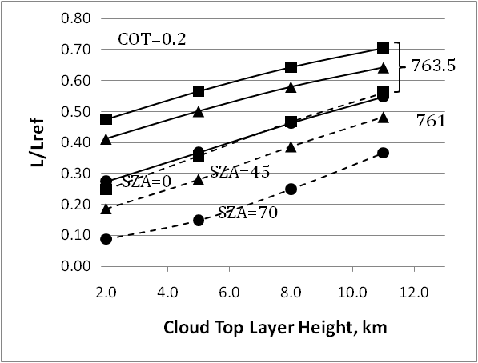
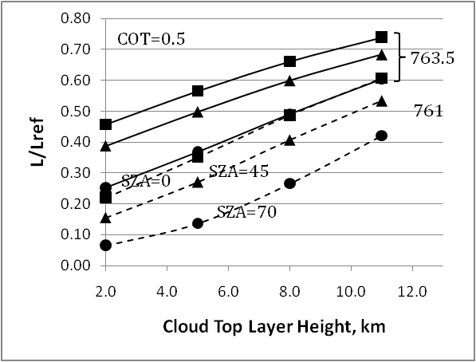
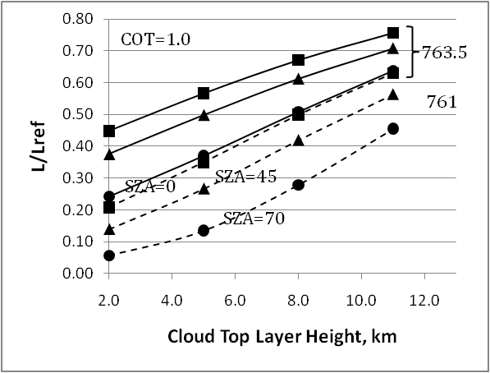
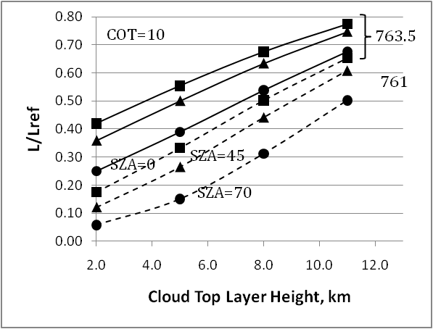
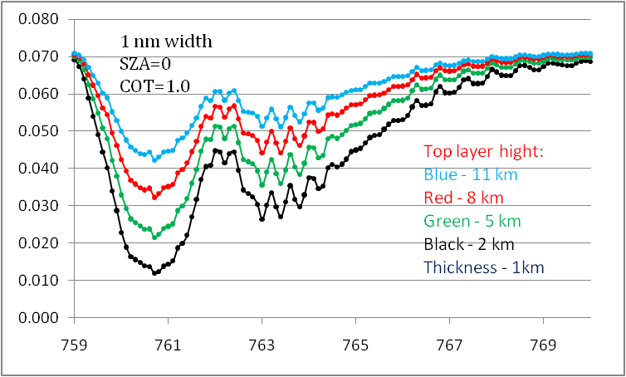
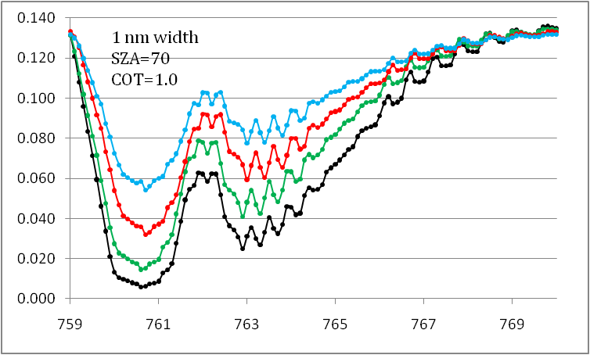
Comparison of channels 761 nm and 763.5 nm
Figures below show a ratio of L to a reference channel (in this case @ 0.759nm)
Channels 761nm and 763.5nm have similar sensitivity to cloud top height, but the SNR is better at 763.5 nm.
Because of residual absorption structure, retrievals based on band 763.5 will be more sensitive to potential band center shift.

Slide 12
While the less absorbing channel 763.5 nm is preferable for aerosol height assessment, the more absorbing channel 761 nm may have better sensitivity for cloud top height assessment, especially for thin cirrus.
This study is currently in progress.

