Slide 1
Wild Fire in Arizona 2011

Slide 2
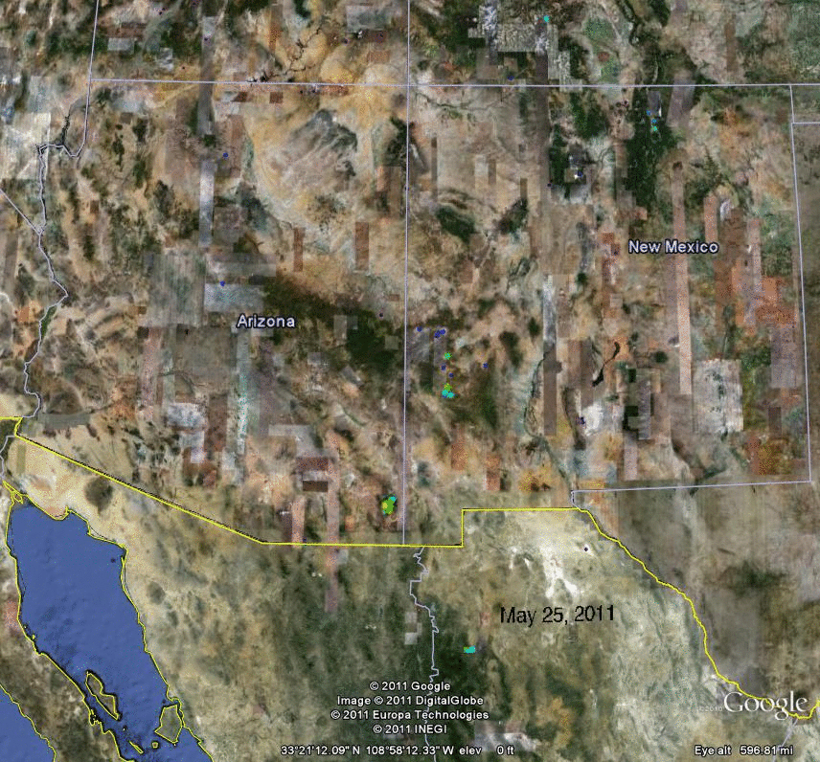
Daily Fire PM2.5 Emissions (May 25—June 13, 2011)
Animation from Shoba’s group.

Slide 3
GOES-E
GOES-W

Slide 4
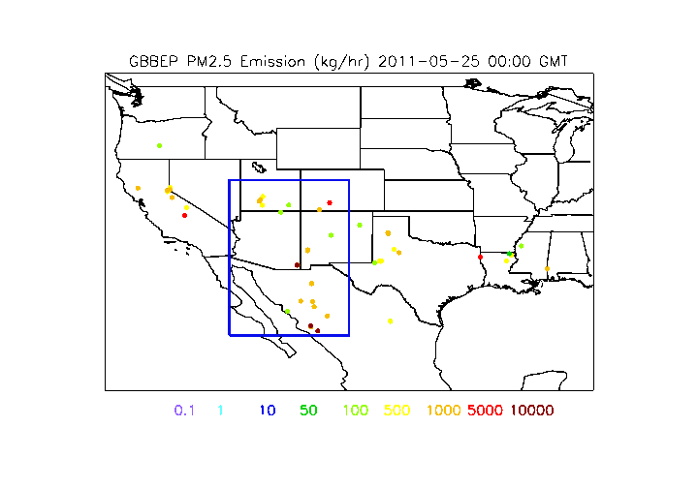
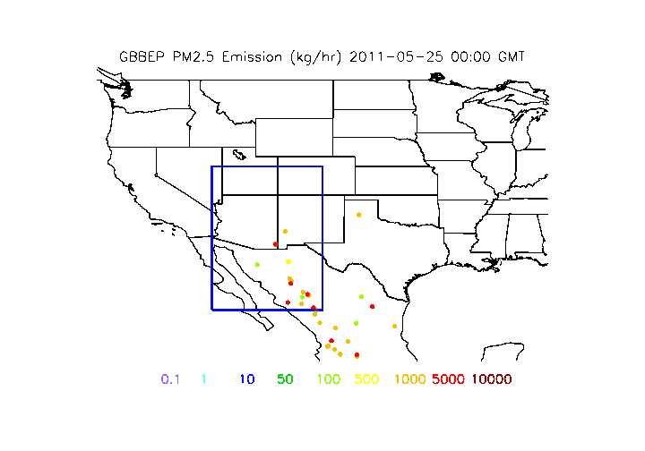
GOES-E
GOES-W

Slide 5
GOES-E
GOES-W

Slide 6
GOES-E
GOES-W

Slide 7
