Slide 1
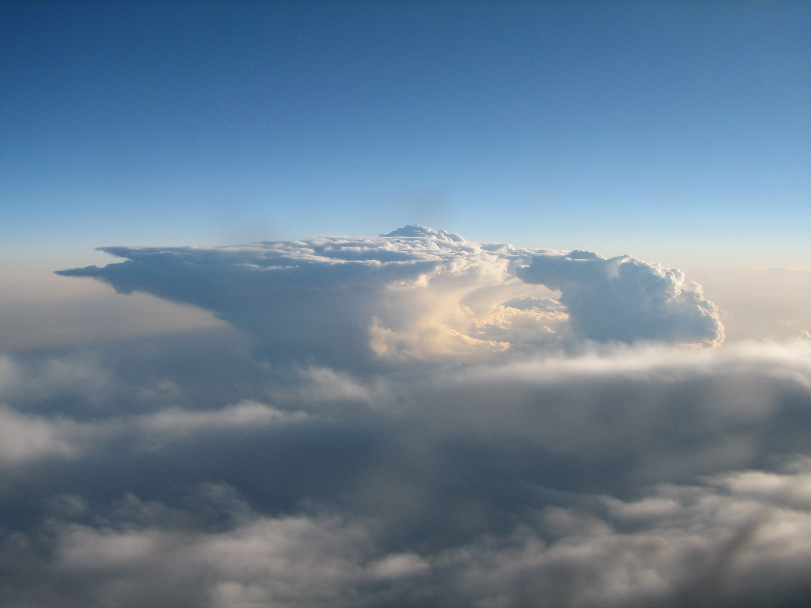
Convective Cloud Modeling
Kenneth E. Pickering
NASA Goddard Space Flight Center
Adjunct Professor, UMD/AOSC
Nov. 19, 2015
AOSC 620

Slide 2
Outline
Cloud-resolving models (CRM) – ingredients
Goddard Cumulus Ensemble (GCE) model
Weather Research and Forecasting (WRF) model
Convective Parameterizations
Multiscale Modeling Framework (MMF)
Use of chemical tracers for convective transport
Mid-latitude storms
Tropical convection
Lightning NO_{x} production

Slide 3

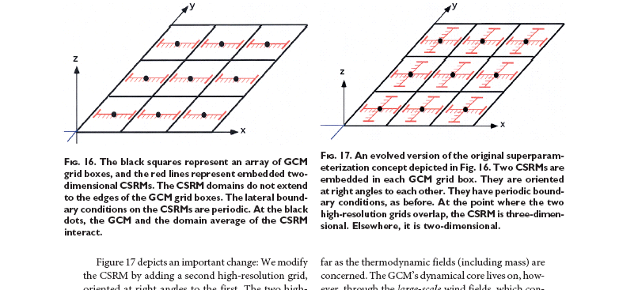
MMF: Multi-scale Modeling framework
Computational Cost of MMF:
10³ more than standard 2.5º x 2.5º GCM
10¹ more than 0.25º x 0.25º GCM
Same as 0.125º x 0.125º GCM
Nesting: Cumulus
parameterization is still
needed
Each GCM box - 2D CRM
18

Slide 4
NASA Cloud Resolving Models
Multi-scale modeling system developed at Goddard with unified physics from:
  Goddard Cumulus Ensemble model (GCE), a cloud-resolving model (CRM)
  NASA unified Weather Research and Forecasting Model (WRF), a region-scale model, and
  Coupled fvGCM-GCE, the GCE coupled to a general circulation model (or GCM known as Goddard Multi-scale Modeling Framework or MMF).
Same parameterization schemes all of the models for cloud microphysical processes, long- and short-wave radiative transfer, and land-surface processes, to study explicit cloud-radiation and cloud-surface interactive processes.
Coupled with multi-sensor simulators for comparison and validation of NASA high-resolution satellite data.
GOCART
LIS: Land Information System (data assimilation and land surface models)
GOCART: Goddard Chemistry Aerosol Radiation and Transport Model
Tao, W.-K., S. Lang, X. Zeng, X. Li, T. Matsui, K. Mohr, D. Posselt, J. Chern, C. Peters-Lidard, P. Norris, I.-S. Kang, A. Hou, K.-M. Lau, I. Choi, M. Yang, 2014: The Goddard Cumulus Ensemble (GCE) Model: Improvements and Applications for Studying Precipitation Processes. An invited paper - Atmos. Res., 143, 392-424
20

Slide 5
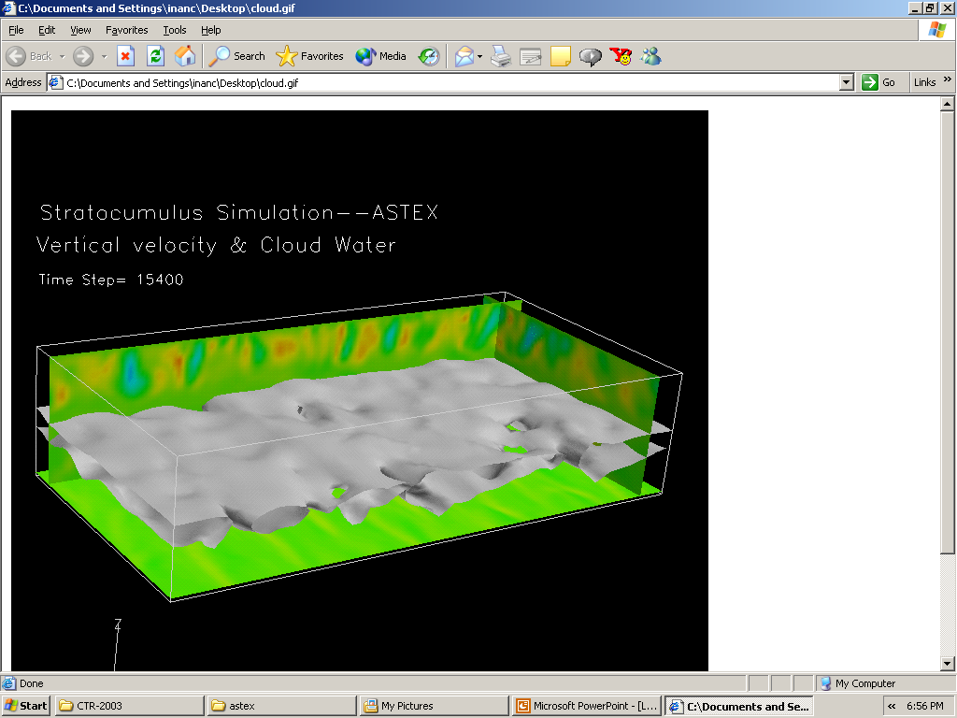
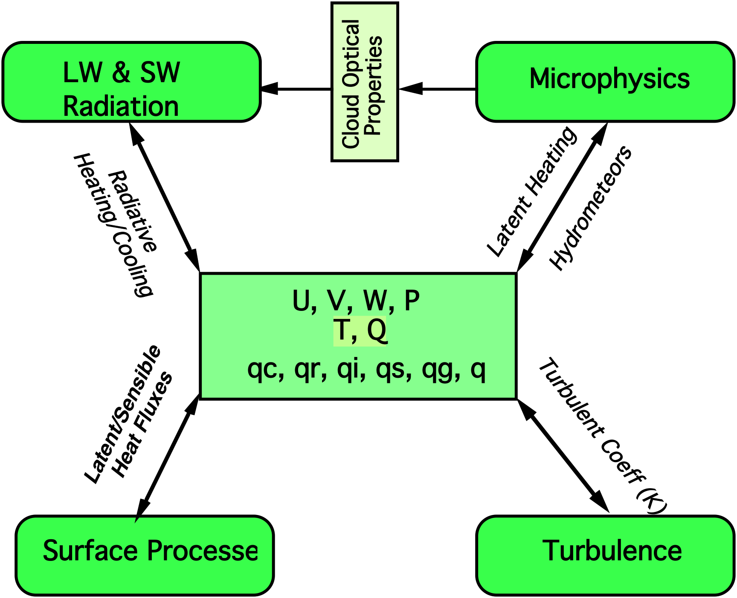
Goddard Cumulus Ensemble (GCE) Model (1982 – Present)
Validation
Improvement
Process Study
(i.e., Trajectory,
T/Q Budget, Tracer,
Sensitive Tests)
Initial Condition
Thermodynamic (T, Q)
Dynamic (U, V, W)
Trace Gases
Surface (T, Q. U/V)
Aerosol
3D GCE Model (LES Mode)
dx=dy=50 m, dz=25 m, dt=1 s
Blue – Observation (ground based, airborne, satellite)
GCE Model Description: Tao and Simpson (1993), Tao et al. (2003), Tao (2003), Tao et al. (2014)
CRM review paper: Tao and Moncrieff (1999 – Geophy Review)
Aerosol review paper: Tao et al. (2012 – Geophy Rev)
21

Slide 6
GCE Model Formulation
Momentum Equations:
∂u/∂t = Perturbation Press. Gradient + Coriolis + Diffusion
∂v/∂t = Perturbation Press. Gradient + Coriolis + Diffusion
∂w/∂t = Perturbation Press. Gradient + Coriolis +
virtual temp perturbation term + Diffusion
Note that Cloud Resolving Models are non-hydrostatic. The hydrostatic
equation is not used and the vertical momentum equation is solved instead.
This is appropriate for small mesoscale circulations such as cumulus convection.
Equations for θ and q_{v}:
∂θ/∂t = temp advection terms + latent heating + radiative heating/cooling
+ diffusion
∂q_{v}/∂t = water vapor advection terms + evaporation + condensation
+ deposition + sublimation

Slide 7
Initial and Boundary Conditions for
Cloud Resolving Model
Two modes of operation:
Idealized convection – initial condition profiles of winds, temperatures,
and humidity are assumed to be horizontally homogeneous in the model domain
Convection initiated with cool pool or warm bubble
Realistic convection – initial and boundary conditions from 3-D analyses derived from a larger-scale model.
Convection will initiate on its own provided sufficient convergence and buoyancy exist in the analyses

Slide 8
Microphysics
Two-category liquid water scheme – cloud water and rain
Ice scheme - choice of three or four category ice schemes
1) cloud ice, snow, graupel or hail
2) cloud ice, snow, graupel, hail
Size distributions of rain, snow, and graupel/hail:
N(D) = N_{o}exp(-λD), where N_{o} is N(D) for D=0; λ is slope of size
distribution, which depends on hydrometeor mixing ratio and density
Hydrometeor mixing ratio equations:
∂q_{c}/∂t = 3-D advection terms + condensation – evap + diffusion
∂q_{r}/∂t = horiz advection + (vert advec – fall speed) – evap + transfer +
melting – freezing + diffusion
∂q_{i}/∂t = 3-D advection terms + deposition – sublimation + transfer +
diffusion
∂q_{s}/∂t = horiz advection + (vert advec – fall speed) + deposition –
sublimation – melting + freezing + transfer + diffusion
∂q_{g}/∂t = horiz advection + (vert advec – fall speed) + deposition –
sublimation – melting + freezing + transfer + diffusion

Slide 9
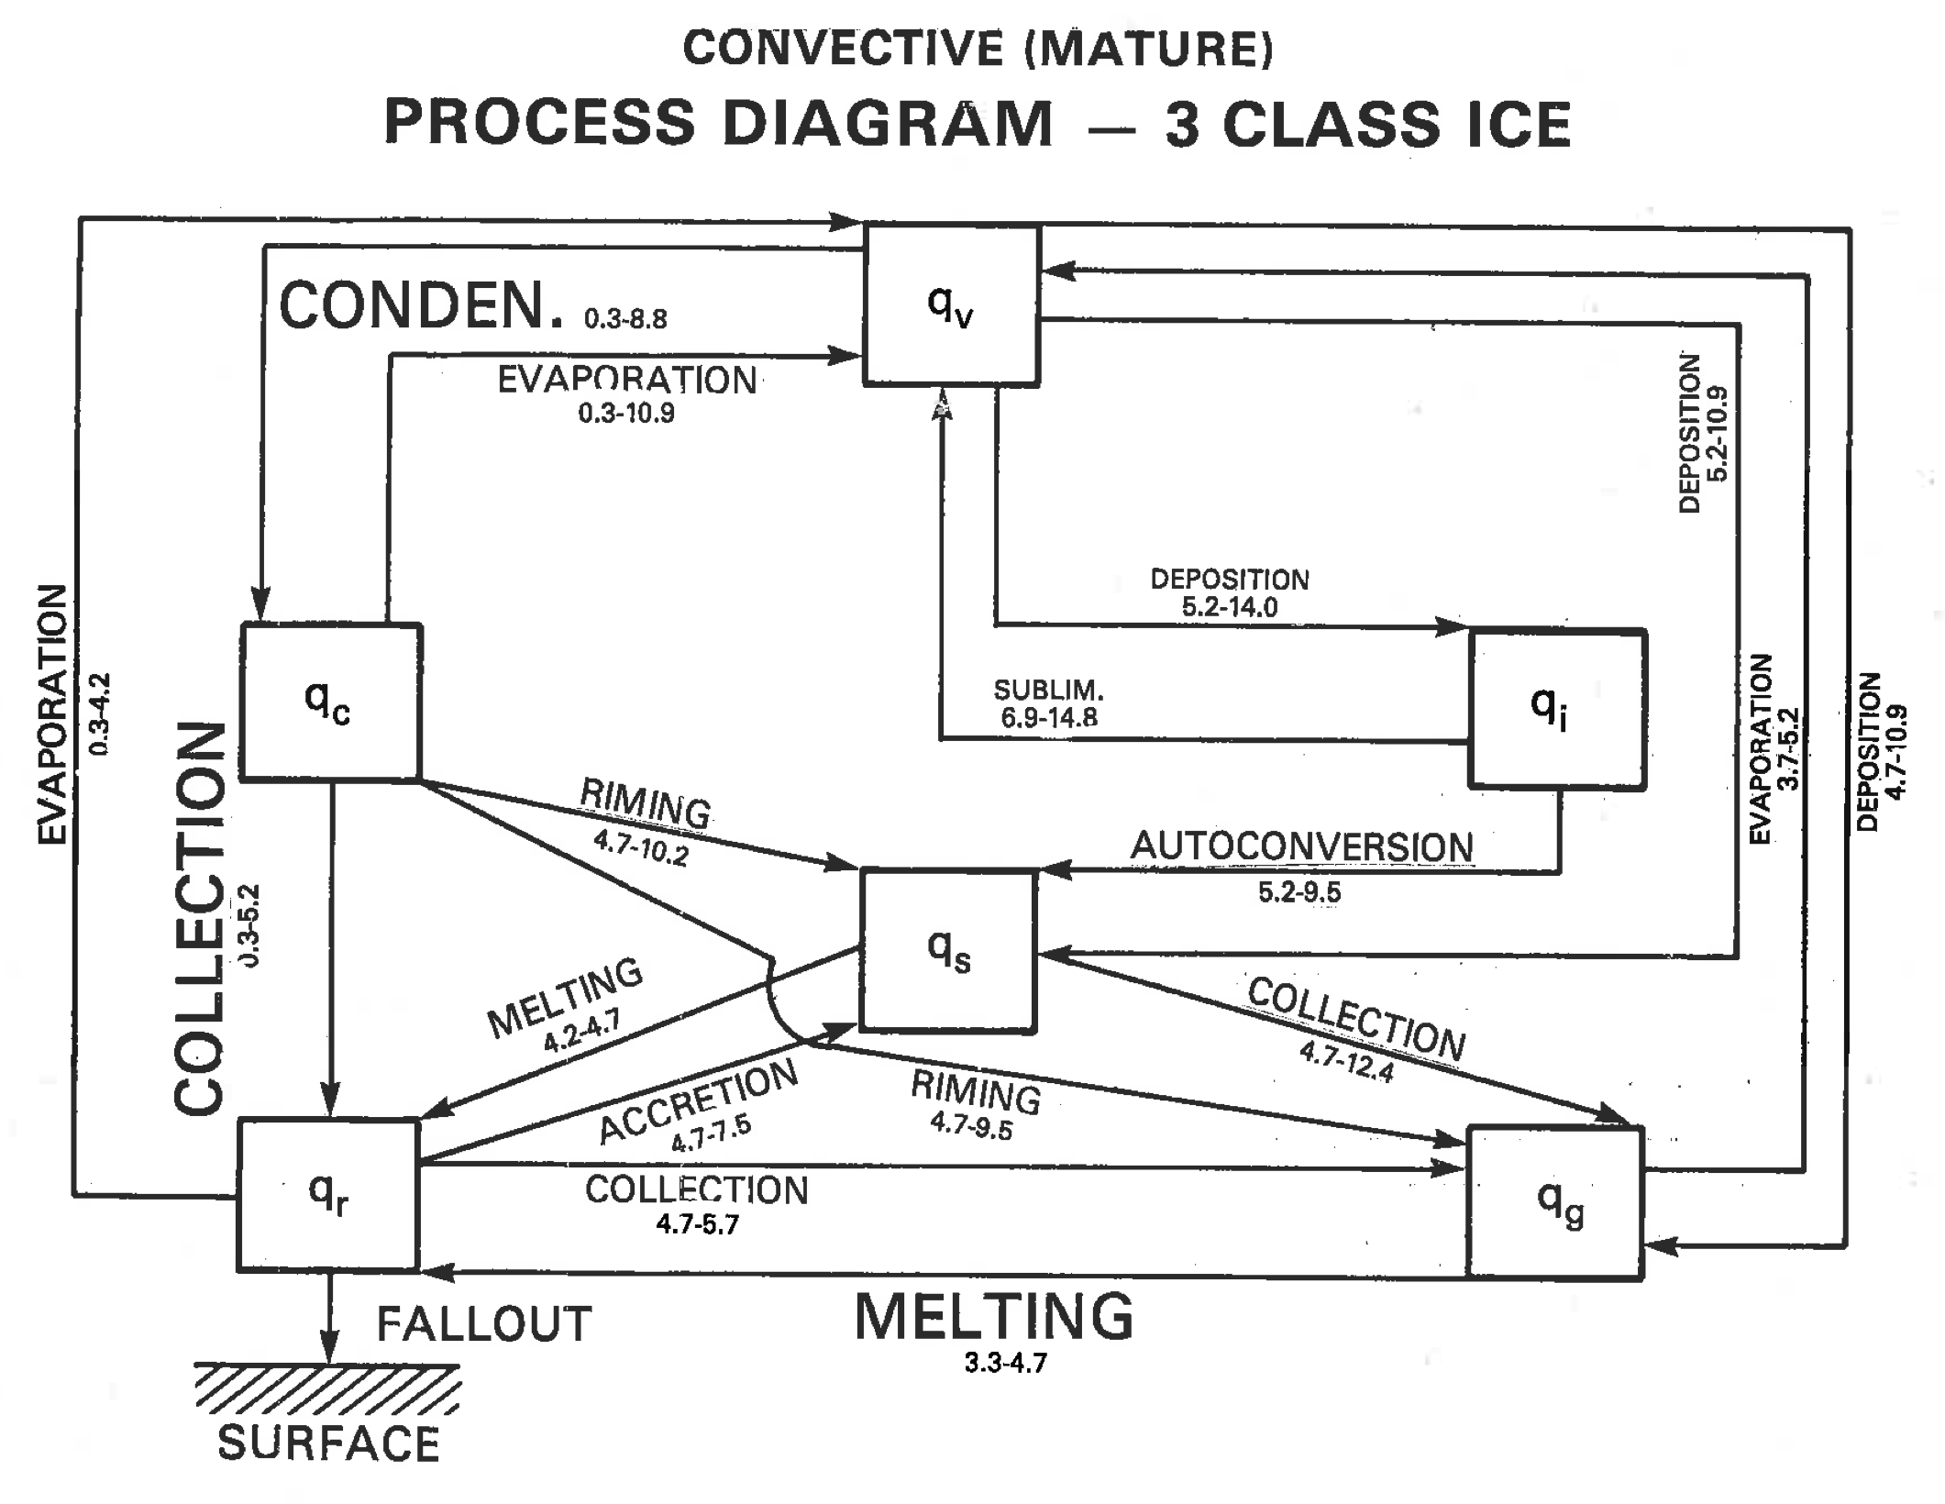
Tropical MCS
Identify the
important
microphysics
processes in the
CRM
Larger letter -> more important
Numerical designation -> altitude of occurrence
Tao, W.-K., J. Simpson, S. Lang, M. McCumber, R. Adler and R. Penc, 1990: An algorithm to estimate the heating budget from vertical hydrometeor profiles. J. Appl. Meteor., 29, 1232-1244.
15

Slide 10
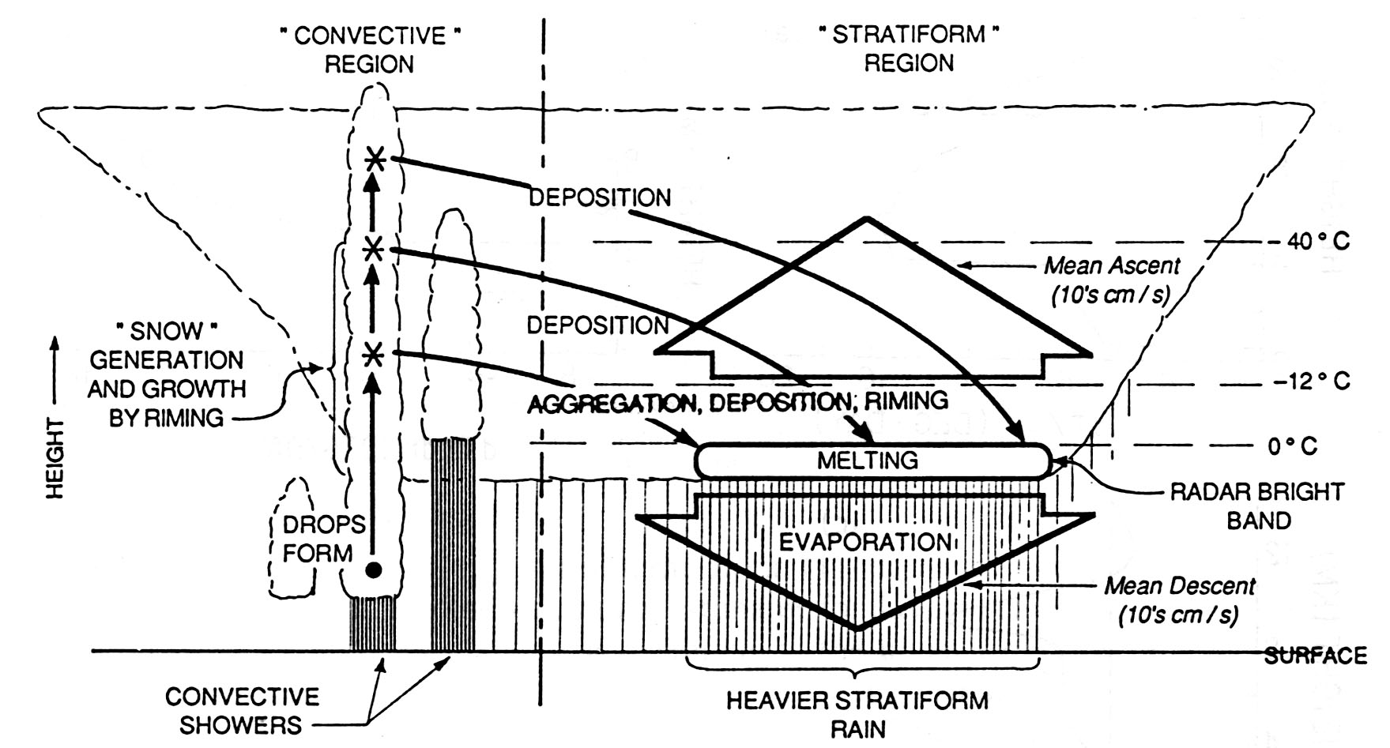
Vertical profiles of microphysics (heating) for idealized convective systems
Where is the origins of growth mechanisms of particles in stratiform region?
Mesoscale ascending and/or horizontal fluxes of hydrometeors from convective region
condensation
deposition
sublimation
Riming
freezing
melting
evaporation
Convective Rain
Stratiform Rain
Schematic of a microphysical processes associated with a tropical mesoscale convective system in its mature stages. Straight, solid arrows indicate convective updraft, wide, open arrows indicate mesoscale ascent and subsidence in the stratiform region Where vapor deposition and evaporation occur. Adapted from Houze (1989).
    Houze, 1989: Observed structure of mesoscale convective systems and implications for large-scale heating. Quart. J. Roy. Meteor. Soc., 115, 425-461.
6

Slide 11
An Integrated Approach to Atmospheric Water Cycle and Climate Change Research
(satellite observations, field campaign, modeling, data processing and applications)
Circulation and dynamical processes
(synoptic to cloud scales)
Clouds
H, M, L, convective,
stratiform, mixed-phase,
precipitating…
Precipitation
Rain, snow, convective,
stratiform, drizzle..
H2O
&
microphysical
processes
Radiative
climate feedback
(direct and indirect effects)
Latent heating &
transport, scavenging processes
Aerosol
Anthropogenic and
natural sources
Weather and climate models are using explicit microphysics schemes developed by CRM for their higher resolution forecast/simulation
7

Slide 12
Microphysical Processes
What are the uncertainties of cloud/microphysical processes?
The vertical profiles of the cloud/precipitation properties in convective and stratiform regions, mixed phase (melting, riming, ice processes), life cycle
Need to have the following cloud properties measurements
3D vertical velocity structures;
High temporal resolution aerosol/CCN measurements;
Vertical (ice, liquid) hydrometeor particles (droplet spectrum, condensation, size, density) measurements;
Comprehensive polarimetric radar measurements (i.e., S/C-band ground-based for convective cores and air/space borne or vertically pointing X/K-band for anvil/stratiform characteristics)
9

Slide 13
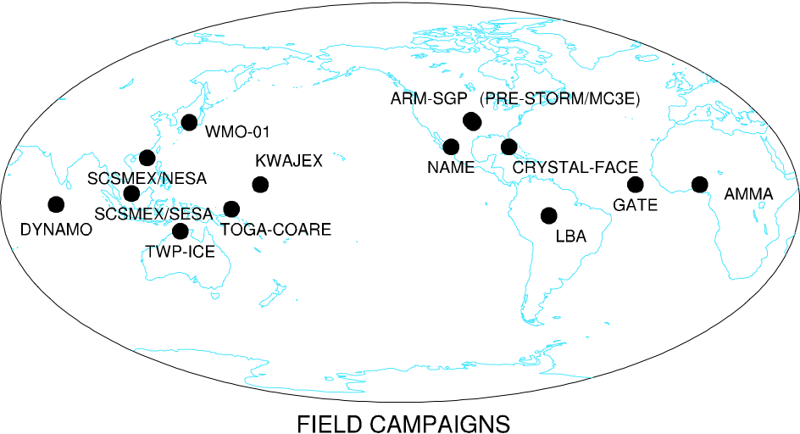
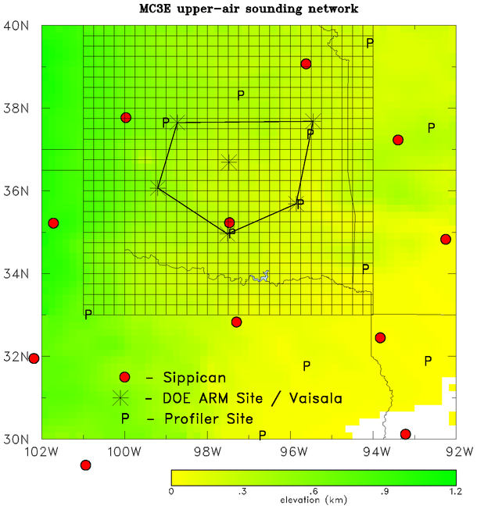
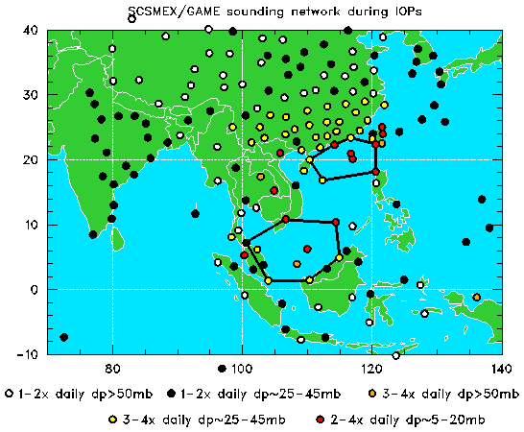
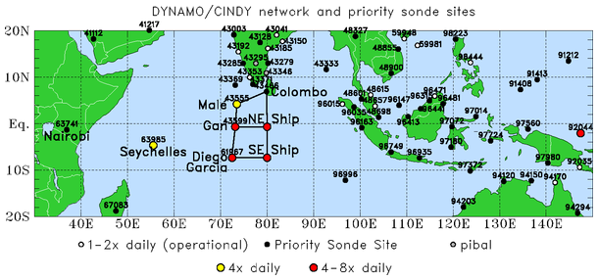
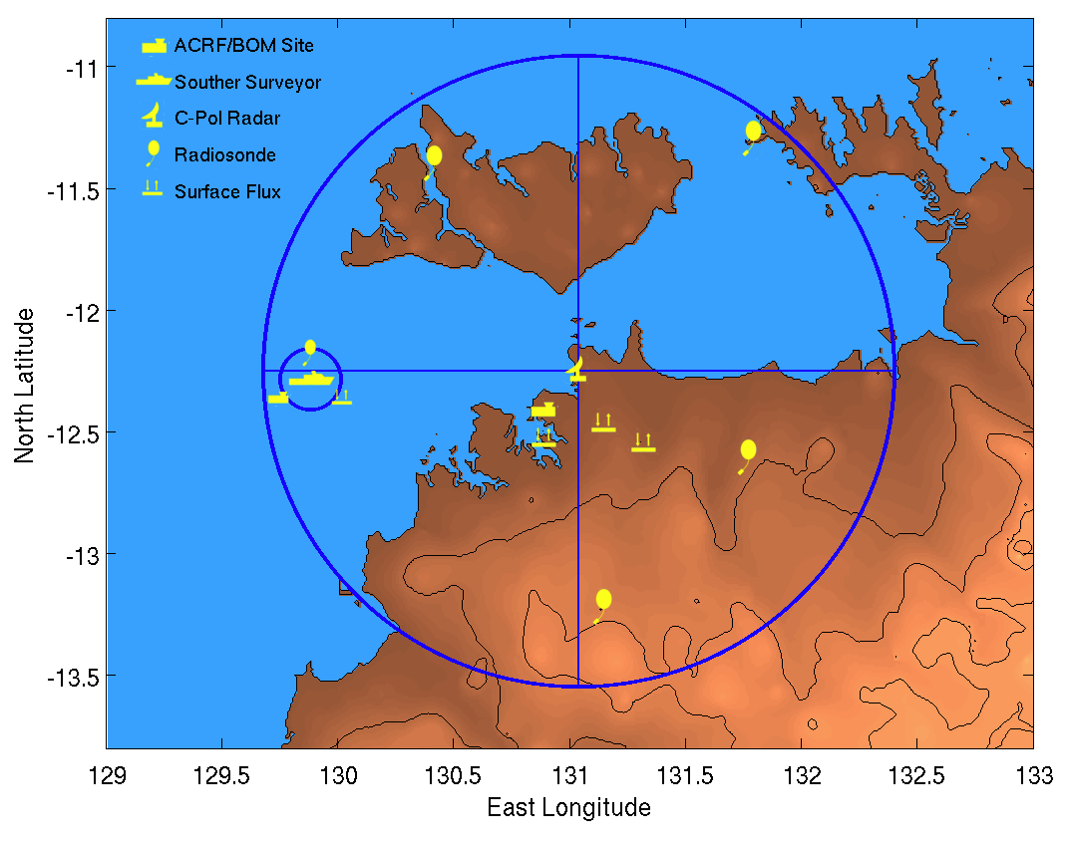
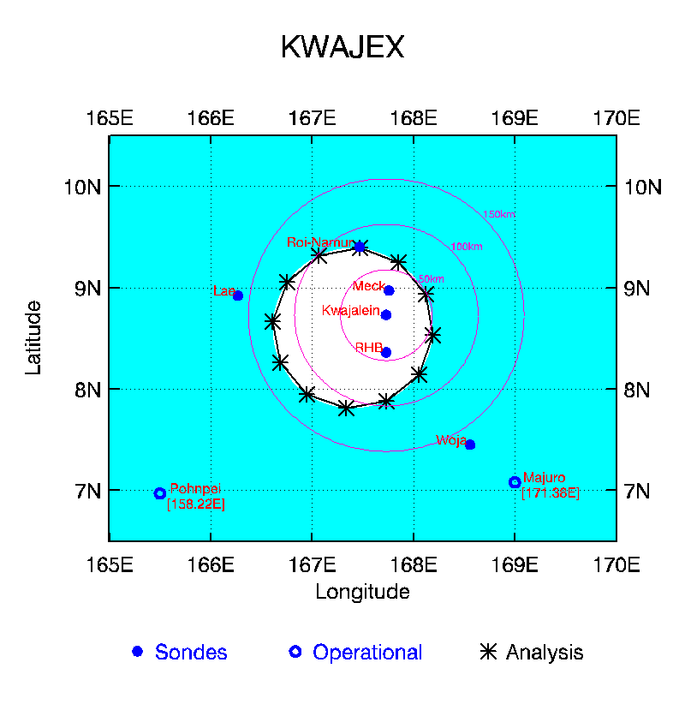
Cases for CRM Model (MC3E, NAMMA, NAME, DYNAMO, MERRA, MMF)
MC3E
SCSMEX
TWP-ICE
25
KWAJEX
DYNAMO

Slide 14
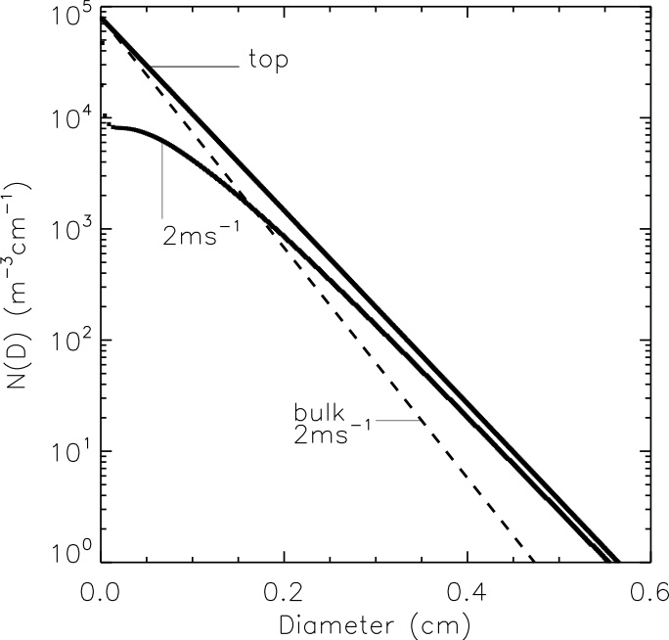
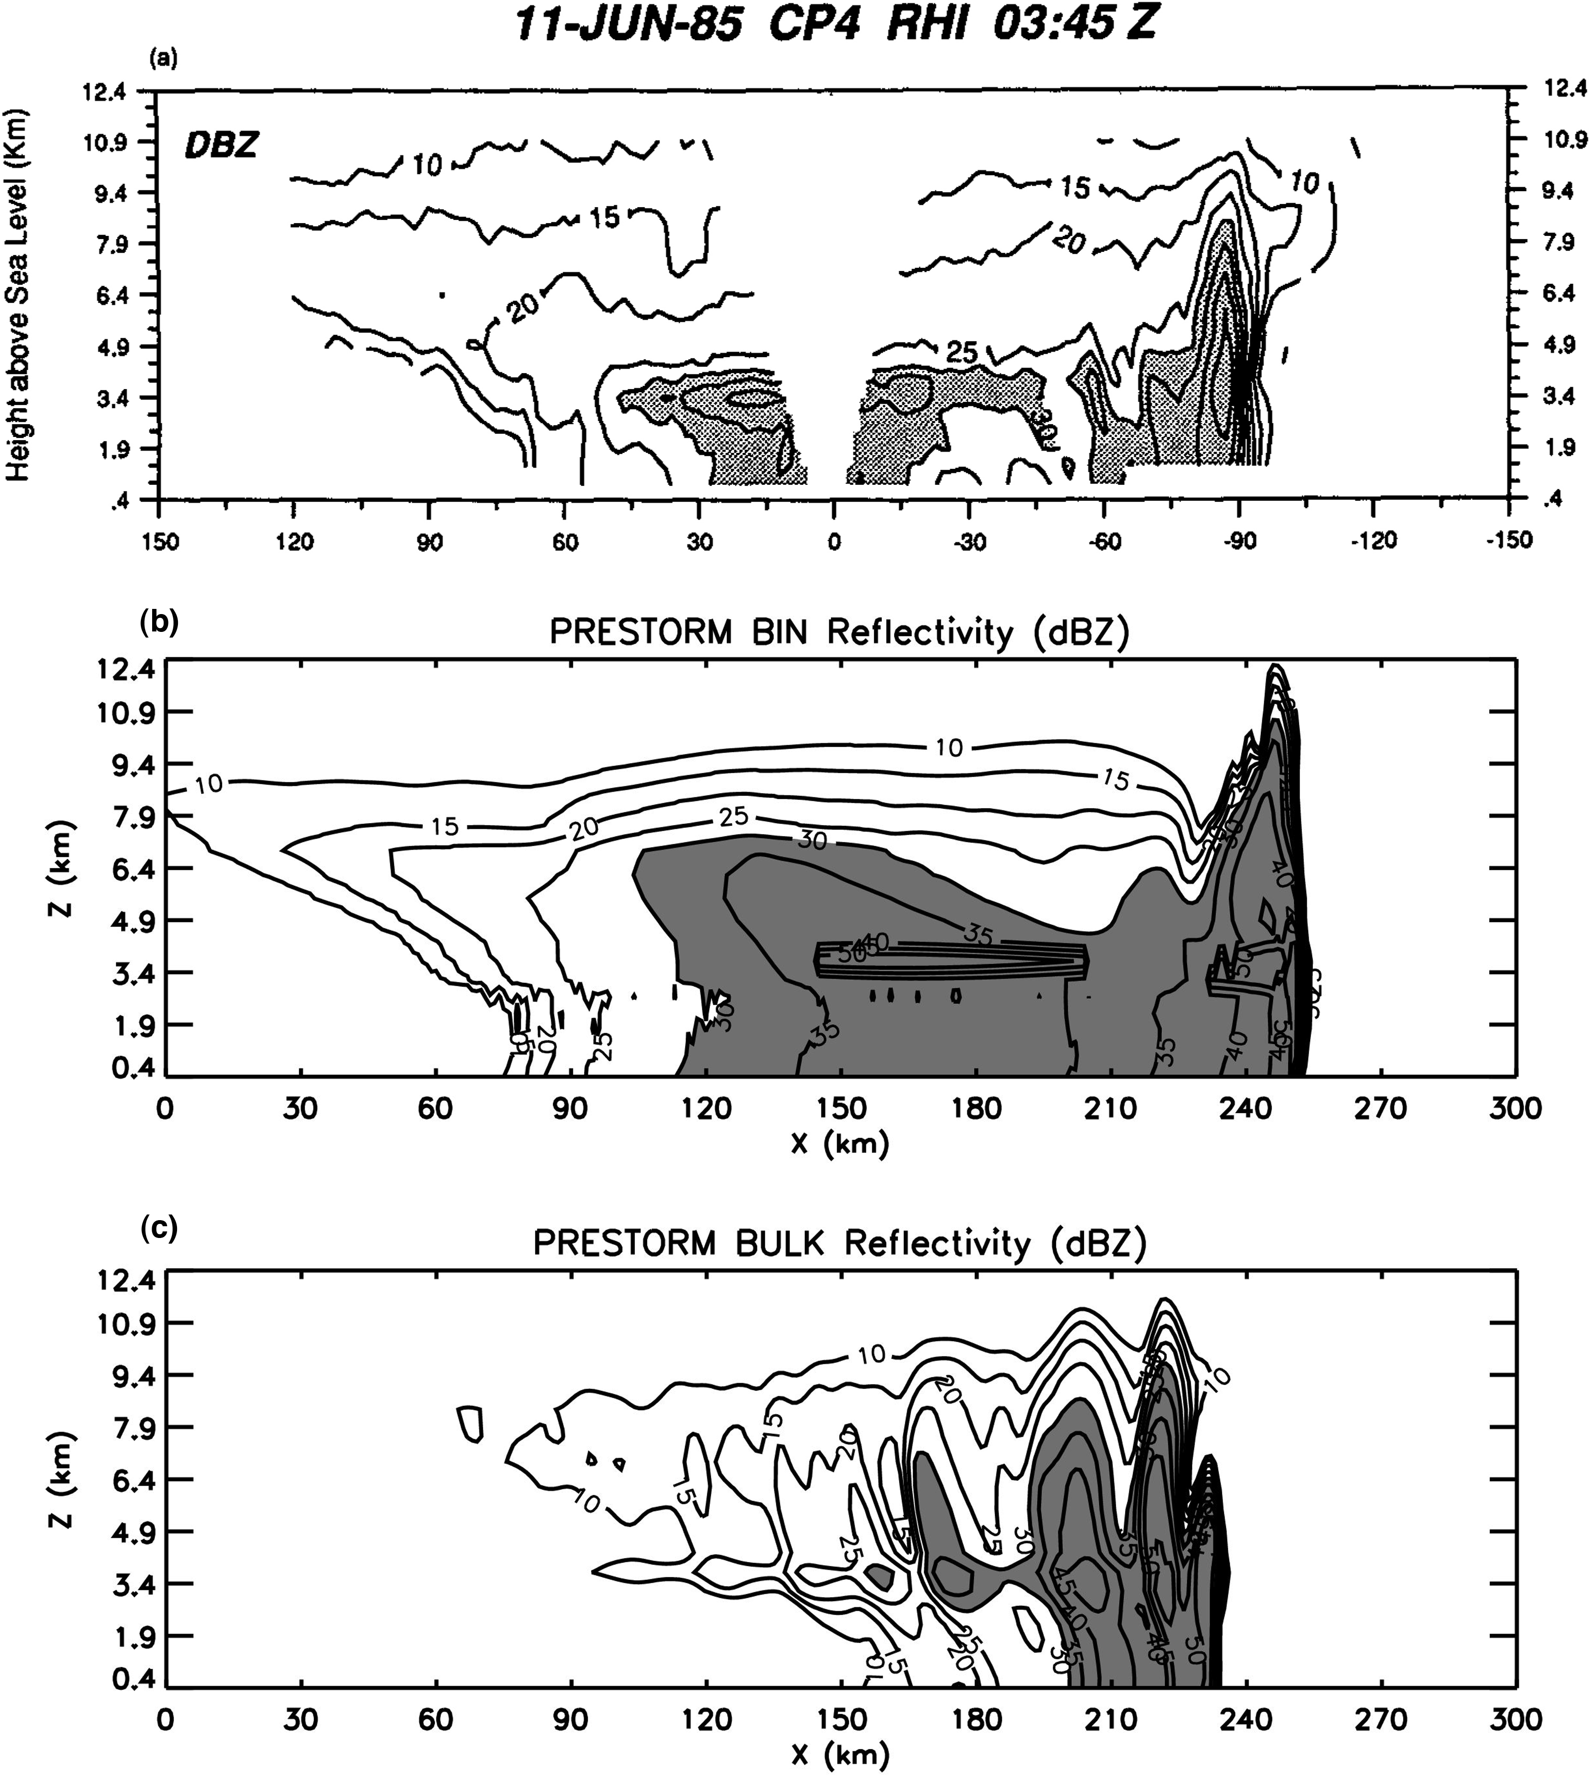
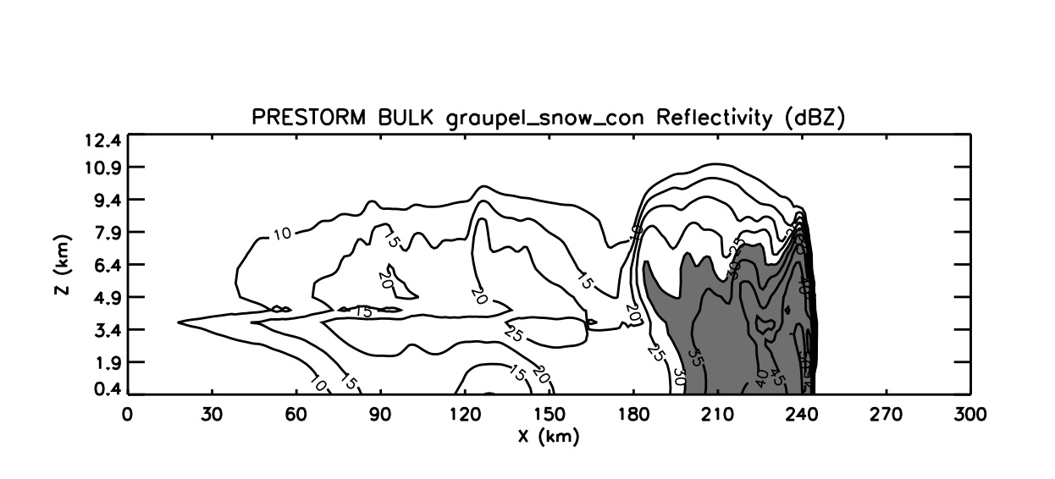
Improving Bulk Microphysics in GCE Using Bin Spectral Scheme
Radar Observation
By assuming exp. rain DSD, bulk scheme artificially increases #s of small drops
bin
observation
Bin Scheme Simulation
Bin Scheme is used to correct the overestimation of rain evaporation in bulk scheme and the density and fall speed of graupel in bulk scheme
Bulk Scheme (Tuned)
Bulk Scheme (original)
Li, X., W.-K. Tao, A. Khain, J. Simpson and D. Johnson, 2009: Sensitivity of a cloud-resolving model to bulk and explicit-bin microphysics schemes: Part I: Comparisons. J. Atmos. Sci., 66, 3-21.
Li, X., W.-K. Tao, A. Khain, J. Simpson and D. Johnson, 2009: Sensitivity of a cloud-resolving model to bulk and explicit-bin microphysics schemes:: Part II: Cloud microphysics and storm dynamics interactions. J. Atmos. Sci., 66, 22-40.
12

Slide 15
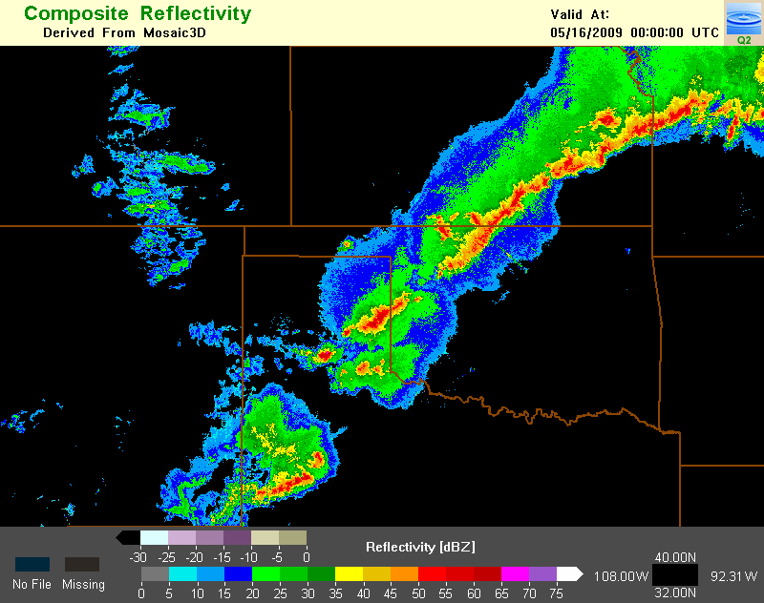
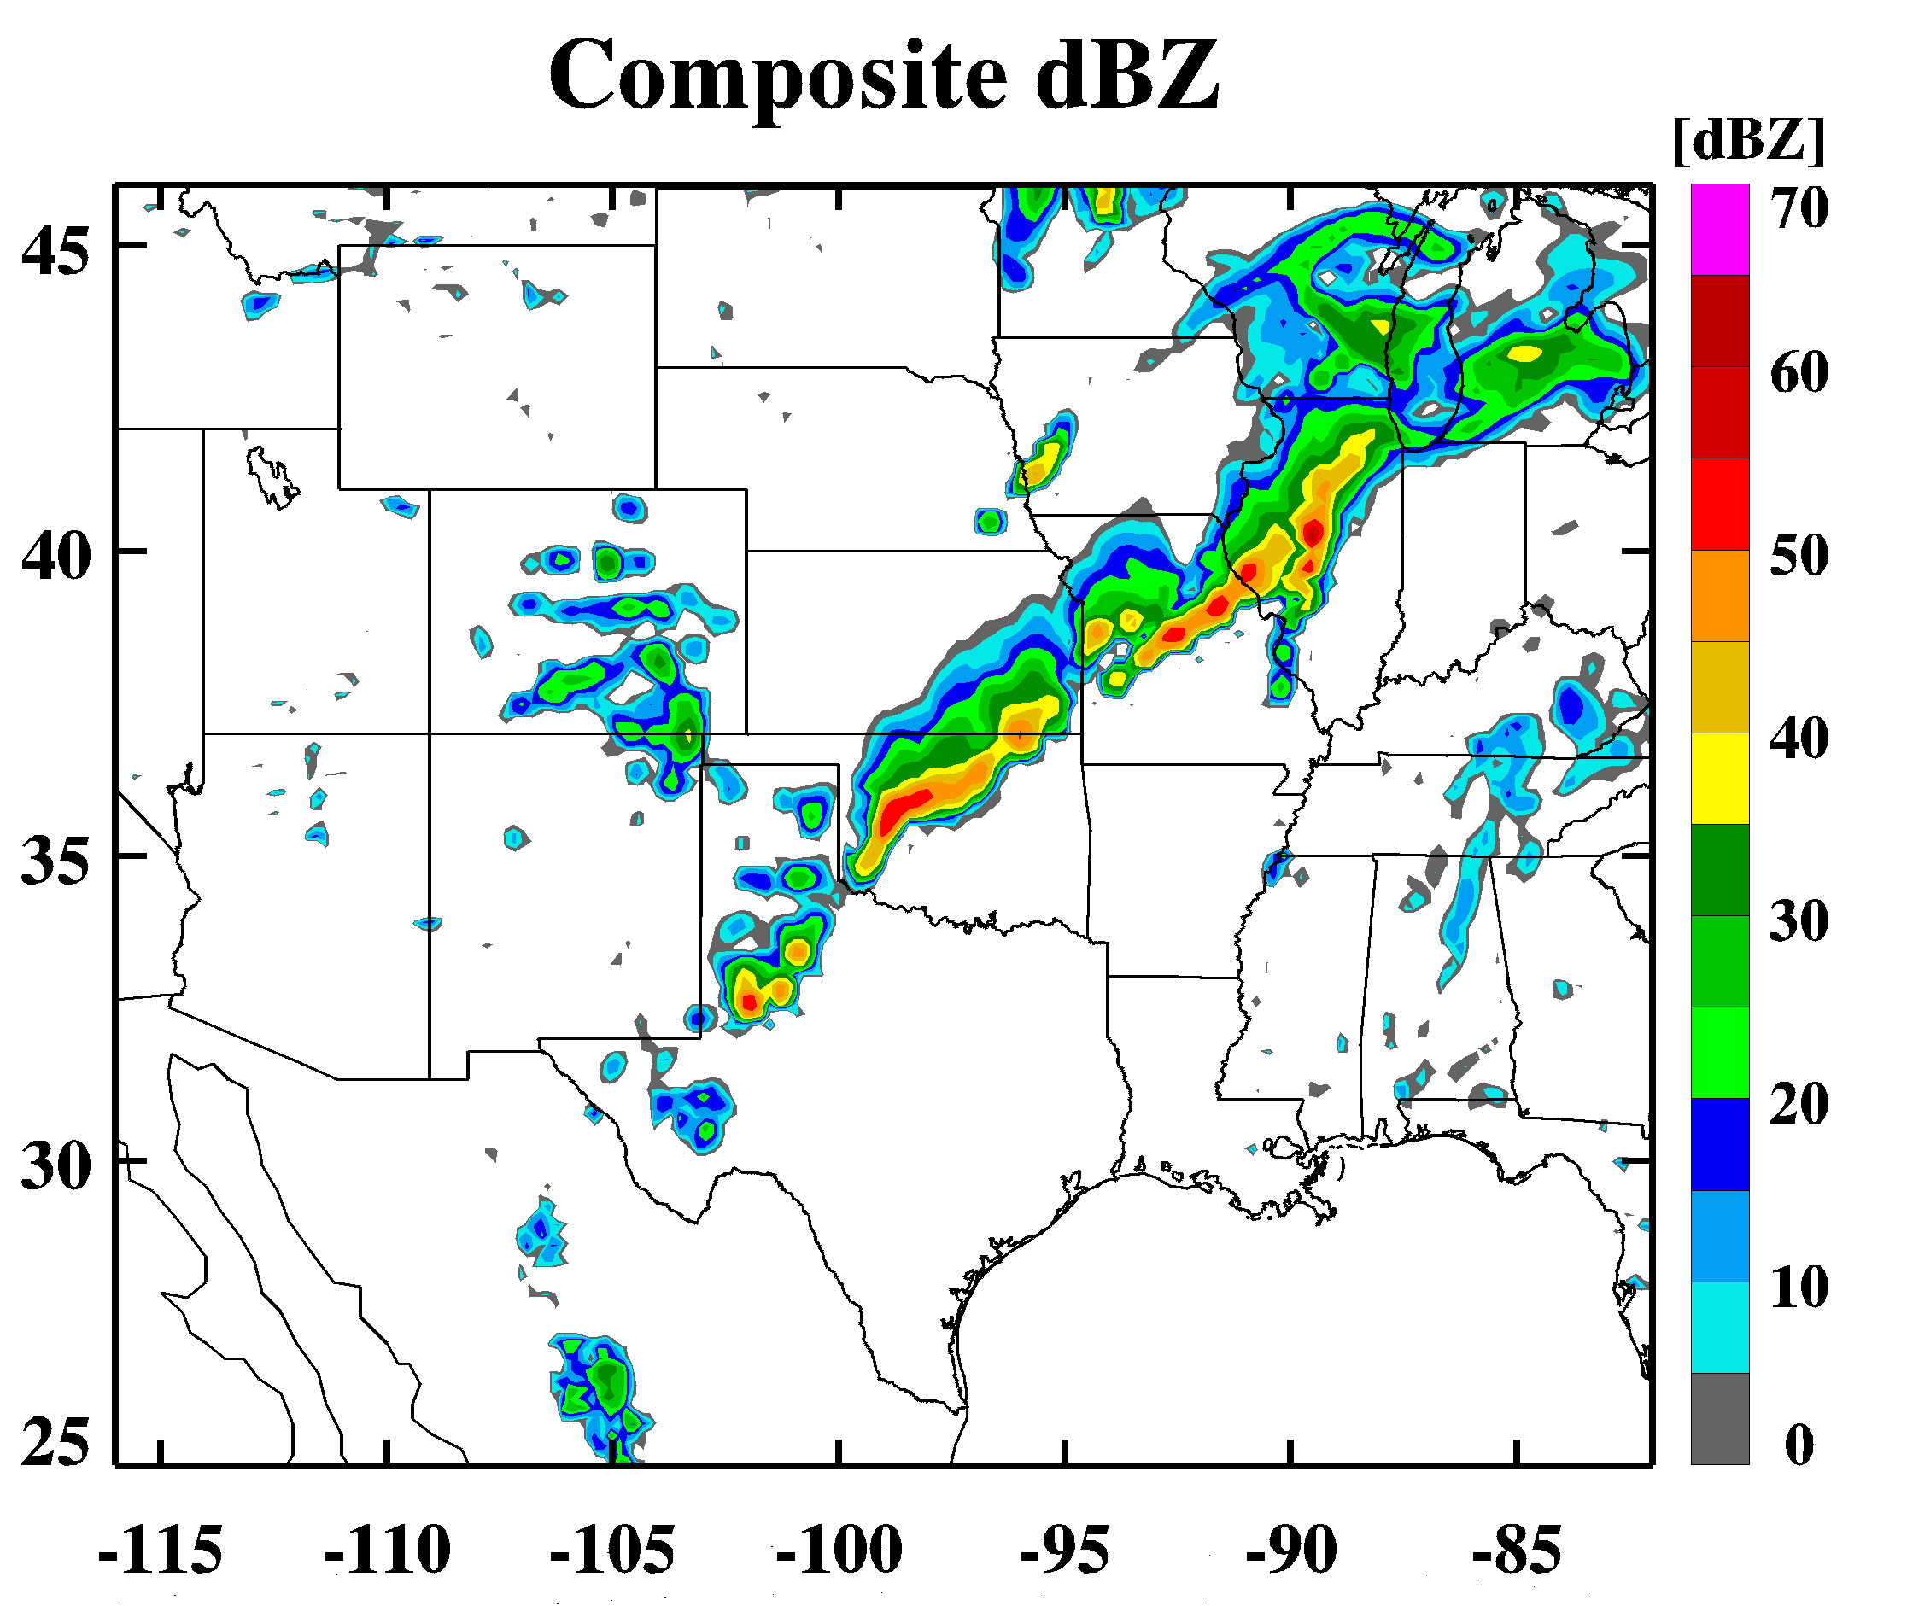
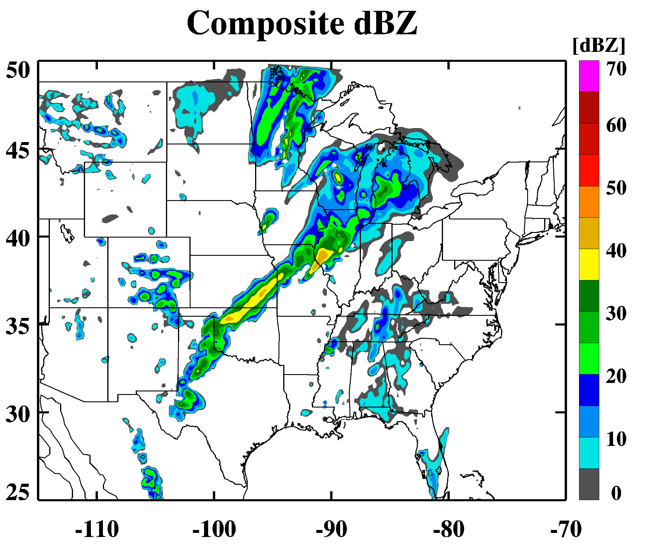
Why do we need to have the 4-ICE scheme?
Observation
3ICE-Hail
3ICE-Graupel
Almost all microphysics schemes are 3-ICE (cloud ice, snow and graupel). Very few 3ICE schemes have the option to have hail processes (cloud ice, snow, graupel or hail)
Both hail and/or graupel can occur in real weather events simultaneously, therefore a 4ICE scheme (cloud ice, snow, graupel and hail) is required for real time forecasts (especially for high-resolution prediction of severe local thunderstorms, mid-latitude squall lines and tornadoes)
Current and future global high-resolution cloud-resolving models need the ability to predict/simulate a variety of weather systems from weak to intense (i.e., tropical cyclones, thunderstorms) over the globe; this requires the use of a 4ICE scheme
23

Slide 16
Microphysics and its Interactions with Other Components
Buoyancy and P-Gradient
are 2 order larger than loading term.
But they are always in opposite sign
(Tao et al. 1995; JAS)
Tao et al. (1987)
Tao and Simpson (1993)
Tao et al. (2003, 2007, 2014)
Lang et al. (2007, 2011, 2014)
Microphysics
Surface Rainfall (intensity) -> LIS
56

Slide 17
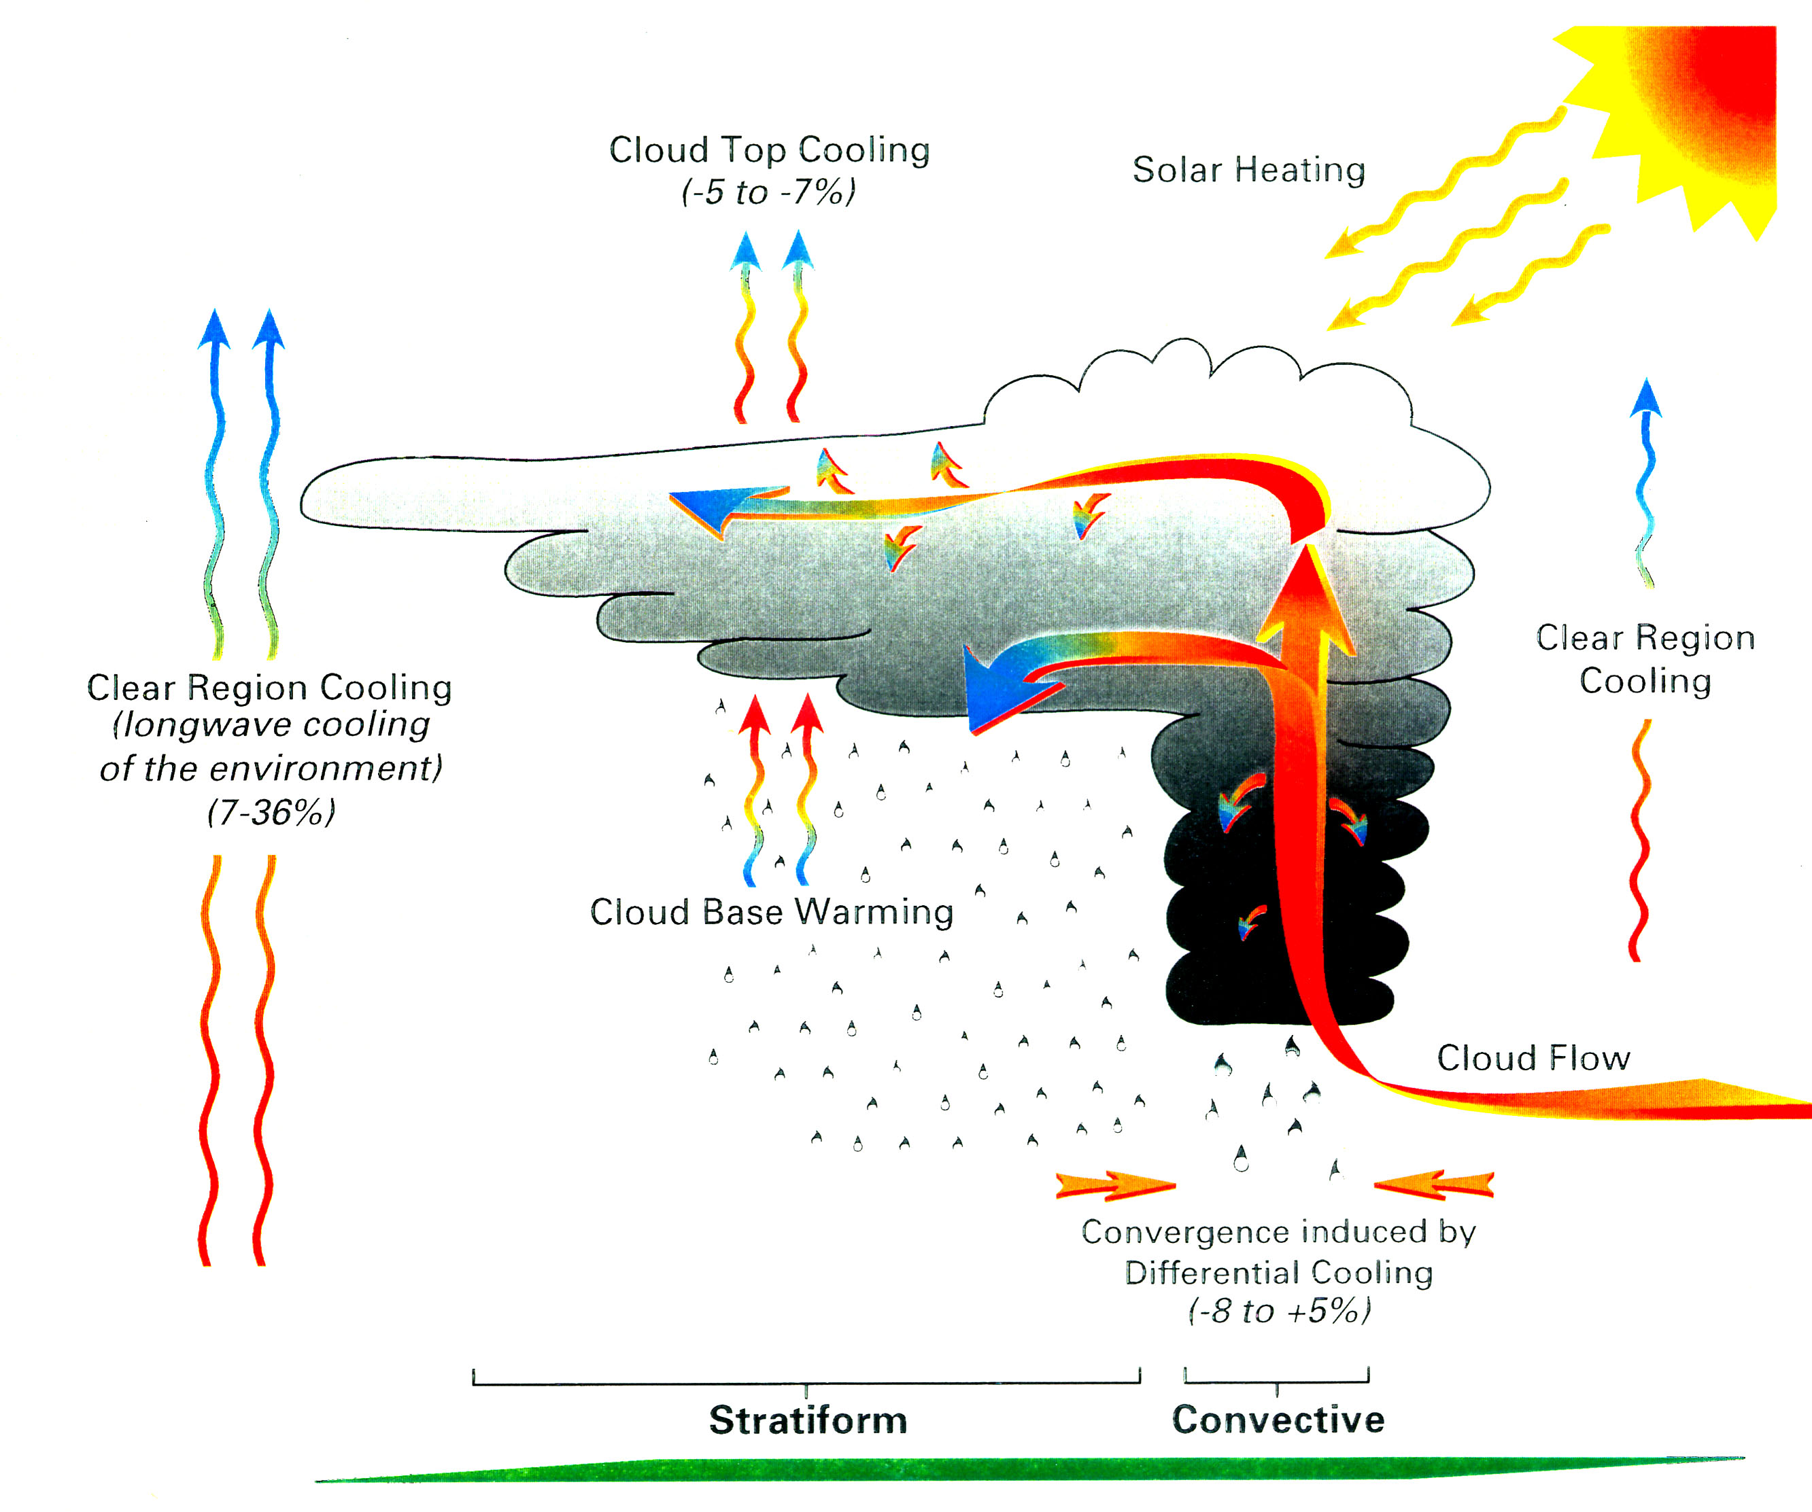
Three Hypotheses
Tao et al. (1996): Cloud-radiation interaction.

Slide 18
Weather Research and Forecasting (WRF) Model
A community model jointly developed by NOAA, NCAR, NASA, DOD, and various universities
Can be used for multiple scales of interest ranging from 10s of meters to global
Contains many choices of boundary layer, surface layer, convection, microphysics, and radiation schemes
Two major dynamic cores (Advanced Research WRF – ARW from NCAR;
Non-hydrostatic Mesoscale Model – NMM from NOAA). NMM version is the basis for the operational North American Mesoscale (NAM) model and Rapid Refresh model
Typically, analyses from larger-scale models are used for initial and boundary conditions
WRF-Chem is a version that runs chemistry on-line with the meteorology
NU-WRF (NASA Unified WRF) uses NASA-developed schemes for microphysics, aerosols, radiation, and land surface

Slide 19
WRF Microphysics Schemes
Kessler scheme (Warm rain only)
Purdue - Lin et al. scheme
WSM 3-class simple ice scheme
WSM 5-class scheme
Ferrier (new Eta) microphysics
WSM 6-class graupel scheme
Goddard GCE scheme* (Tao et al. 2003; Lang et al. 2007)
Milbrandt-Yau 2-moment (4ICE) scheme
Morrison 2-moment scheme
SBU-YLin, 5-class scheme
WSM double moment, 5-class scheme
WSM double moment, 6-class scheme
Thompson scheme in V3.0
Thompson graupel scheme (2-moment scheme in V3.1)
*5 options: Warm rain only, 2ICE,
3ICE-graupel, 3ICE-hail,
4ICE
32

Slide 20
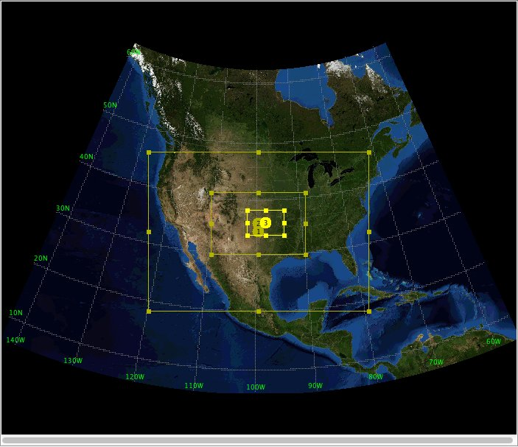
MC3E – NASA GPM and DOE ASR Joint Field Campaign
(April- June 2011)
Three nested domain (9km, 3km, 1km) with 60 vertical layers.
Physics: Goddard Microphysics scheme, Grell-Devenyi ensemble cumulus scheme, Goddard Radiation schemes, MYJ planetary boundary layer scheme, Noah surface scheme, Eta surface layer scheme.
NASA Unified WRF (NU-WRF)
Blue box: Goddard Physical Packages
27

Slide 21
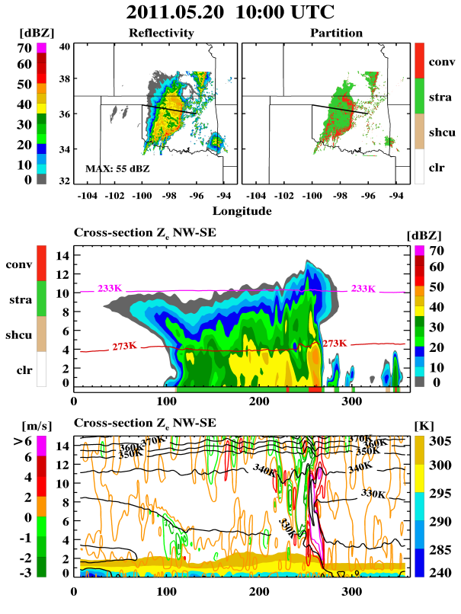
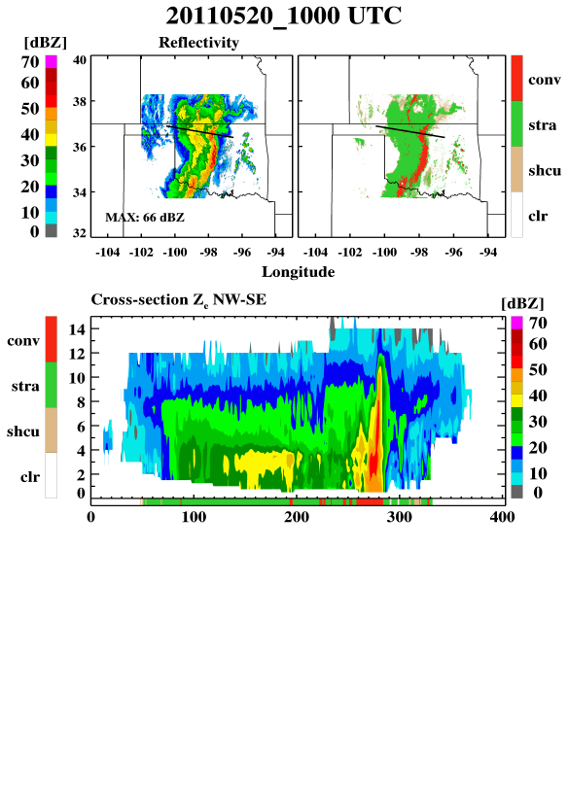
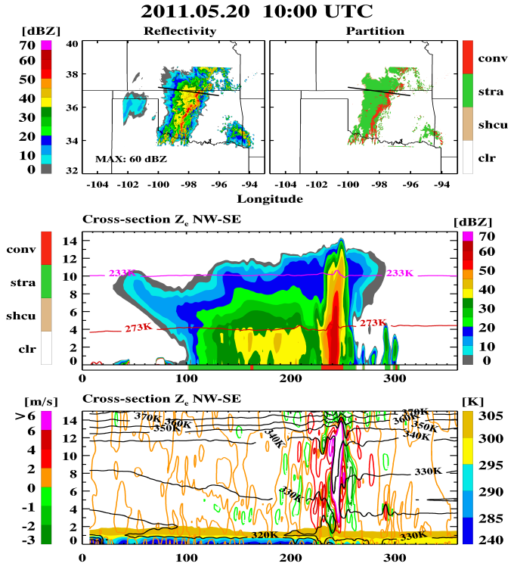
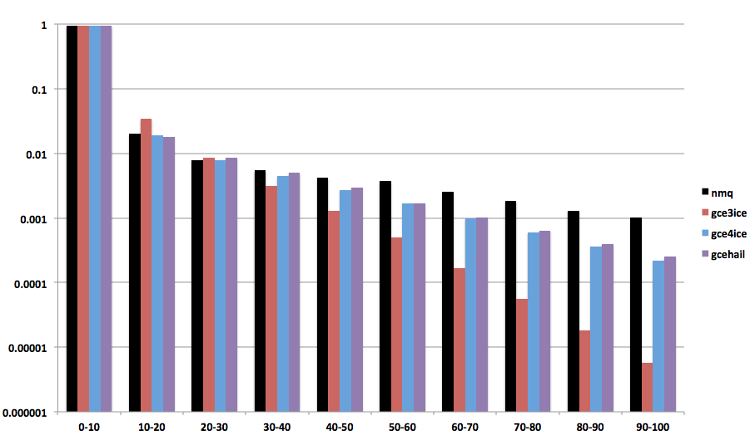
Tao, W.-K., D. Wu, S. Lang, J. Chern, A. Frridlind, C. Peters-Lidard, T. Matsui, 2015: High-resolution NU-WRF model simulations of MC3E deep convective-precipitation systems: Part I: Comparisons between Goddard microphysics schemes and observation. J. Geophys. Rev., (revised and submitted)
3ICE - Graupel
Observed
4ICE
W-velocity
Cool Pool
Black: Obs
Red: Graupel
Blue: 4ICE
PDF – Rainfall Intensity >
Both 4ICE and 3ICE-Hail simulated more heavy rainfall than 3ICE-Graupel
27

Slide 22
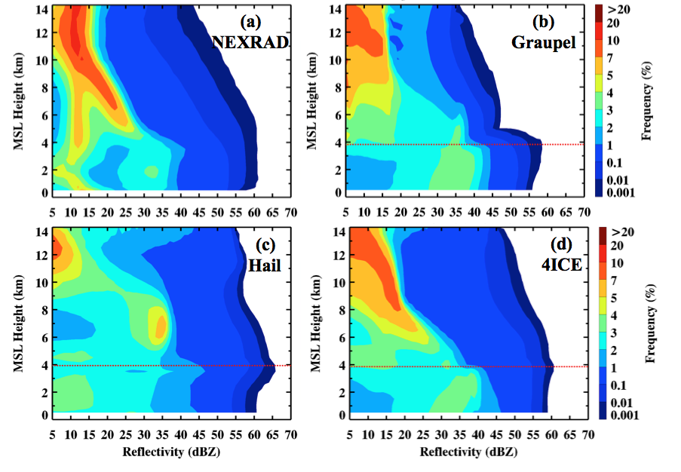
Contoured Frequency Altitude Diagrams (CFADs)
29

Slide 23
Convective Parameterizations
Convection cannot be resolved in most regional and global models (grid size 4 km or greater) and is considered a “sub-grid-scale process” that has to be parameterized in terms of grid-scale variables.
Convective parameterizations must account for static stability of the temperature profile, convective available potential energy (CAPE), convective inhibition (CIN), latent heat release during convection, entrainment of drier air into convection, evaporative cooling, liquid water load, and compensating subsidence.
Types of convective parameterizations:
Shallow convection scheme – Used for fair weather cumulus and stratocumulus
Deep convection scheme – Used for cumulus congestus and cumulonimbus convection

Slide 24
Deep Convective Parameterizations
Anthes-Kuo scheme – latent heat release dependent on horizontal moisture convergence
Betts-Miller scheme – convective adjustment scheme – temp and humidity profiles are nudged toward assumed post- convective profiles
Arakawa-Schubert and Grell schemes – destabilization due to large- scale forcing used to estimate the amount of latent heat by convection. Grell scheme assumes a single cloud; Arakawa- Schubert schemes assumes a population of clouds of different heights
Kain-Fritsch and Fritsch-Chappel schemes – magnitude and duration of convection needed to remove a specified fraction of CAPE from the model sounding

Slide 25
List of Convective Parameterization Schemes in WRF
Kain–Fritsch Scheme
Moisture–advection–based Trigger for Kain–Fritsch Cumulus Scheme
RH–dependent Additional Perturbation to option 1 for the Kain-Fritsch Scheme
Betts–Miller–Janjic Scheme
Grell–Freitas Ensemble Scheme
Old Simplified Arakawa–Schubert Scheme
Grell 3D Ensemble Scheme
Tiedtke Scheme
Zhang–McFarlane Scheme
New Simplified Arakawa–Schubert Scheme (Standard and for HWRF)
Grell–Devenyi (GD) Ensemble Scheme
Old Kain–Fritsch Scheme

Slide 26
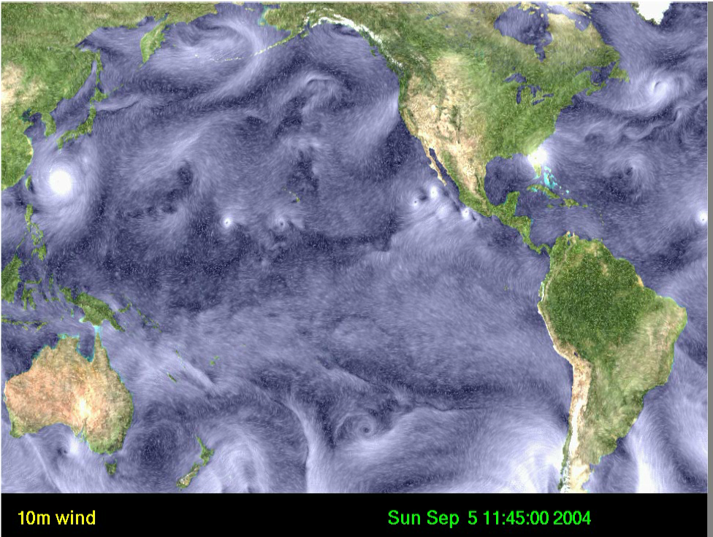
NASA Goddard MMF
Moist physics tendencies (T and q) Cloud and precipitation
Z => P
fvGCM
GCE
Z <= P
Large-scale forcing, Background profiles (T, q, u, v, w)
2D GCE has 64 x 32 (x-z) grid points with 4 km horizontal resolution
fvGCM and GCE coupling time is one hour
Interpolation between hybrid P (fvGCM) and Z (GCE) coordinate: using finite-volume Piecewise Parabolic Mapping (PPM) to conserve mass, momentum and moist static energy
37
Tao, W.-K., J. Chern, R. Atlas, D. Randall, X. Lin, M. Khairoutdinov, J._L. Li, D. E. Waliser, A. Hou, C. Peters-Lidard, W. Lau,J. Jiang and J. Simpson, 2009: Multi-scale modeling system: Development, applications and critical issues, Bull. Amer. Meteor. Soc. 90, 515-534.

Slide 27
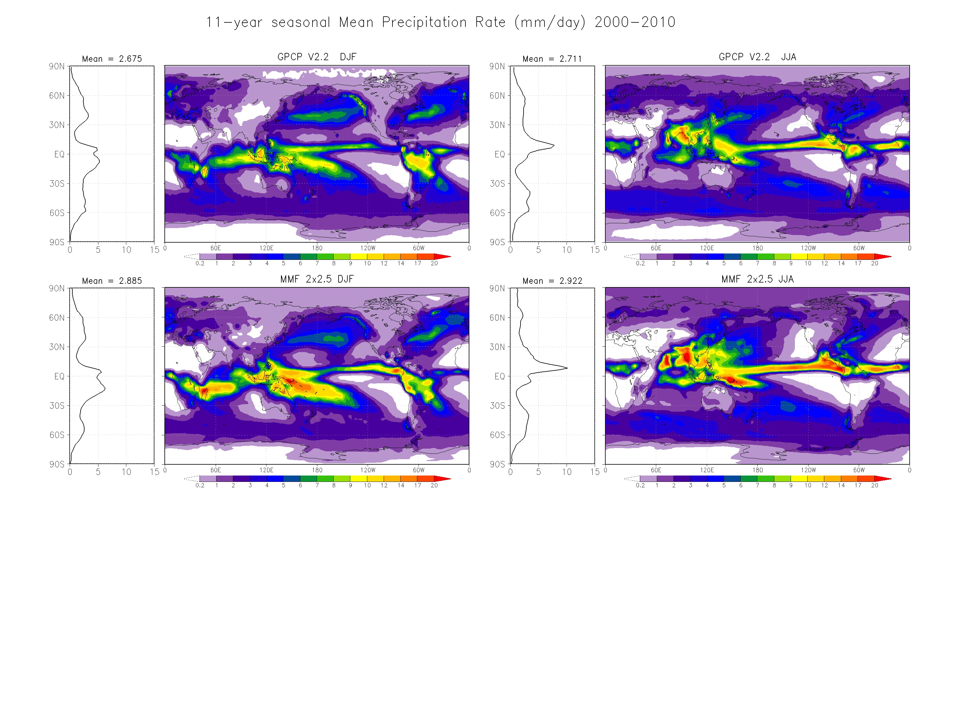
2.675
Winter
2.771
Summer
GPCP
13- year
1998-2011
2.885
2.922
Goddard
MMF
Seasonal changes in precipitation intensity, location and areal coverage over the West Pacific warm pool, Pacific and Atlantic ITCZs, South Pacific Convergence Zone (SPCZ), and Amazon are well captured. Excessive rainfall in JJA remains an issue in MMFs as same as high resolution GCMs-global cloud resolving Models
39

Slide 28

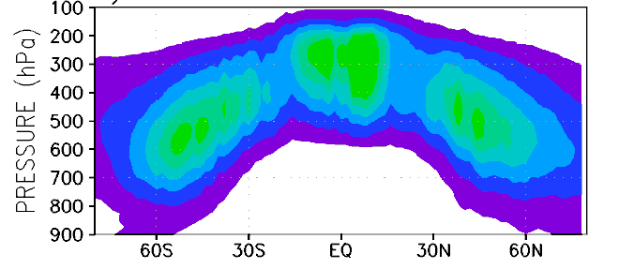
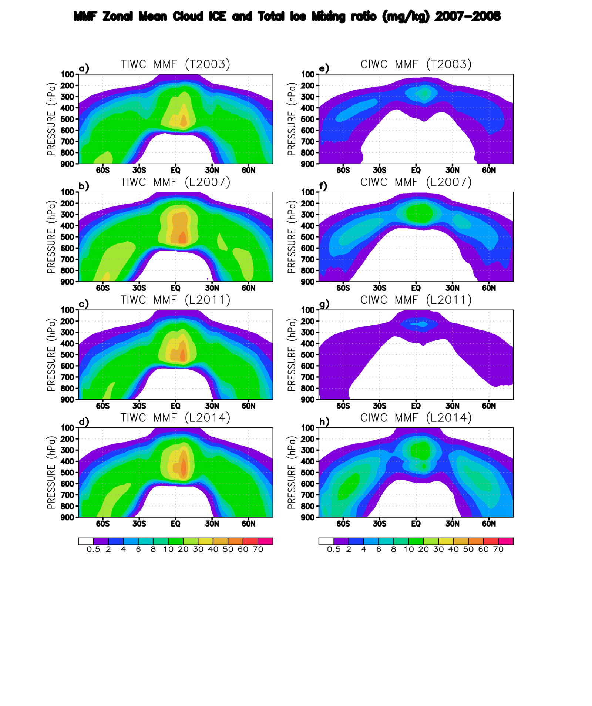
Global Cloud Ice in the Goddard MMF with Improved Microphysics
J.-D. Chern, W.-K. Tao, S. E. Lang, J., J.-L. Li, K. I. Mohr, G. M. Skofronick Jackson, C. D. Peters-Lidard
NASA GSFC Mesoscale Atmospheric Processes Laboratory
The Goddard MMF in conjunction with satellite observations is used for the rigorous evaluation and continued improvement of Goddard microphysics schemes. A series of 2-year (2007-2008) simulations performed with the Goddard MMF show that:
The new four-class (cloud ice, snow, graupel, and frozen drops/hail) ice scheme (4ICE) produces a better overall spatial distribution of cloud ice amount and cloud radiative forcing than earlier three-class ice schemes (3ICE), with biases within the observational uncertainties.
The improvement of 4ICE scheme is due to many microphysics upgrades not through model parameters tunings. The scheme is suitable for all local (i.e. GCE), regional (i.e. NU-WRF), and global cloud-resolving models with the same sets of model parameters.
The Goddard MMF provides a unique and computationally feasible platform for stringent model evaluation and parameter optimization for global cloud-resolving models.
CloudSat 2C-ICE
MMF with 3ICE scheme
MMF with 4ICE scheme
Chern, J.-D., W.-K. Tao, S.E.Lang, J.-L. F. Li, K. I. Mohr, G. M. Skofronick-Jackson, and C. D. Peters-Lidard, 2015: Performance of the Goddard Multiscale Modeling Framework with Goddard microphysical schemes. J. Adv. Model. Earth Syst. (Submitted).
Annual zonal mean cloud ice mixing ratio (10⁻⁶ g g⁻¹) from the CloudSat 2C-ICE estimates and GMMF simulations with Goddard 3ICE and 4ICE microphysics.
41

Slide 29
Chemical Tracers
Trace gases with chemical lifetimes considerably longer than the time scale of convection (20 min to several hours) can be used as tracers of convective transport.
- can be used to diagnose the validity of a cloud model simulation
- can be used to study transport patterns within convective storms (updrafts, downdrafts, entrainment, detrainment, etc.)
Commonly used tracers: CO, O₃, ethane, propane
Can be run in GCE or WRF as inert tracers or in WRF-Chem as reactive species within the chemistry mechanism
Initial profiles specified from aircraft observations in field programs or from
3-D fields from a larger-scale chemical transport model

Slide 30
Observations and Models
Combination of observations and model simulations is a powerful tool to better understand physical and chemical processes in thunderstorms
Convection/chemistry field experiments (the last 30 years):
PRESTORM – OK, KS 1985
ABLE-2A – Brazil 1985
ABLE-2B – Brazil 1987
STEP – Australia 1987
NDTE – North Dakota 1989
TRACE-A – Brazil 1992
STERAO – Colorado 1996
EULINOX – Germany 1998
CRYSTAL-FACE – Florida 2002
TROCCINOX – Brazil 2005
SCOUT-O3/ACTIVE – Australia 2005
AMMA – West Africa 2006
TC4 – Costa Rica 2007
DC3 – Central and SE US 2012
GoAmazon – Brazil 2014

Slide 31
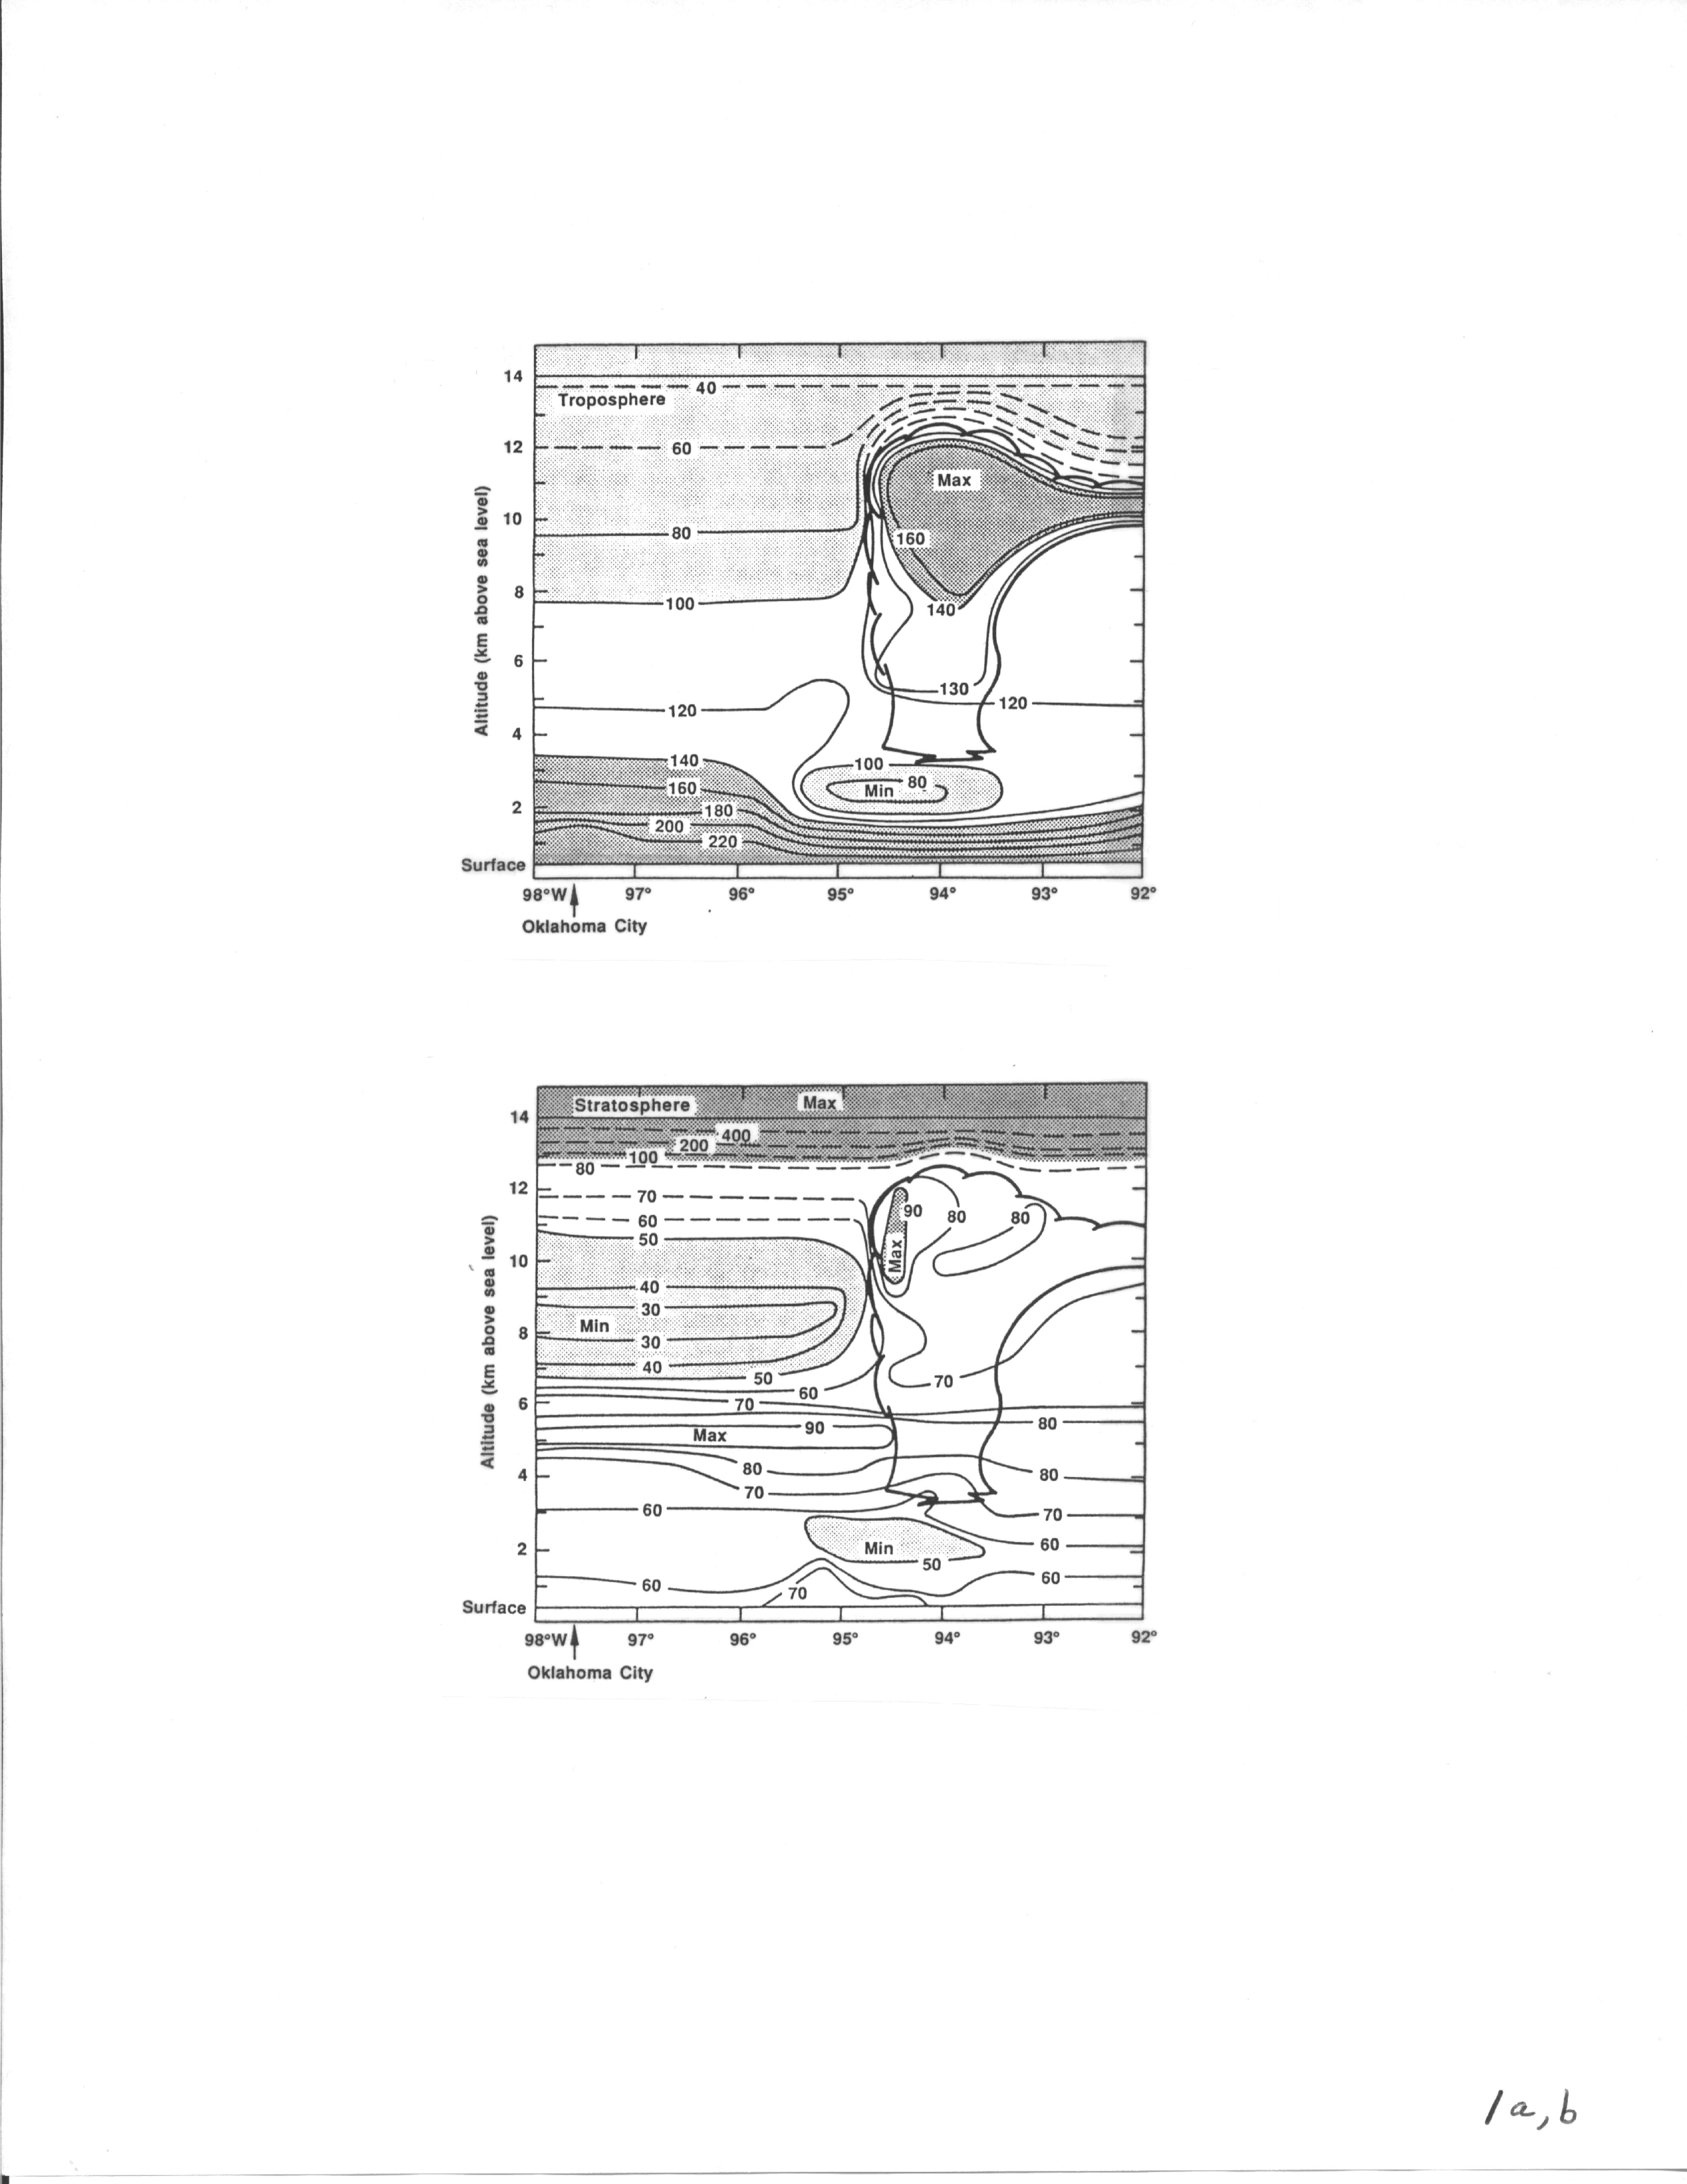
Aircraft Measurements of Trace Gas Redistribution in
Oklahoma PRESTORM June 15, 1985 MCC
CO
O₃
Dickerson et al., 1987, Science

Slide 32
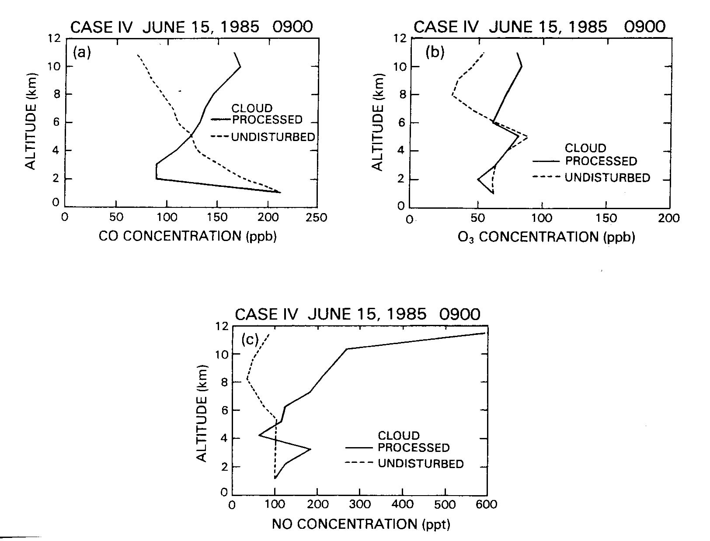
Pickering et al., 1990

Slide 33
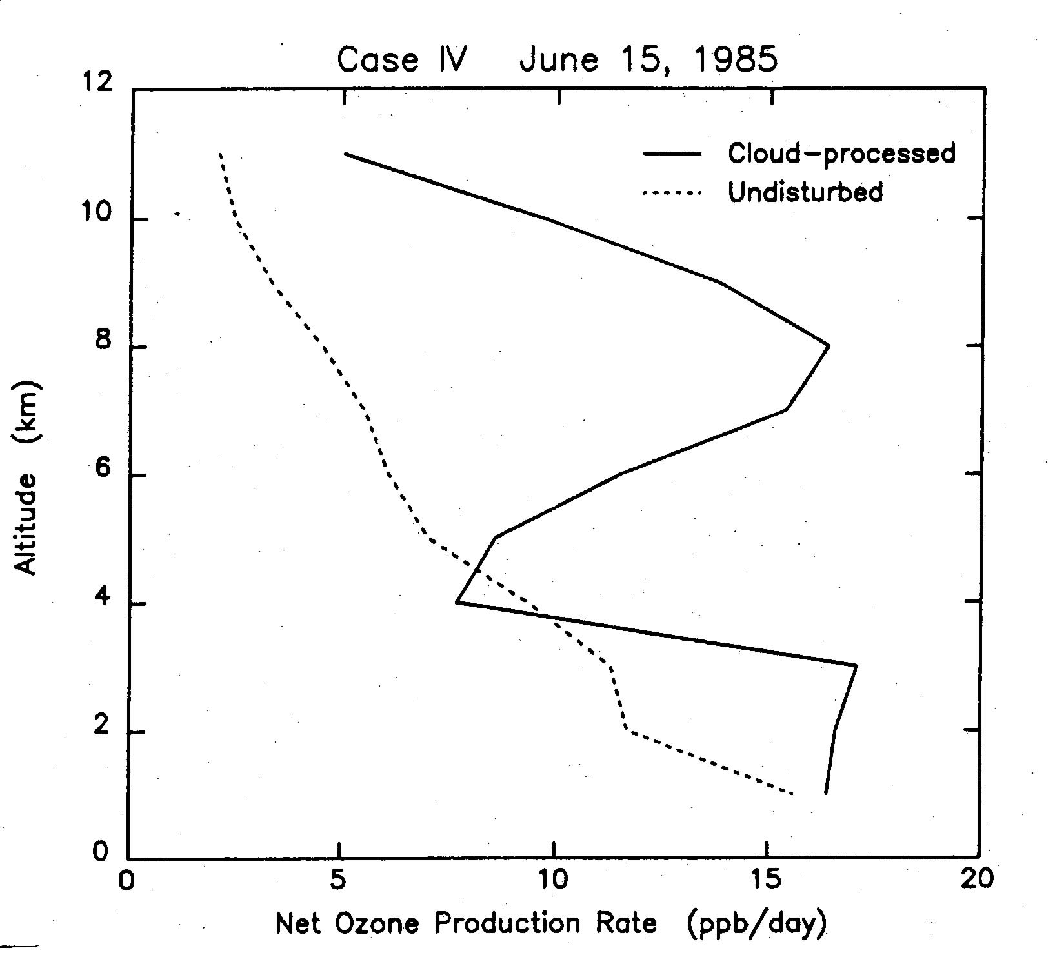
Pickering et al., 1990
Mid – upper trop. ozone production
enhanced by factor of 4
Convection plays a major role in modulating upper tropospheric ozone;
Greenhouse forcing by trop ozone maximizes in this region

Slide 34
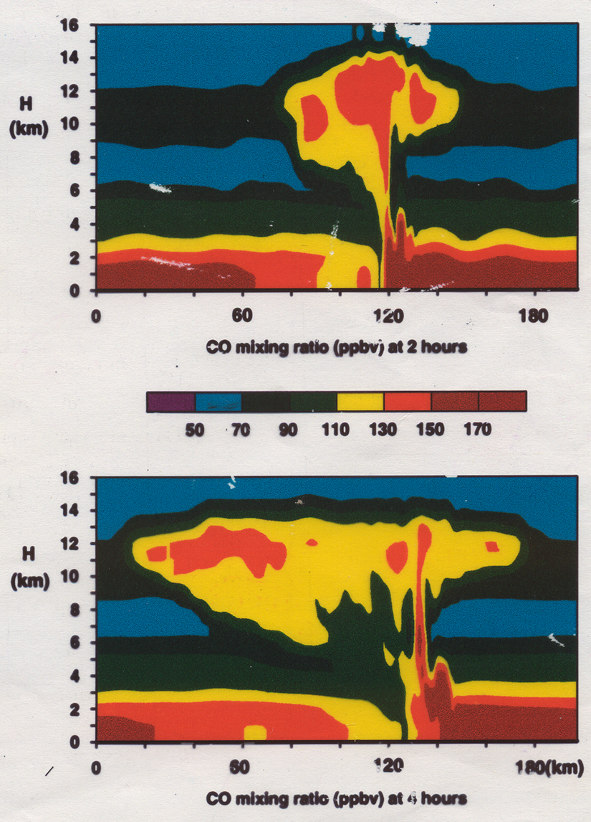
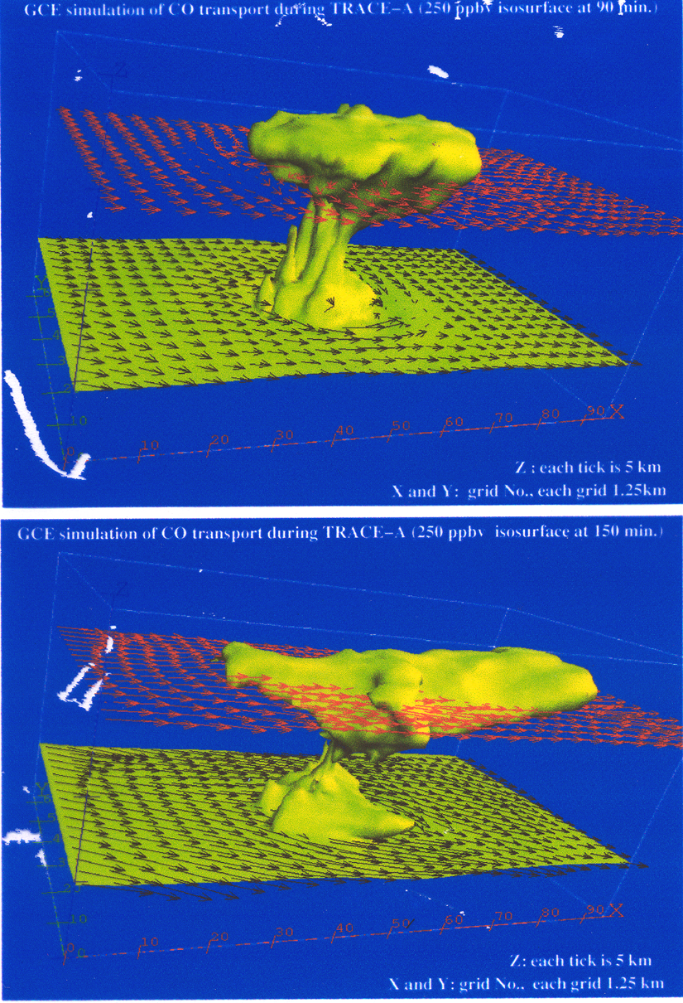
Inert Tracer Calculation - June 10-11, 1985 Squall Line
The 3D GCE model-generated wind fields were used to redistribute the mixing ratios of CO and O₃, which were assumed to act as conserved tracers during the period of convective mixing.

Slide 35
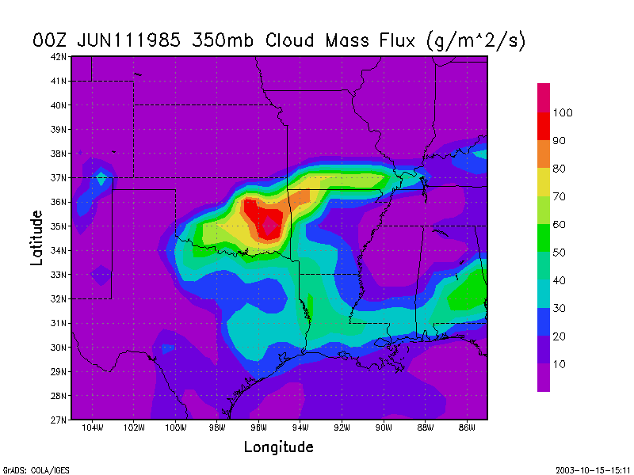
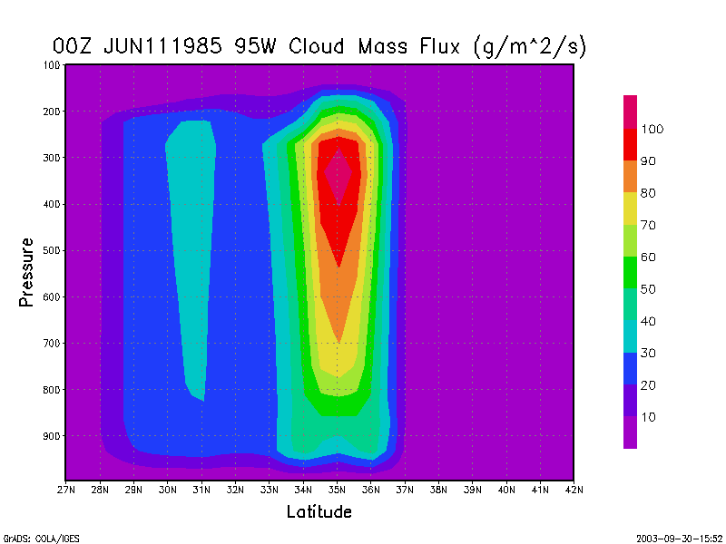
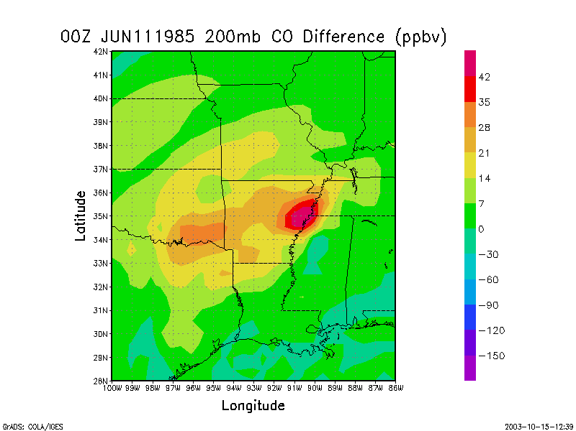
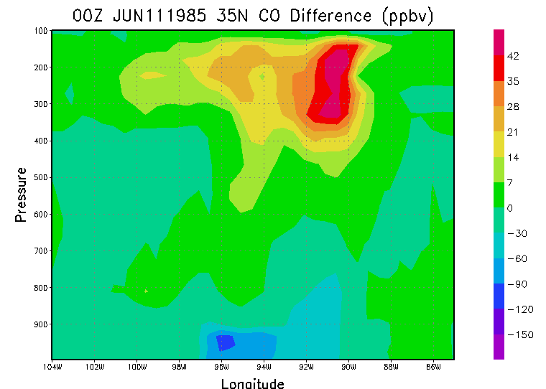
UMD-CTM Stretched-Grid with 0.5 degree resolution – Uses Relaxed Arakawa-Schubert Convection Scheme
Park
et al.,
2004

Slide 36
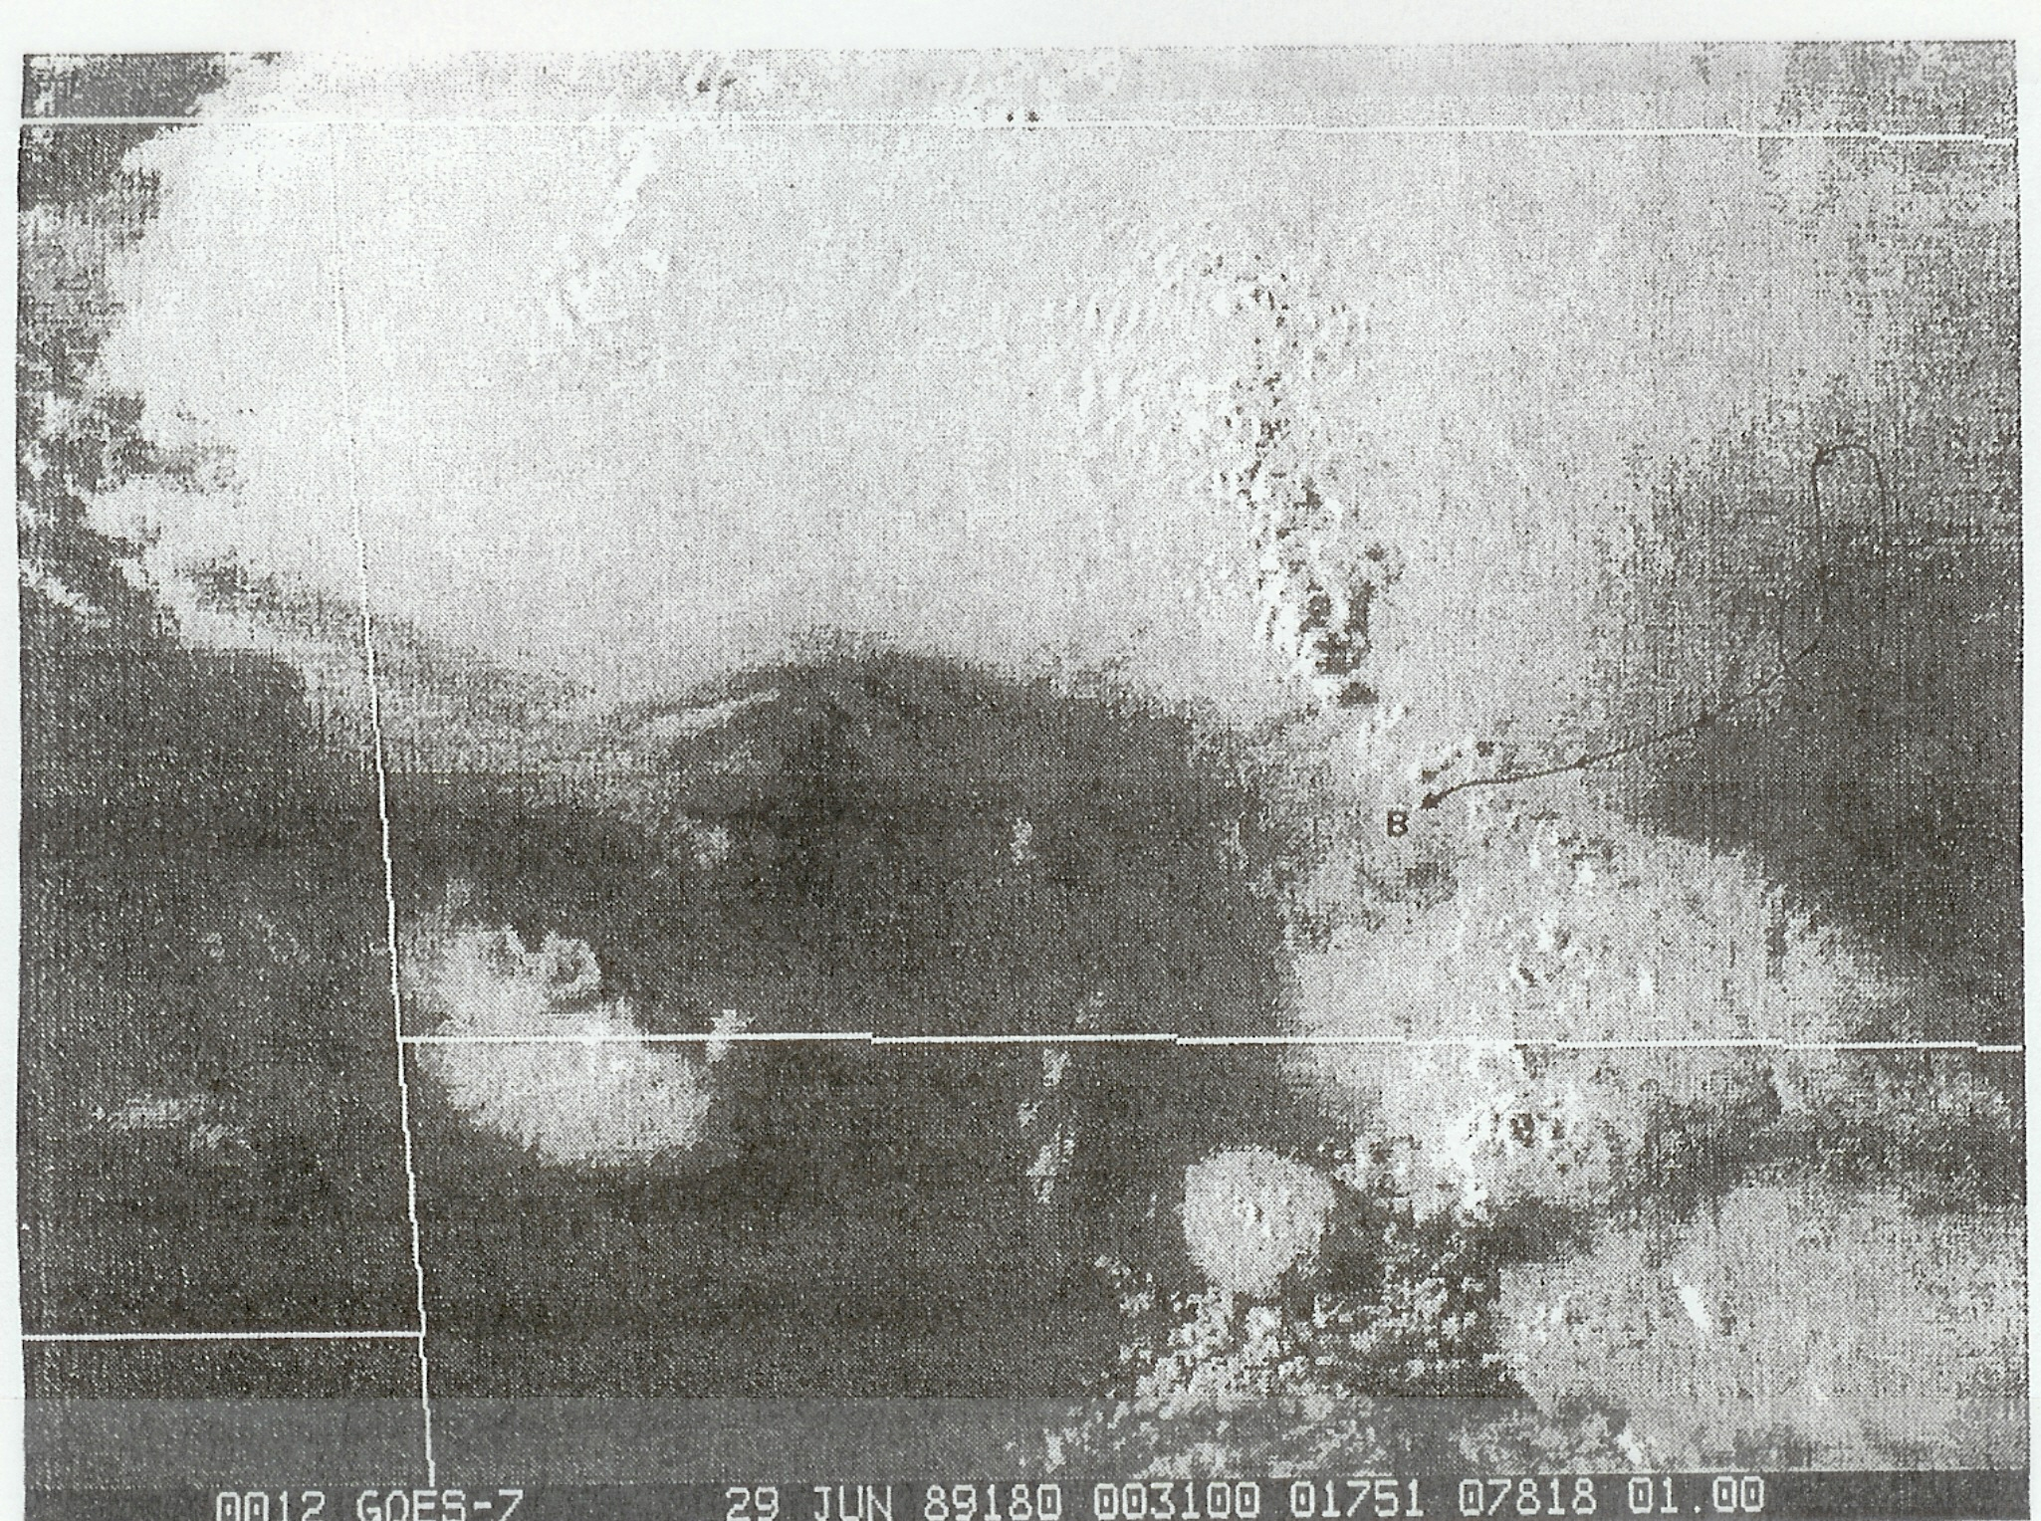
ND
SD
North Dakota Thunderstorm Experiment

Slide 37
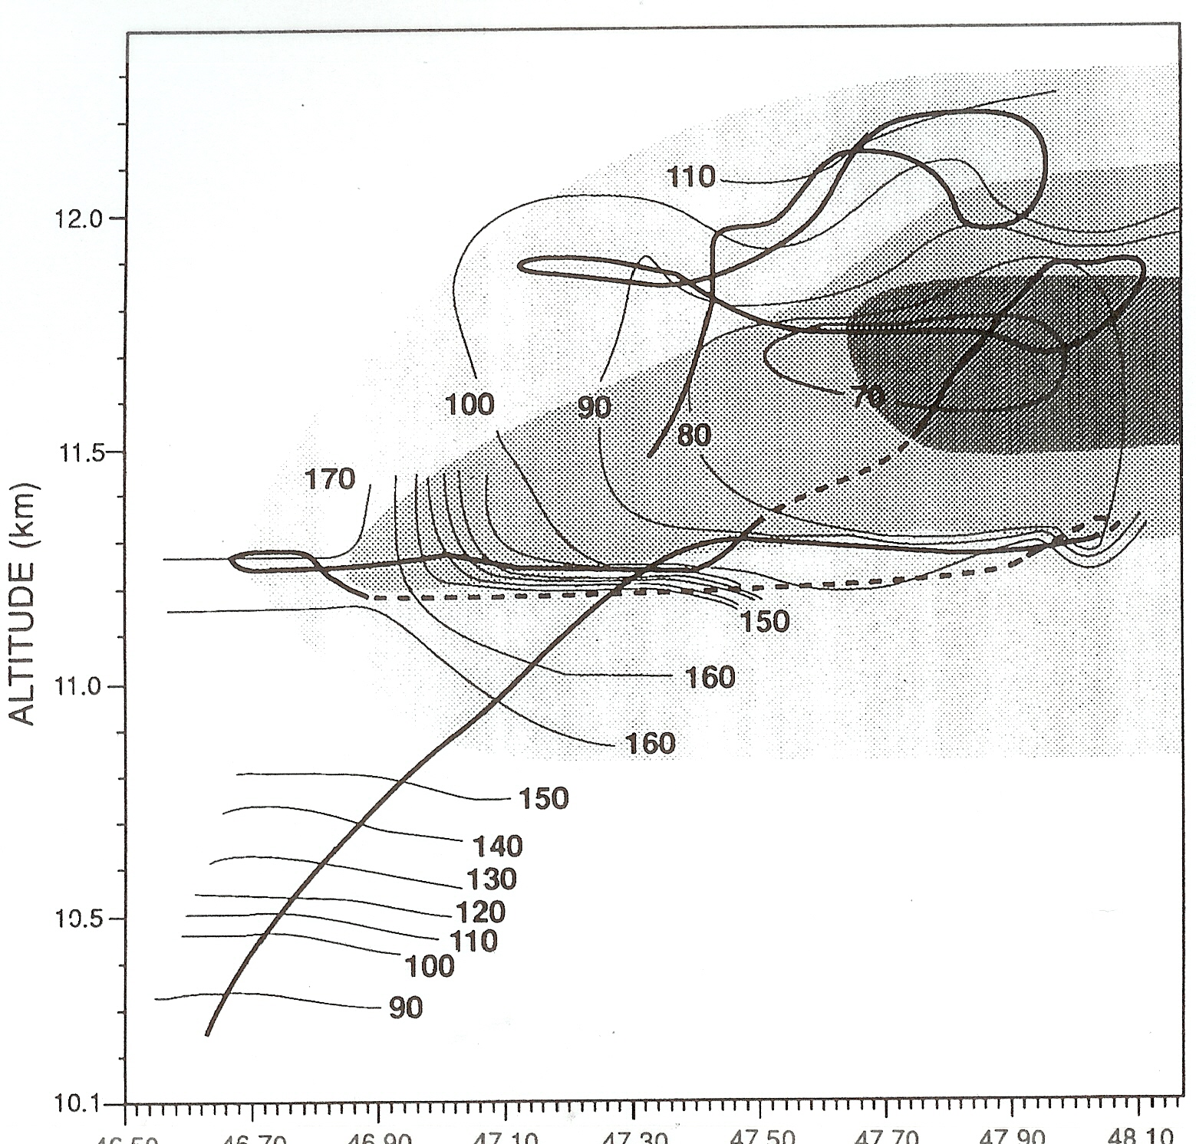
North Dakota Thunderstorm Experiment – July 28, 1989
Ozone
Preconvective tropopause
Poulida et al., 1996

Slide 38
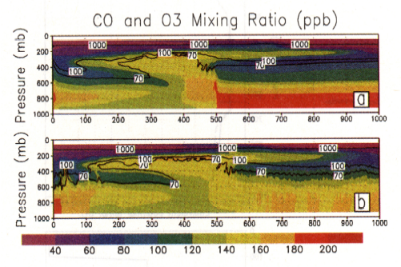
CO and O₃ Tracer Simulation for June 28, 1989 NDTP storm
CO – color scale; O₃ – isolines
(a) base simulation; (b) moist boundary condition simulation
Note downward ozone transport near
rear anvil
Stenchikov et al. (1996)

Slide 39
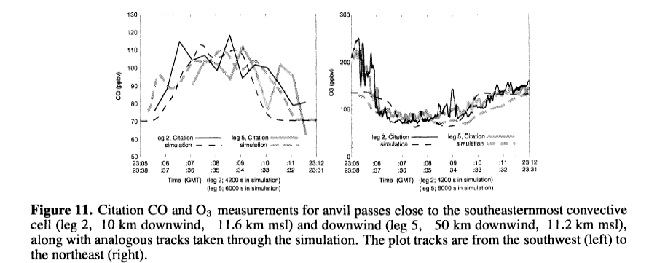
CO and O₃ Tracers Along Anvil Passes for July 10, 1996 STERAO storm
Note enhanced ozone at southwest (upwind)
edge of anvil
Skamarock et al. (2000)

Slide 40
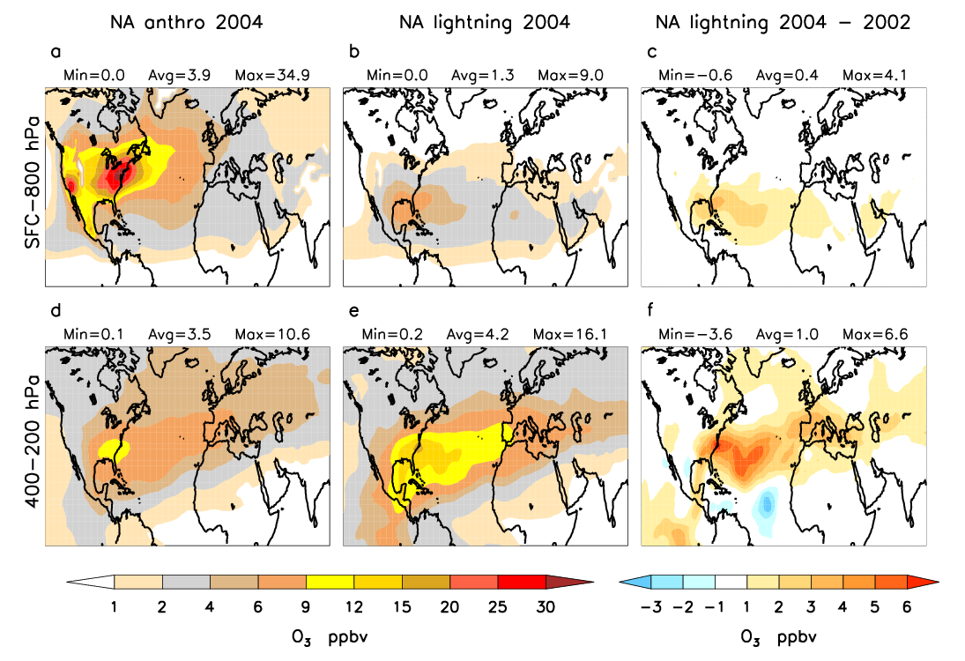
Ozone Export from North America – Early Summer
Martini et al., 2010

Slide 41
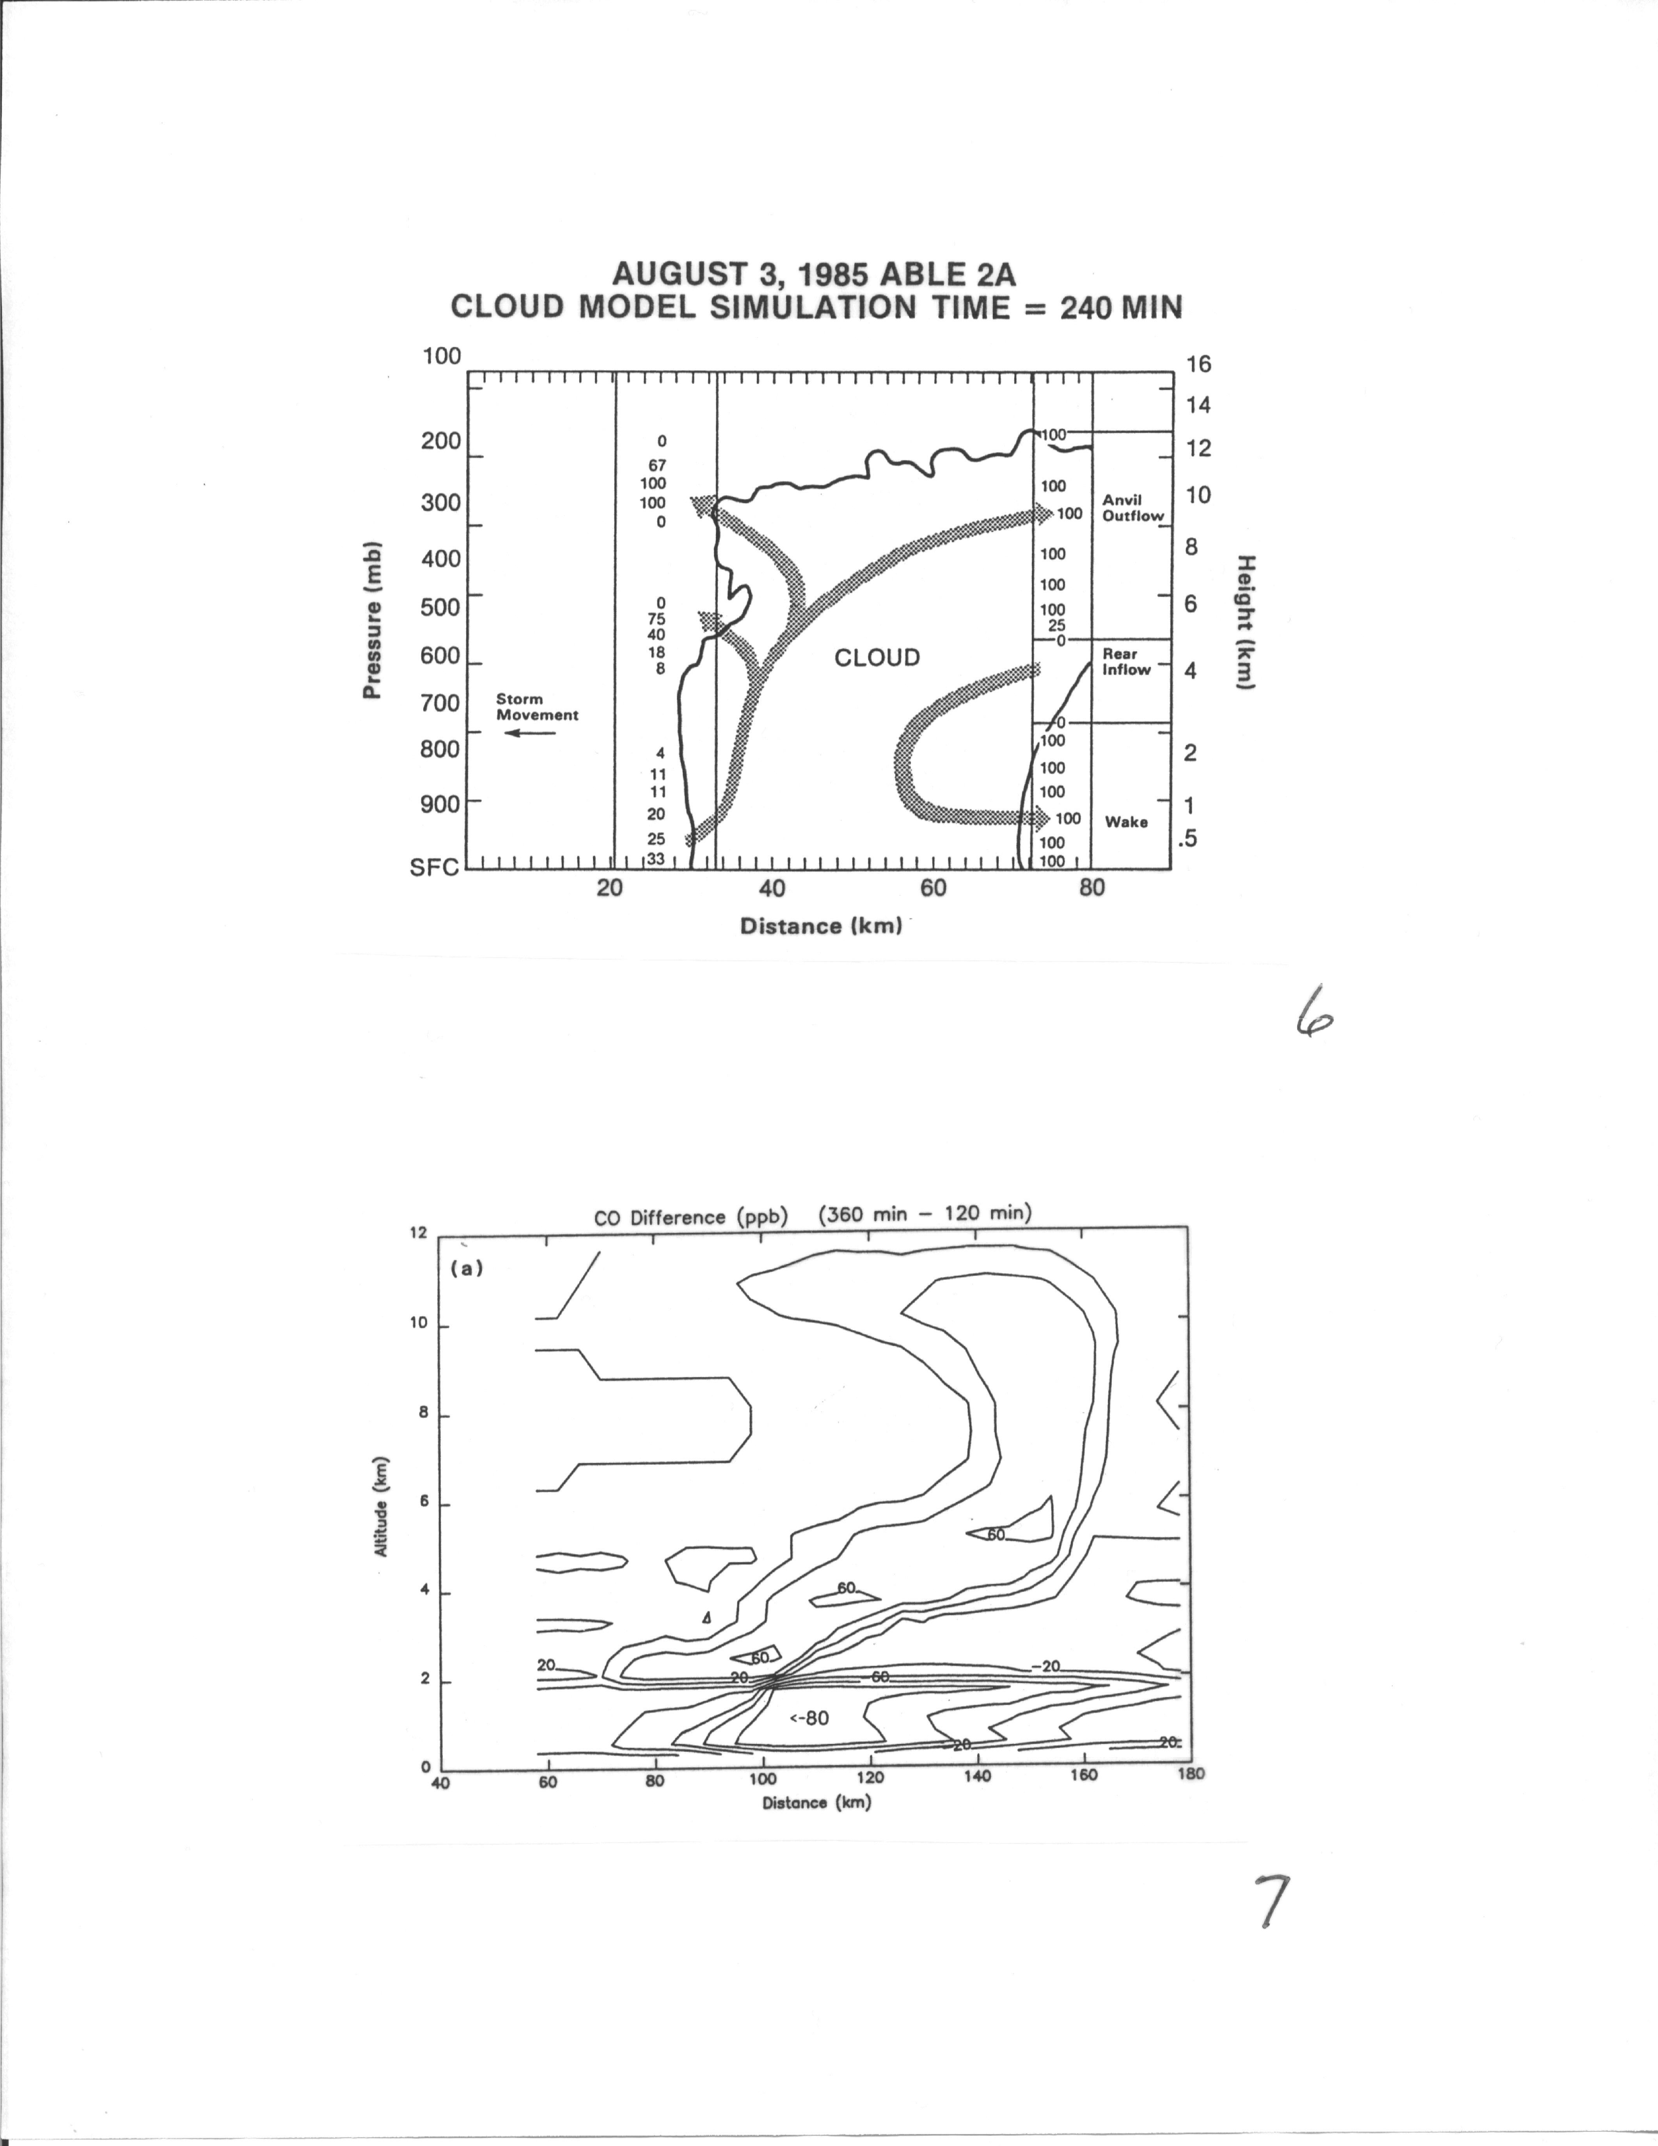
Tropical squall
line over Amazon
Basin
Arrows indicate
major transport paths
Columns of numbers
indicate percentage
of air at these
locations that is cloud
outflow based on
trajectory analysis
Dry Season
Pickering et al, 1991
CO redistribution
from biomass burning
plume

Slide 42
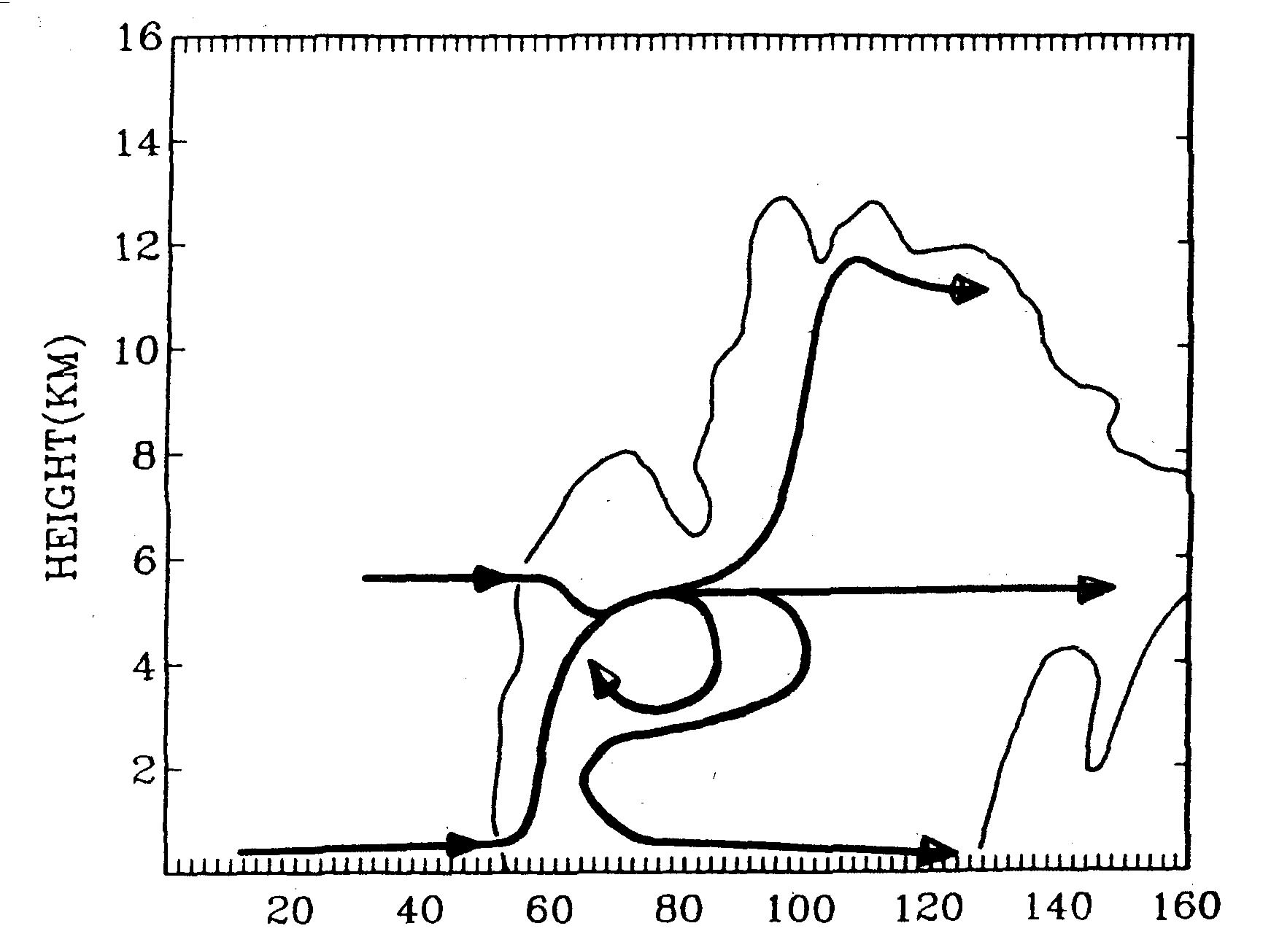
ABLE-2B April 26, 1987 Brazil Squall Line
Arrows indicate
major transport
pathways
Wet Season
Scala et al., 1990

Slide 43
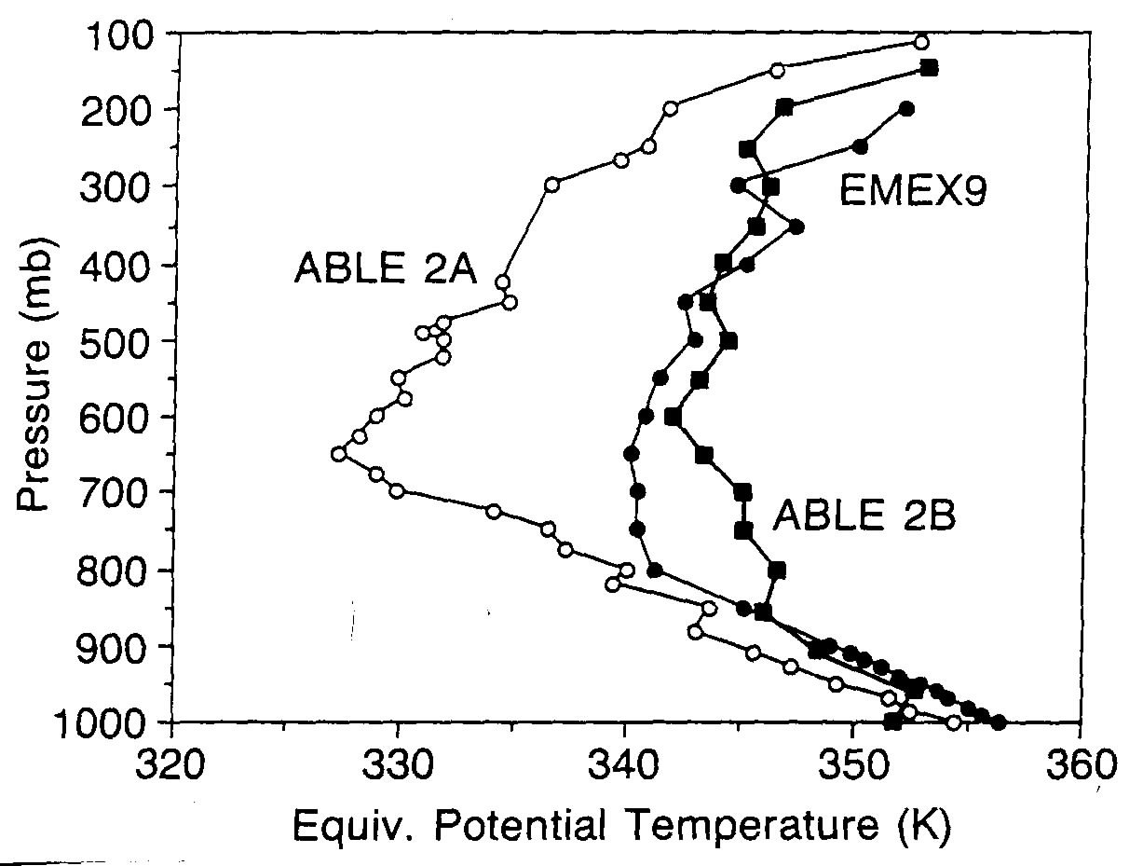
Darwin, Aus.
Monsoon
Dry season
Brazil
Wet season
Brazil
More vigorous vertical transport
of tracers with strong theta-e min.
Pickering et al., 1993

Slide 44
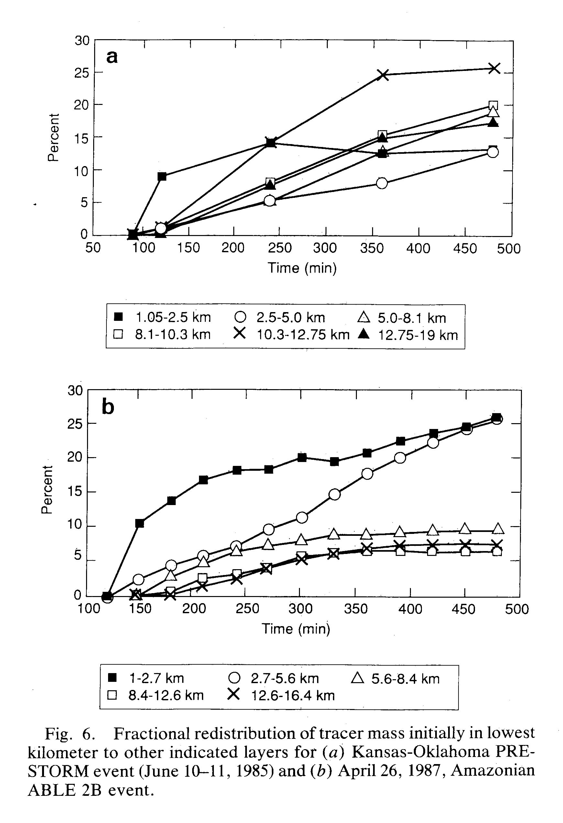
PRESTORM
June 10-11
ABLE 2B
Weak vertical transport
to upper troposphere due
to midlevel overturning
April 26
Pickering et al., 1992

Slide 45
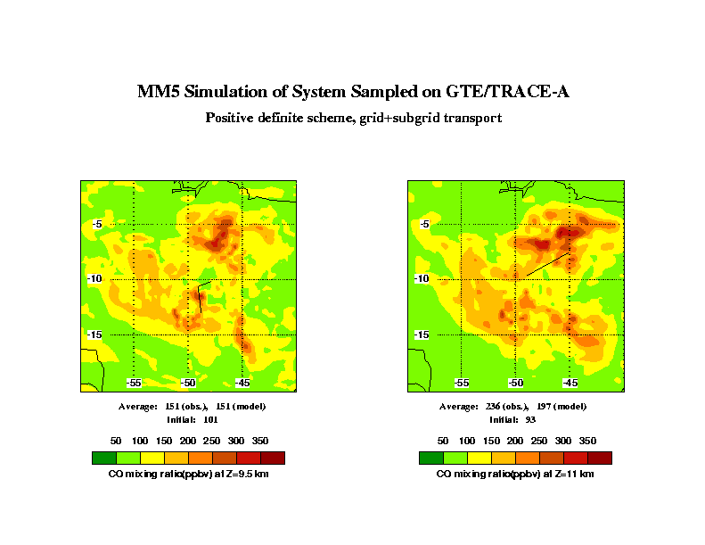
Convective Transport of Biomass Burning Emissions over Brazil
Kain-Fritsch Convective Parameterization
9.5 km
11 km
Comparison of model
with DC-8 observations
along sampling tracks
(thin lines)
Pickering et al., 1996

Slide 46
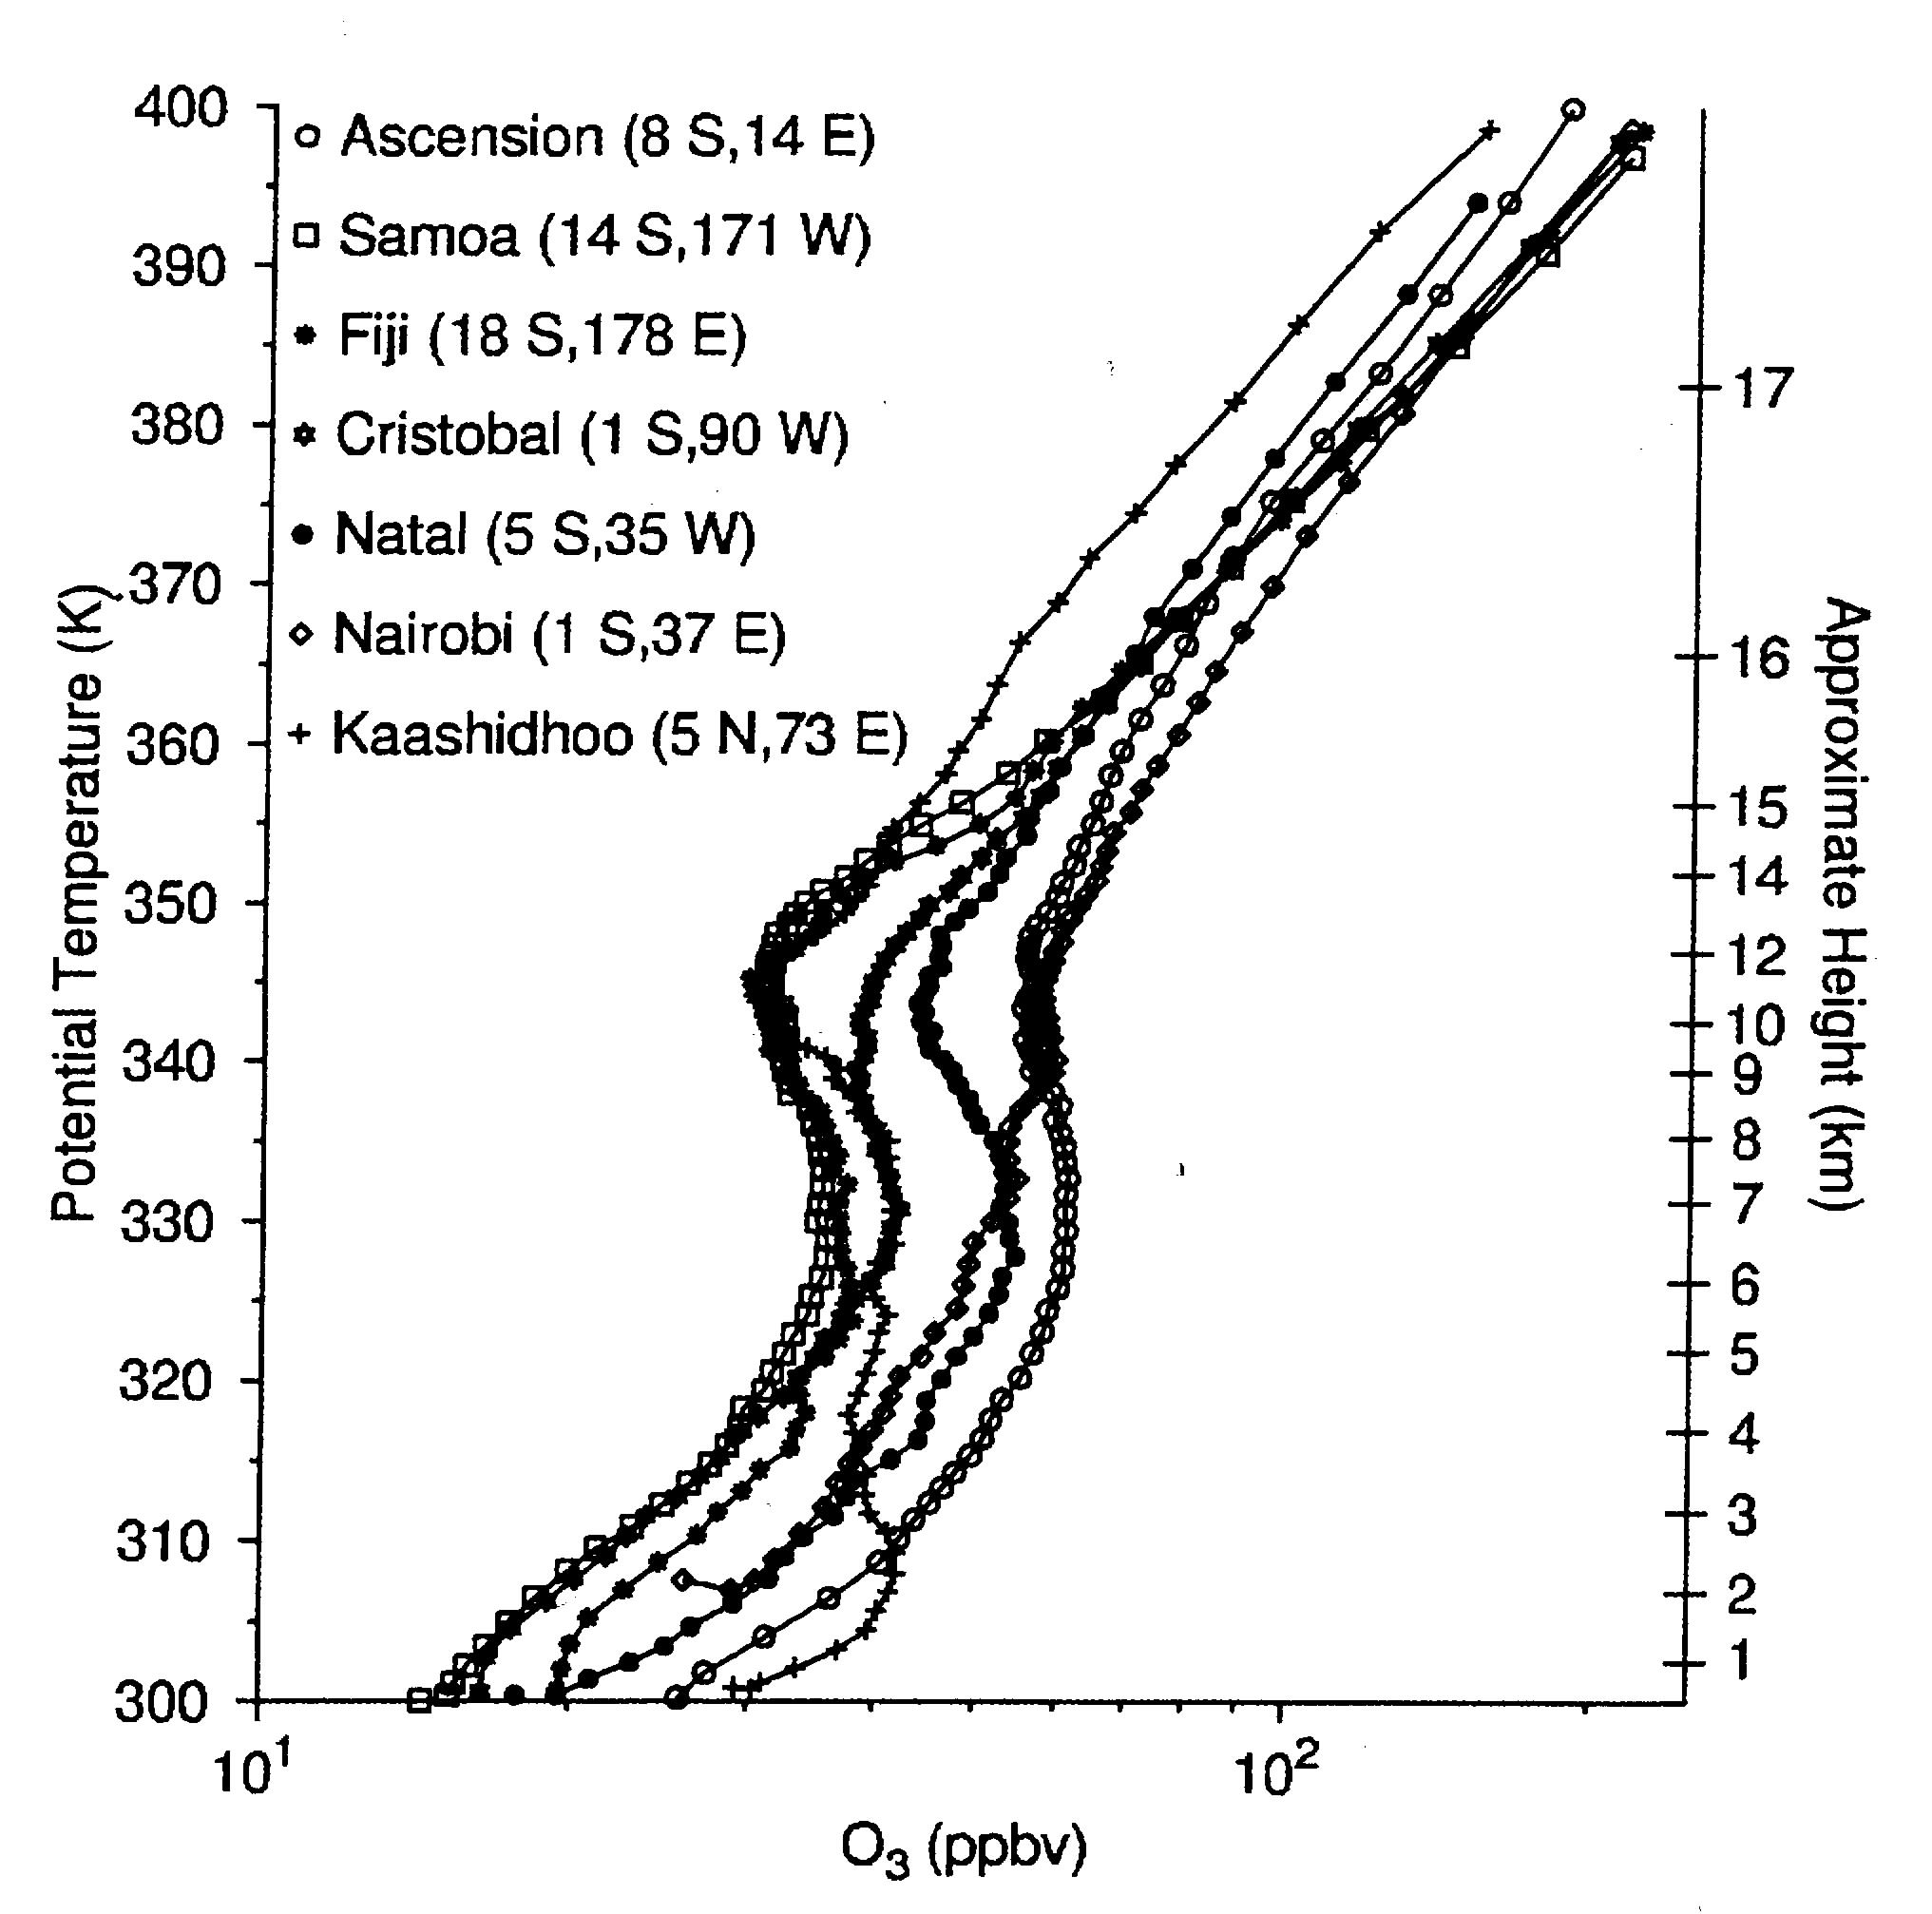
Note ozone minimum at 12 km
resulting from convective outflow
Folkins et al., 2002

Slide 47
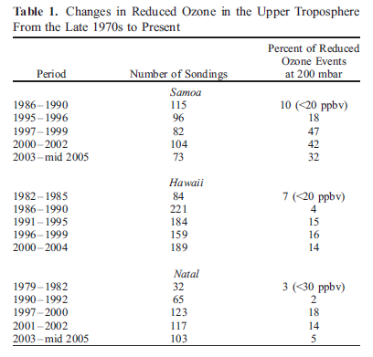

Low Ozone Events in UT Indicative of Convective Frequency
1998 - 2004
Increases in frequency of low ozone events
in the UT in the mid to late 1990s
suggest increased convection
Solomon et al., 2005

Slide 48

Physics:
Cu parameterization:
Kain-Fritsch scheme (for the outer grid only)
Cloud microphysics:
Goddard microphysics 3ice-Graupel
Radiation:
New Goddard radiation scheme for both longwave and shortwave
PBL parameterization:
Mellor-Yamada-Janjic TKE scheme
Surface Layer:
Monin-Obukhov (Janjic)
Land Surface Model:
Land Information System (LIS)
AMMA WRF Simulations
Resolutions: 18, 6 and 2 km
Grid size: 391x271, 424x412, 466x466, and 61 vertical layers
Δt = 18 seconds
Starting time: 00Z 08/06/2006
Initial and Boundary Conditions:
GEOS-5/MERRA; no data assimilation

Slide 49

How can we compare aircraft observations with global model output?
CO in global model
grid cell
~ 100-200 km
???
Simulate storm using
cloud resolving model,
compare results with obs
Compare CRM and
Global model results
Average CO over CRM
domain
Ott et al., 2009,JAS
Notes:
But these aircraft observations present a difficult challenge when we're talking about global models. These observations are typically made every 1 second or two which translates into a resolution of maybe a quarter kilometer, while a grid cell in a global model is typically on the order of a few hundred kilometers across. And some of these observations are in the cloud where we would expect to find enhanced mixing ratios of species emitted in the boundary layer, while some observations are outside the cloud. In other words, its difficult to compare aircraft observations and a column from a global model because we don't know how representative of the column the observations are.
One way around this dilemma is to use cloud cloud-resolving models as an intermediate step. Cloud resolving models, or CRMS, are typically run at a resolution of 1 or 2 km, so they are able to resolve individual clouds, as well as the updraft and downdraft structure within the storm. Because we can see the cloud in a cloud resolving model, we can sample the area in the domain that best matches the way the observations were taken. For example, in some field projects, aircraft observations are taken mainly in the anvil region, while in others the aircraft flies near the core updraft region. A cloud resolving model allows us to sample the region that best matches the area where observations were taken.
Once we have compared the cloud-resolving simulation with observations to make sure that the storm produced by the CRM gives a reasonable representation of convective transport, we can average over the domain, in-cloud and out, and compare the results with a grid column from a global model. In this way, we can test the convection and transport in the global model against a detailed, reasonable representation of convection from a cloud-resolving model.

Slide 50
Evaluation Procedures
Select specific events from convective field experiments to simulate tracer transport in detail using a cloud-resolved model (Weather Research and Forecast (WRF) model)
AMMA – West Africa, August 2006
Initialize WRF with profiles of chemical tracers based on aircraft observations in air undisturbed by convection
Observations described by Huntrieser et al. (2011, ACP)
Simulate tracer transport in same events using Single Column Model (SCM) option of GEOS-5 Fortuna 2.1 (forced by MERRA)
Evaluate SCM tracer using storm-averaged WRF tracer results
Adjust RAS parameters to improve agreement

Slide 51




MERRA-LIS
Box 1
Box 2

Slide 52

WRF with MERRA/LIS
initial and boundary conditions

Slide 53


Evaluation of Parameterized Convective Transport
in the Offline NASA Global Modeling Initiative (GMI)
Chemistry and Transport Model
GMI CTM driven
by GEOS-4 DAS
with Zhang and
McFarlane convective
parameterization
GMI CTM driven
by GEOS-5 DAS
with Relaxed Arakawa-
Schubert convective
parameterization
NASA DC-8 data from TC4 flight matched in time and with nearest grid cell
in GMI model with deep convection
T. Lyons

Slide 54
Lightning NO Production
How much NO is produced per cloud-to-ground (CG) flash and per intracloud (IC) flash? Or per meter of flash length?
Varies over two orders of magnitude
How are lightning channels distributed throughout a storm?
Some indication of bimodal distribution in the vertical
How is the NO distributed in the vertical at the end of the storm?
Mostly in middle and upper troposphere

Slide 55
How many flashes occur globally?
Satellite observations indicate ~44 flashes/s
How are the flashes distributed geographically?
At least 75% occur over continents
What is the IC/CG flash number ratio, and how does it vary from storm to storm?
Over continental U.S. annual mean varies from ~1.5 to ~10, with mean ~3
What is the global annual production ?
Literature estimates range from 2-20 Tg/yr
in the most recent decade, but 2-8 Tg/yr appears most likely
Notes:
75

Slide 56

Cloud/Chemistry Modeling Approach
Or 3-D field from larger-
scale model
GCE – Goddard Cumulus Ensemble Model, Tao et al. (2001)
CSCTM – Cloud-Scale Chemical Transport Model, DeCaria et al. (2005)

Slide 57

July 12, 1996 STERAO-A Storm – NE Colorado

Slide 58

July 12, 1996 – STERAO-A
CG: 460
CG: 460
IC:46
IC: 345
Moles NO
Alpha = 0.75
Per Flash
Alpha = 0.1
CG: 460
CG: 460
IC: 460
IC: 690
Alpha = 1.0
Alpha = 1.5
Model-simulated vs. Measured NOx Profiles
For Four Lightning NO Production Scenarios
DeCaria et al. (2005)

Slide 59

NASA CRYSTAL-FACE

Slide 60



From MM5 simulation run at 2-km horiz. res.
Total of 5651 CG flashes
over life of storm
Output from UMD CSCTM
driven by cloud-resolved MM5
simulation
CRYSTAL-FACE
South Florida
July 29, 2002
Notes:
So now I’m going to show some plots from the MM5 simulation of the storm. This is a plot of radar reflectivity at 1km. Convection began along the coast about three hours earlier than observed, which explains why this plot is for 1430, when the storm actually began around 17 UT.

Slide 61

CRYSTAL-FACE
IC/CG = 5
P_{CG} = 590 moles/fl
P_{IC} = 354 moles/fl
Model
Ridley NO obs. + PSS NO₂
Ridley NO obs. + PSS NO₂
& j(NO₂) x 2

Slide 62

Hector Storm Nov. 16, 2005 SCOUT-O3/ACTIVE
Satellite-observed Anvil
& Flight Tracks
WRF Simulation
Cummings et al., 2013

Slide 63


Hector Storm Simulation – Nov. 16, 2005
WRF-Chem Simulation with 500 moles NOx/flash
Mean Egrett anvil observation: 845 pptv
Mean Simulated NOx: 834 pptv
Mean Simulated NOx: 811 pptv
Cummings et al., 2013

Slide 64



Deep Convective Clouds and Chemistry – DC3
May/June 2012

Slide 65
Effects of Deep Convection
Convection over “Polluted Regions”
- Venting of boundary layer pollution
- Transport of NO_{x}, NMHCs, CO, and HO_{x} precursors to the upper troposphere (UT) and sometimes to the lower stratosphere (LS), where chemical lifetimes are longer and wind speeds greater
- Downward transport of cleaner air to PBL
- Transported pollutants allow efficient ozone production in UT, resulting in enhanced UT ozone over broad regions
NO + HO₂ → NO₂ + OH
NO₂ + hʋ → NO + O*
O₂ + O* + M → O₃ + M
- Increased potential for intercontinental transport
- Enhanced radiative forcing by ozone

Slide 66
Effects of Deep Convection
Convection over “Clean” Regions
In remote regions low values of PBL O₃ and NO_{x} are transported to the upper troposphere
Potential for decreased ozone production in UT
Larger values of these species tranported downward to PBL where they can more readily be destroyed
Convection over all Regions
- Lightning production of NO (much more over land)
- Perturbation of photolysis rates
- Effective wet scavenging of soluble species
- Nucleation of particles in convective outflow

