Slide 1
Anomalously low free-tropospheric ozone in the NH starting 2020 during the Covid pandemic and continuing: Impact on trends Jerry R. Ziemke, Natalya A. Kramarova, Stacey M. Frith NASA Goddard Space Flight Center Code 614
Quadrennial Ozone Symposium, Boulder, CO 14-19 July 2024

Slide 2
Main Issues
Covid-19 lockdowns resulted in reduced free-tropospheric ozone (by 5-15%) throughout the NH in year 2020 - many papers!
Now: Satellite products indicate anomalous low free-tropospheric ozone in the NH has continued four consecutive years (2020-2023)
Due to Meteorology? MLS lower stratospheric ozone is anomalously low for 2020-2023 in both hemispheres (models suggest 25%-33% drop in free-tropospheric ozone in year 2020 due to influx of very low stratospheric ozone)
Due to reduced anthropogenic sources? (OMI tropospheric NO2 is anomalously low for 2020-2023 in NH)

Slide 3
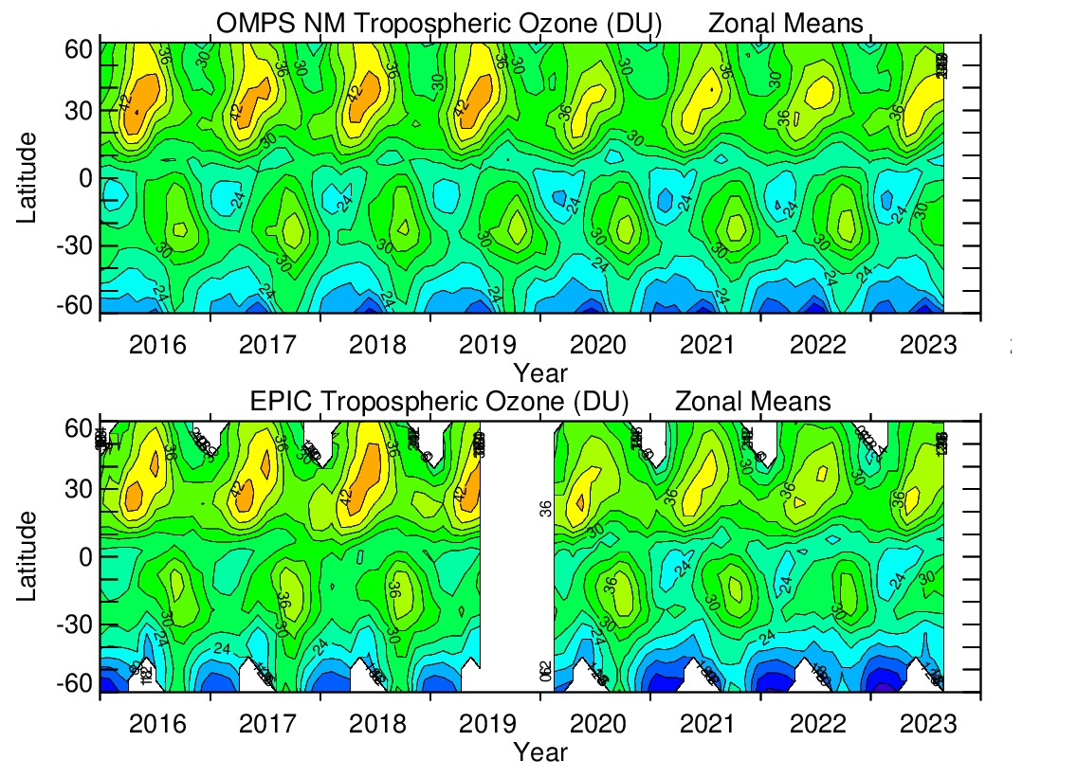
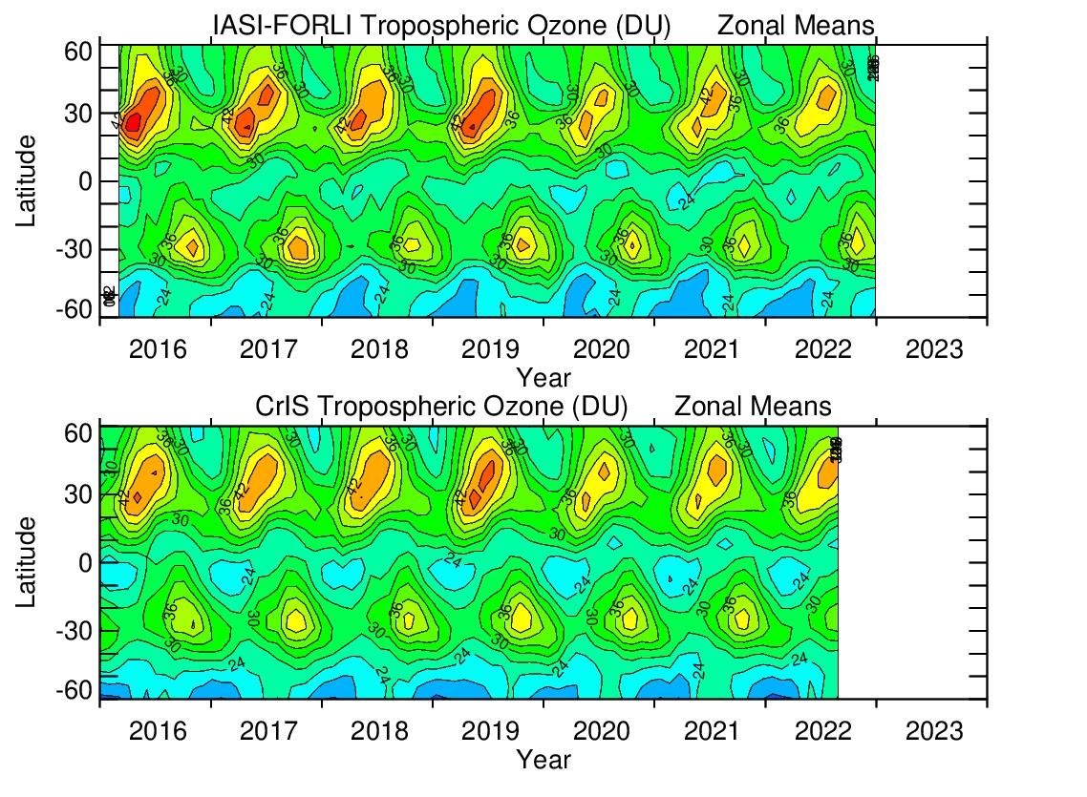
Tropospheric Column Ozone from Satellite: ~2-3 DU drop for 2020-2024 Compared to pre-Covid
TOARII (Tropospheric Ozone Assessment Report II) Satellite Tropospheric Ozone Data:
OMPS and EPIC: Code 614, NASA GSFC, 2024 IASI-SOFRID: B. Barret, E. Le Flochmoen, et al., 2024
IASI-GOME2: E. Cuesta et al., 2024 IASI-FORLI: C. Wespes, et al., 2024 CrIS: N. Smith, C. Barnet, et al., 2024

Slide 4
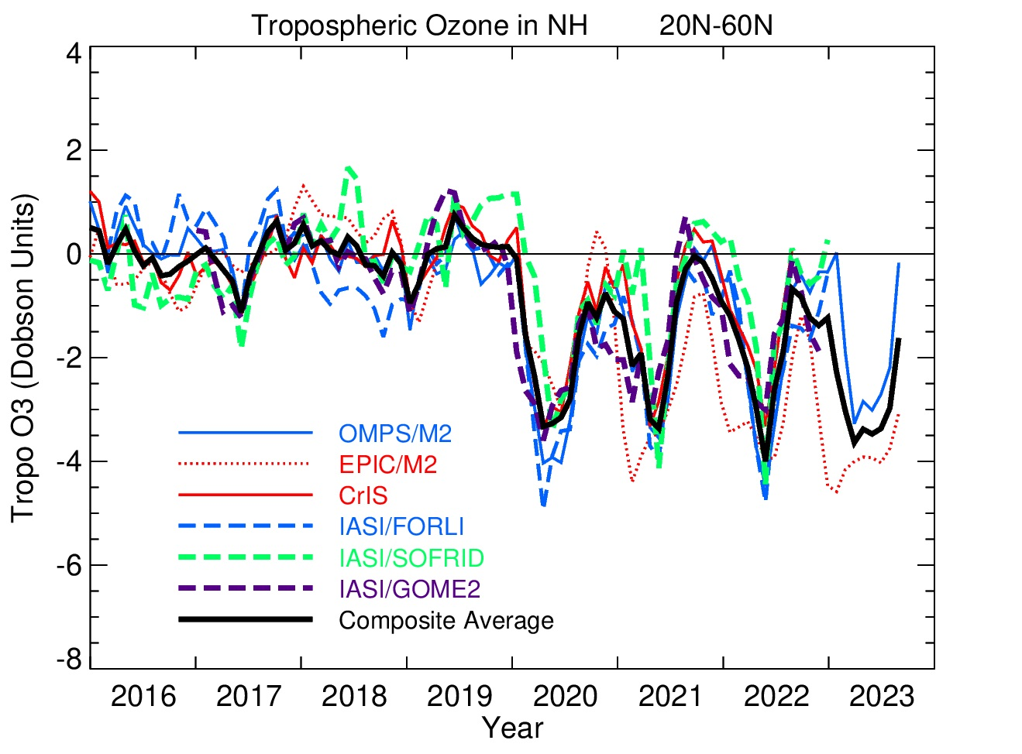
Tropospheric Ozone Satellite Products from TOARII: 20ºN-60ºN Hemispheric Averages
Deseasonalilzed
data:
2016-2019
seasonal cycles
removed from
entire record
~3 Dobson Unit drop four years in a row starting in 2020
(Data source: TOARII:
Tropospheric Ozone
Assessment Report II)

Slide 5
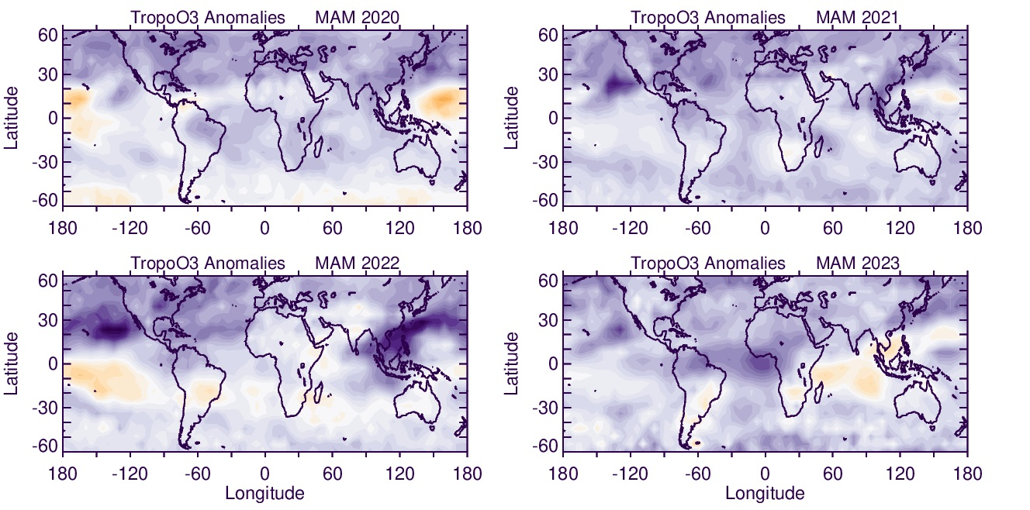
Composite Anomaly Maps – Spring 2020-23
“Anomalies”: Deseasonalilzed data by subtracting 2016-2019 seasonal cycles from entire records

Slide 6
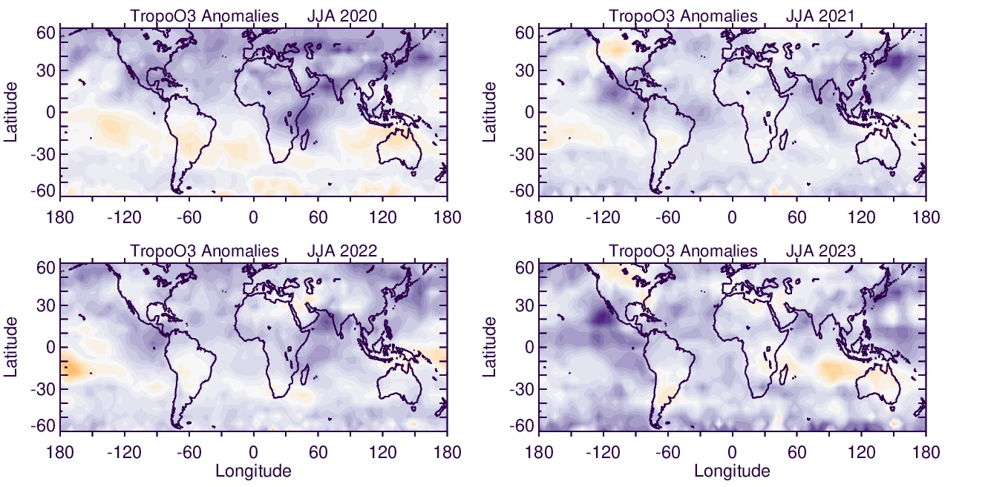
Composite Anomaly Maps – Summer 2020-23
“Anomalies”: Deseasonalilzed data by subtracting 2016-2019 seasonal cycles from entire records

Slide 7
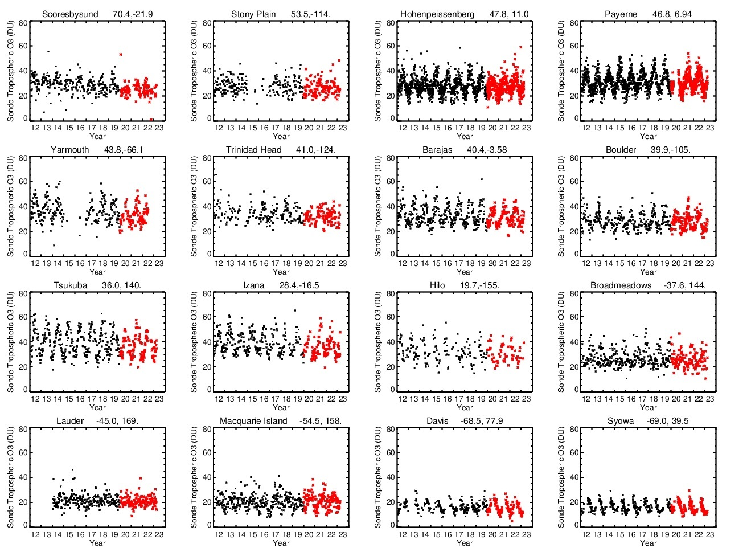
SONDE
DAILY TIME
SERIES
OF
TROPO
COLUMN
OZONE
RED:
2020 AND BEYOND

Slide 8
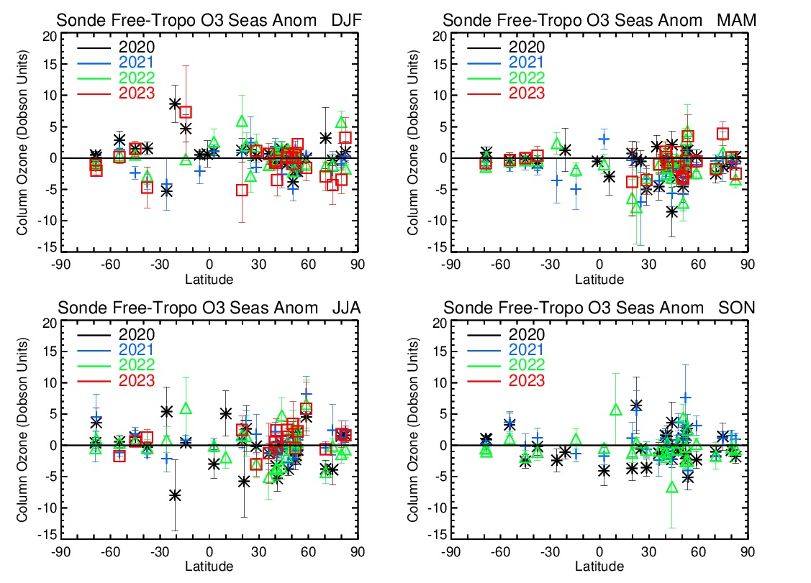
Seasonal Anomalies in Free-Tropospheric Ozone (3km-to-Tropopause) from Ozonesondes
DJF
MAM
“Free
Tropospheric
Ozone”:
Column ozone
from 3 km
up to the
tropopause
JJA
SON

Slide 9
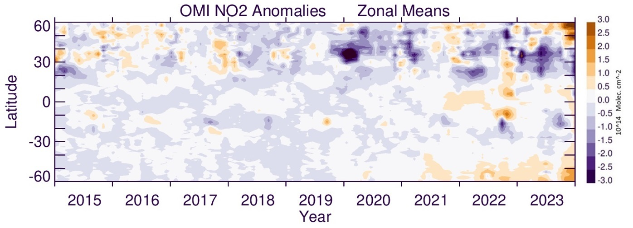
OMI Tropospheric Column NO2 Indicates Anomalously Low Amounts in NH for 2020-2023
(Anomalies based on removing 2016-2019 seasonal cycles)

Slide 10
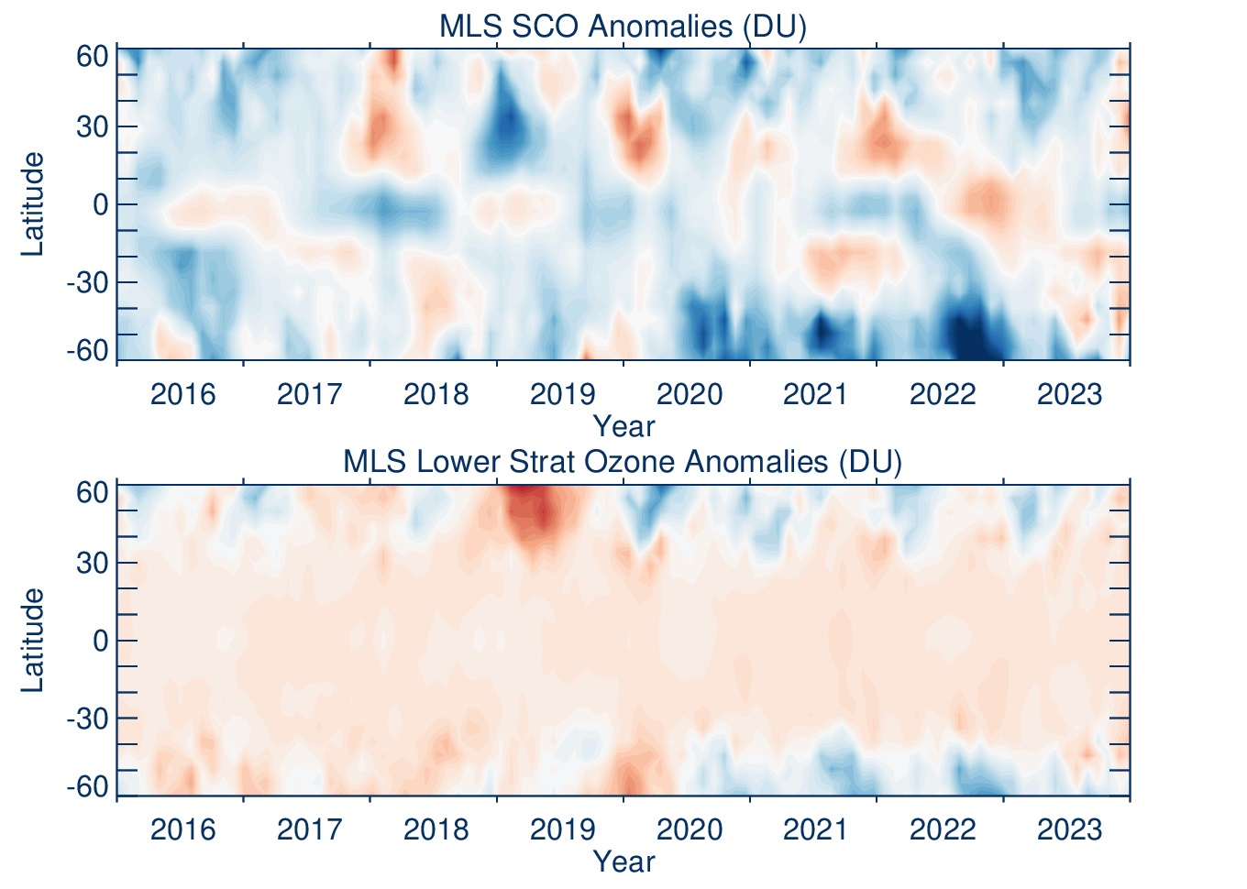
MLS Stratospheric Column Ozone and Lower-Stratospheric Column Ozone Anomalies
Both columns
use MERRA2
PV-θ tropopause
Anomalies based
on 2016-2019
average seasonal
cycles
“Lower Strat
Ozone”: Column
ozone from 80hPa
down to the
tropopause
-5 DU is
about
-25 ppbv

Slide 11
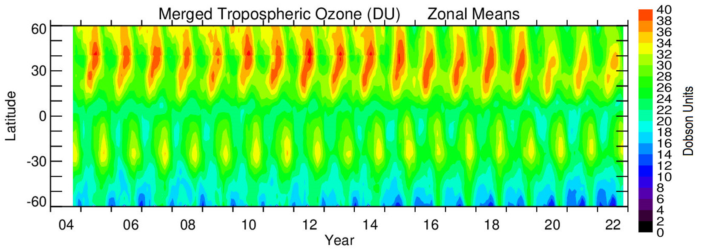
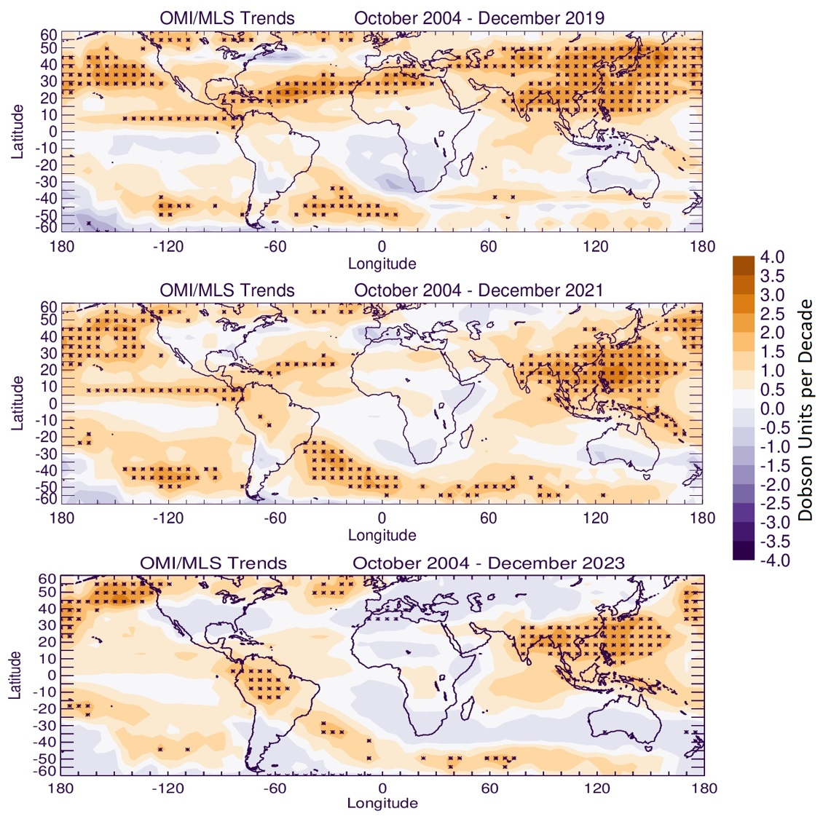
Starting in 2020 During Covid-19: Sudden drop of ~3 DU in NH zonal mean Tropospheric Column Ozone in spring-summer that still continues in 2023
2004-2019:
2004-2021:
Anomalous drops in TCO beginning in 2020 have affected long-term trend calculations
2004-2023:
MLR Trend Model: O3(x,y,t) = A(x,y,t) + t ∙ Trend(x,y,t)
+ B(x,y,t) ∙ ENSO(t) + C(x,y,t) ∙ IOD(t) + Residual(x,y,t)

Slide 12
Conclusions
Anomalous drops in NH free tropospheric ozone (~5-15%) that started during Covid-19 has continued now for 2020-2023
Drops coincide with anomalous drops in tropospheric NO2 and lower-stratospheric ozone
Current and future trends in tropospheric ozone will be impacted

